Slide 1
The Alzheimer’s Disease (AD) Time-Course:
Biological vs Psychological Markers for Screening, Assessing Progression, and Developing Treatments and Prevention
J. Wesson Ashford, M.D., Ph.D.
Clinical Professor (affiliated), Department of Psychiatry and Behavioral Sciences
Stanford University
Director, War Related Illness & Injury Study Center (WRIISC)
VA Palo Alto Health Care System
Wes.Ashford@va.gov washford@medafile.com ashford@Stanford.edu
June 10, 2019
www.warrelatedillness.va.gov www.medafile.com
www.memtrax.com www.brainhealthregistry.org

Slide 2
Disclosure
Dr. Ashford is an unpaid consultant to MemTrax, LLC, which provides an on-line screening test for memory function.
Dr. Ashford has applied for patent protection for a continuous performance memory test which he developed
Dr. Ashford is a full-time employee of the VA
The views expressed by Dr. Ashford do not represent the official views of the VA

Slide 3
Dementia Definition
Multiple Cognitive Deficits:
  Memory dysfunction
  especially new learning, a prominent early symptom
  At least one additional cognitive deficit
    aphasia, apraxia, agnosia, or executive dysfunction
Cognitive Disturbances:
  Sufficiently severe to cause impairment of occupational or social functioning and
  Must represent a decline from a previous level of functioning

Slide 4
Differential Diagnosis
(mnemonic device: AVDEMENTIA)
Alzheimer Disease (pure ~40%, + mixed~70%)
Vascular Disease, MID (5-20%)
Drugs, Depression, Delirium
Ethanol (5-15%)
Medical / Metabolic Systems
Endocrine (thyroid, diabetes), Ears, Eyes, Environment
Neurologic (other primary degenerations, etc.)
Tumor, Toxin, Trauma
Infection, Idiopathic, Immunologic
Amnesia, Autoimmune, Apnea, AAMI
Adapted from Yesavage, 1979

Slide 5
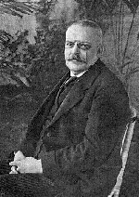
Alzheimer’s Disease
First described by Alois Alzheimer, a German neuropathologist, in 1907
Observed in a 51-year-old female
patient with paranoia, memory loss, disorientation, and hallucinations
Postmortem studies characterized senile plaques and neurofibrillary tangles (NFTs) in the cerebral cortex
  Senile plaques: Extracellular accumulation of insoluble
  fragments of beta-amyloid (Aβ₁₋₄₂)
  NFTs: Intracellular accumulation
  of hyperphosphorylated
  tau strands
Notes:
Purpose:
To introduce Alzheimer’s disease and the discovery of senile plaques and neurofibrillary
tangles
Key Points:
Frau Auguste D. was brought by her husband to Alois Alzheimer at a German mental asylum. The husband complained that she had changed drastically over the last few years, that she had become insanely jealous, had severe memory loss, fits of screaming, and hallucinations. He no longer recognized the woman he was married to.
Upon her death, Alois Alzheimer examined her brain and observed abundant senile plaques and strange neurofibrillary formations in the cerebral cortex, which he determined were responsible for her dementia.
As we now know, senile plaques, made up of insoluble amyloid beta fragments, and neurofibrillary tangles of hyperphosphorylated tau are the hallmarks of Alzheimer’s disease.

Slide 6
Brun & Englund, Histopathology, 1981

Slide 7
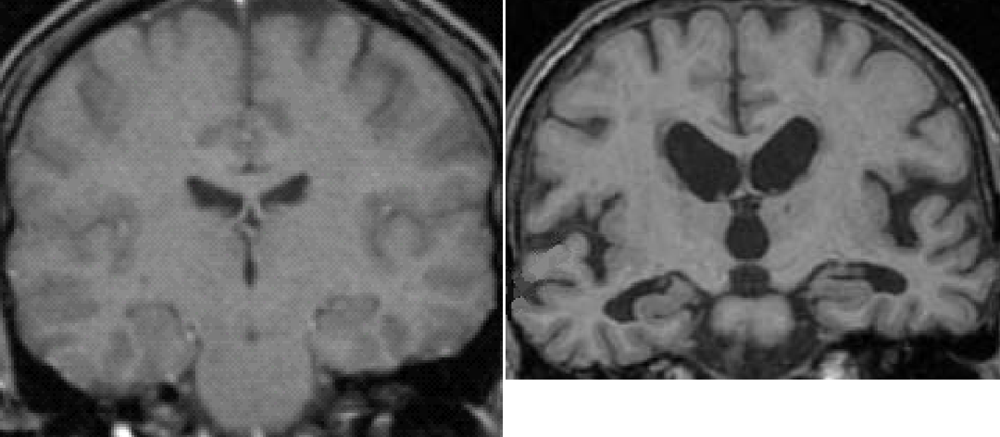
MRI scans of brain, coronal sections
Normal Alzheimer
Ashford, 1088

Slide 8
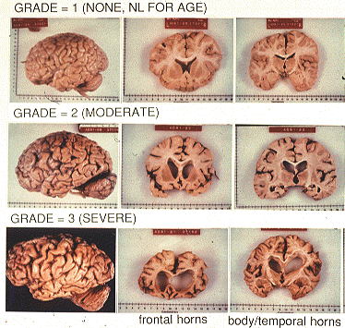

Slide 9
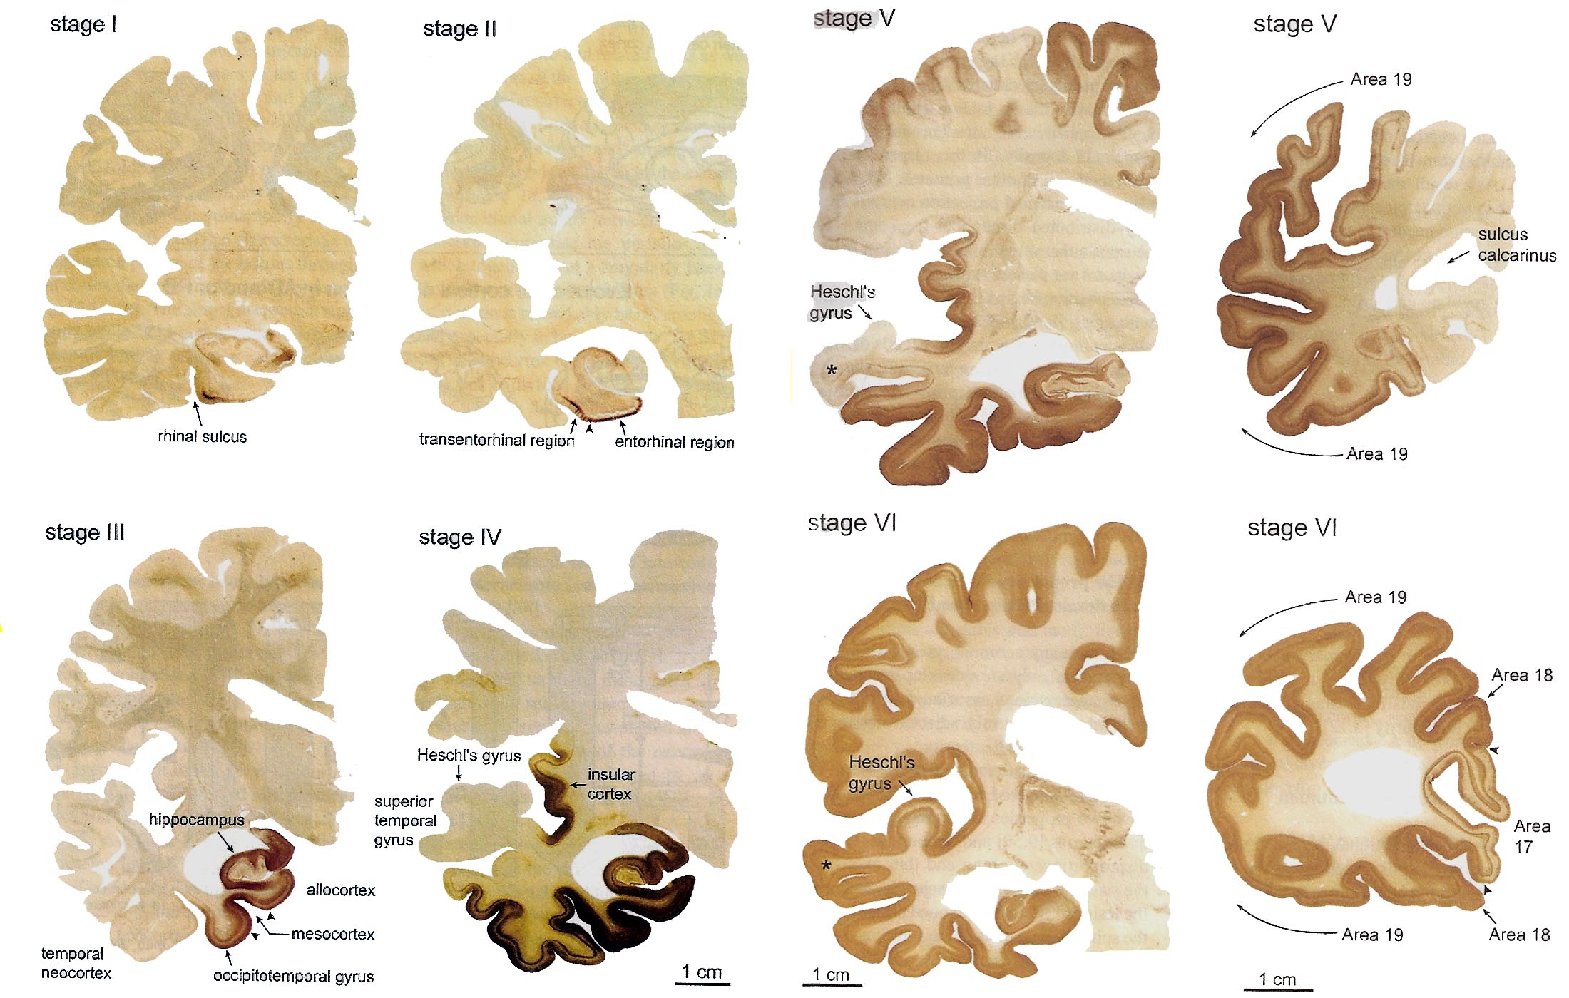
Braak & Braak, 1991; Braak et al., 2006

Slide 10
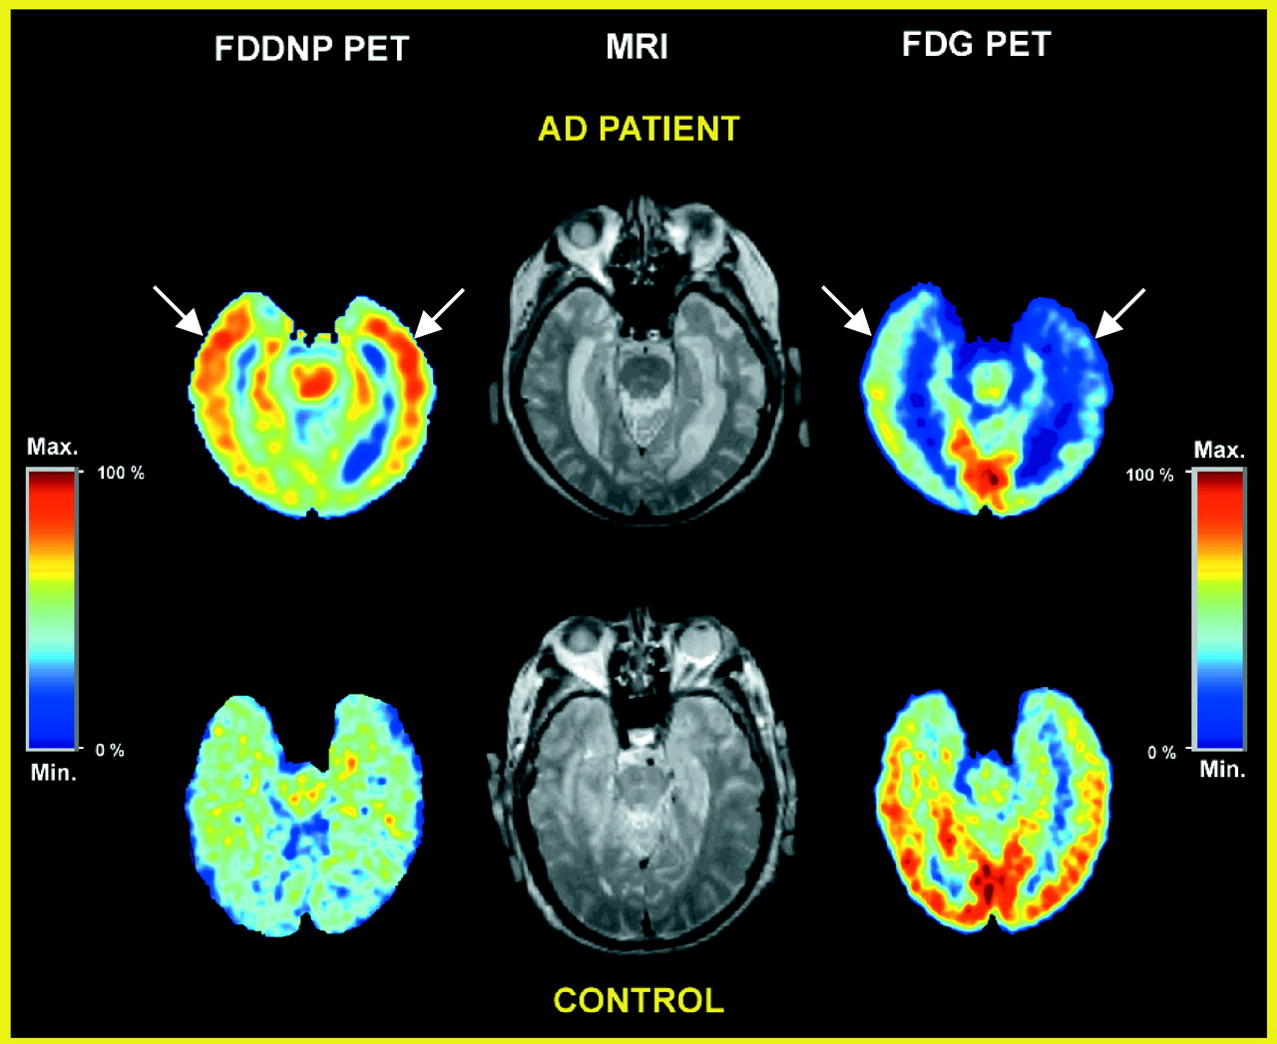
Shoghi-Jadid et al., 2002
Small, Kuhl, Fujikawa, Ashford, 1988

Slide 11
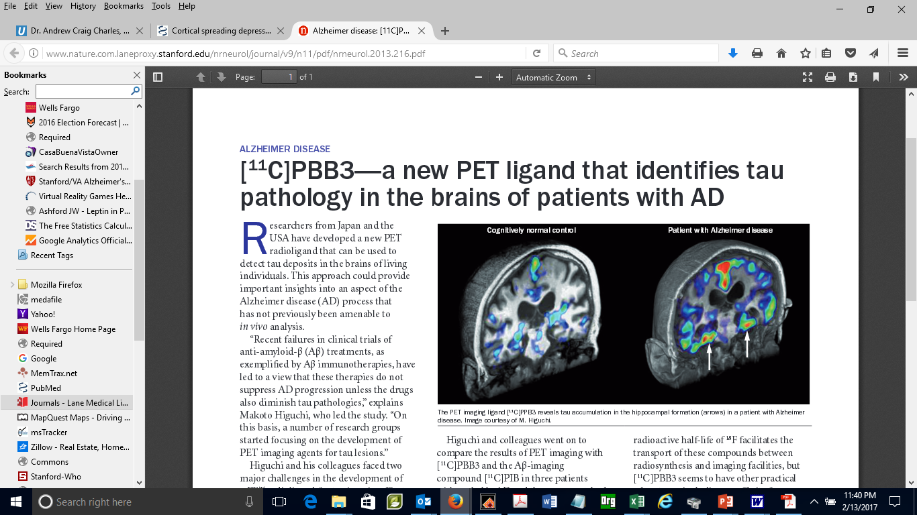
Higuchi, 2013

Slide 12
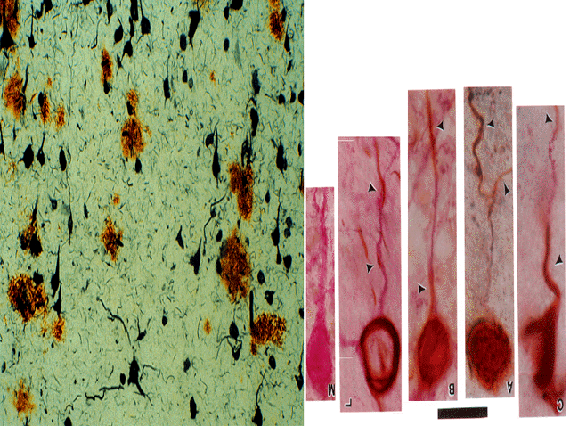
Ashford et al., 1998
J Neuropathol Exp Neurol.57:972

Slide 13
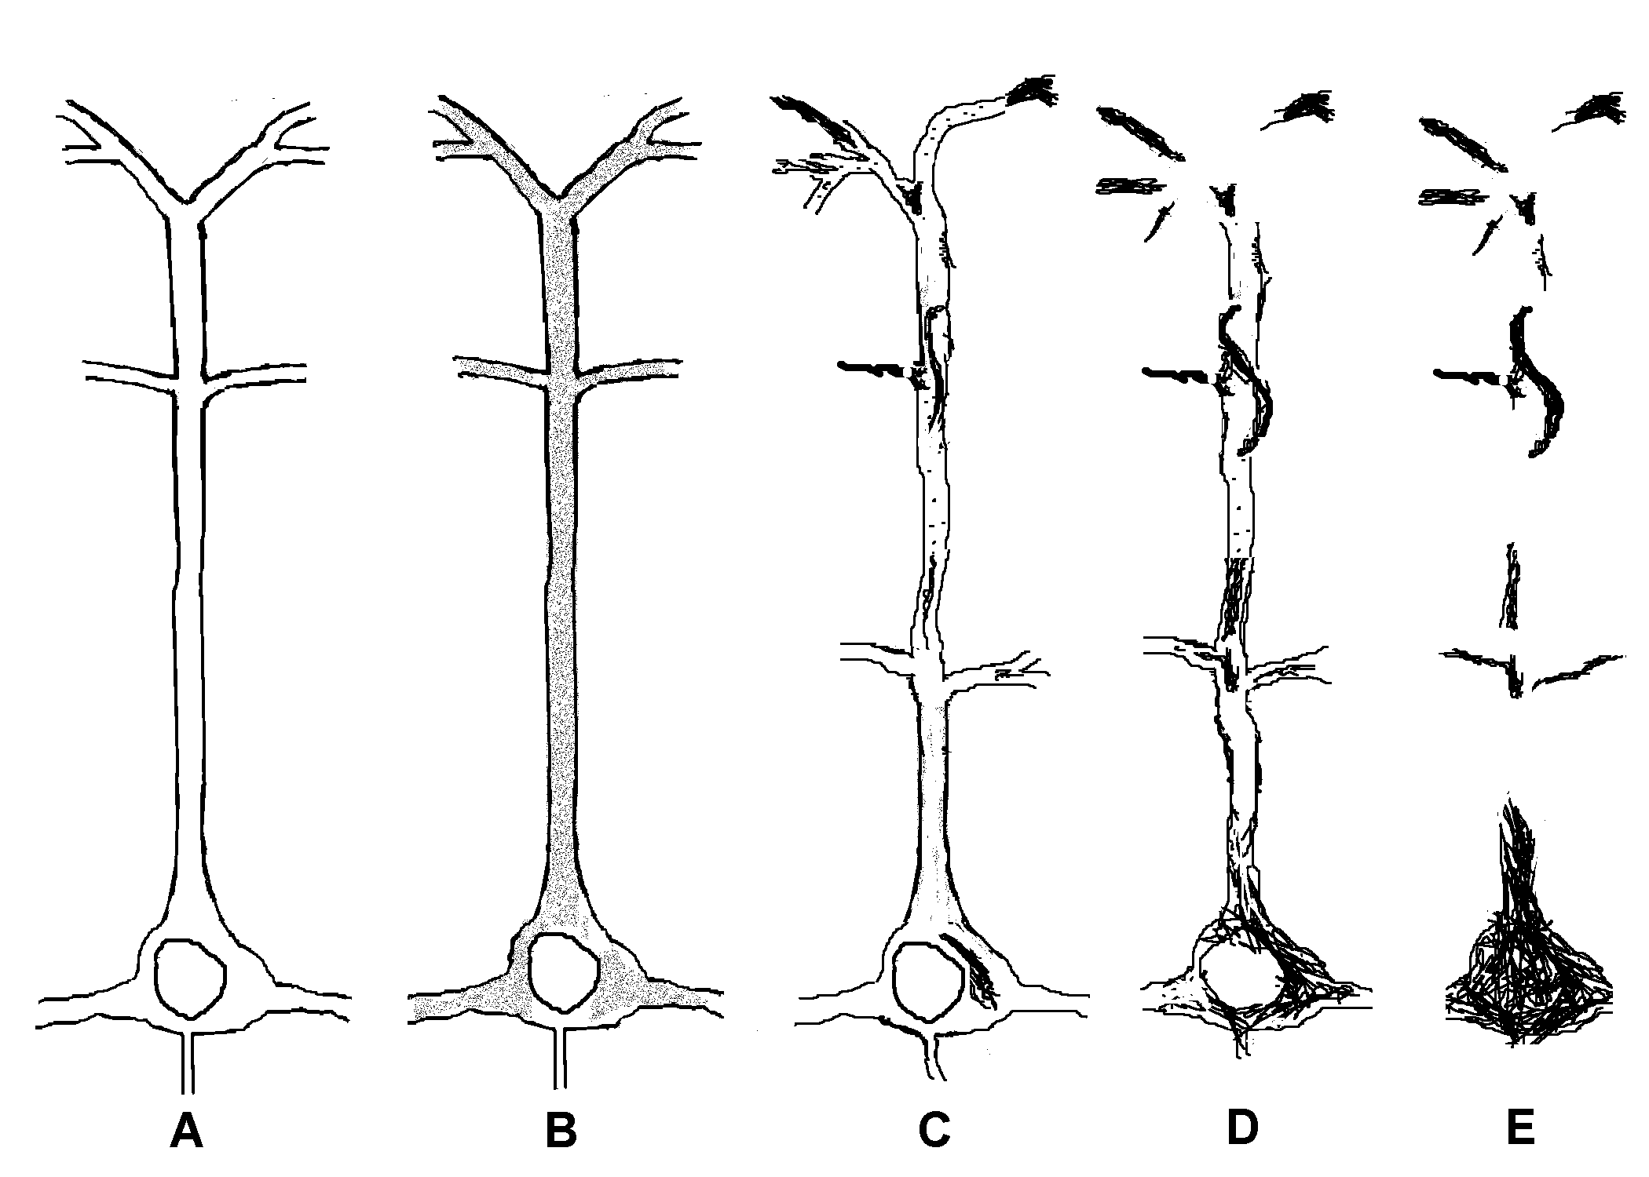
Progression of tau hyperphosphorylation to neuropil threads and neurofibrillary tangles
Ashford et al., 1998, J Neuropathol Exp Neurol.57:972

Slide 14
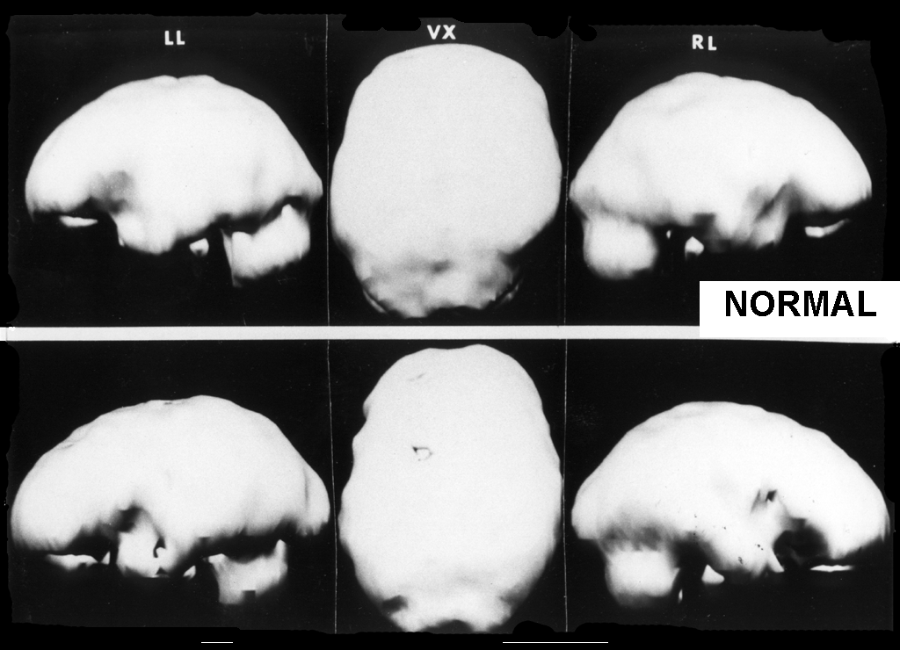

Slide 15
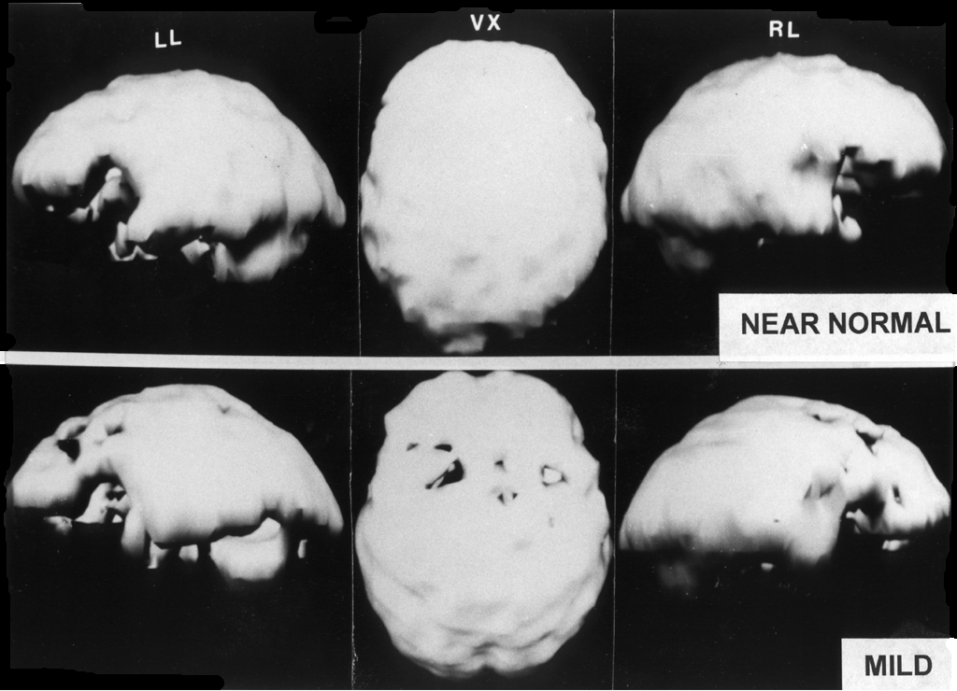

Slide 16
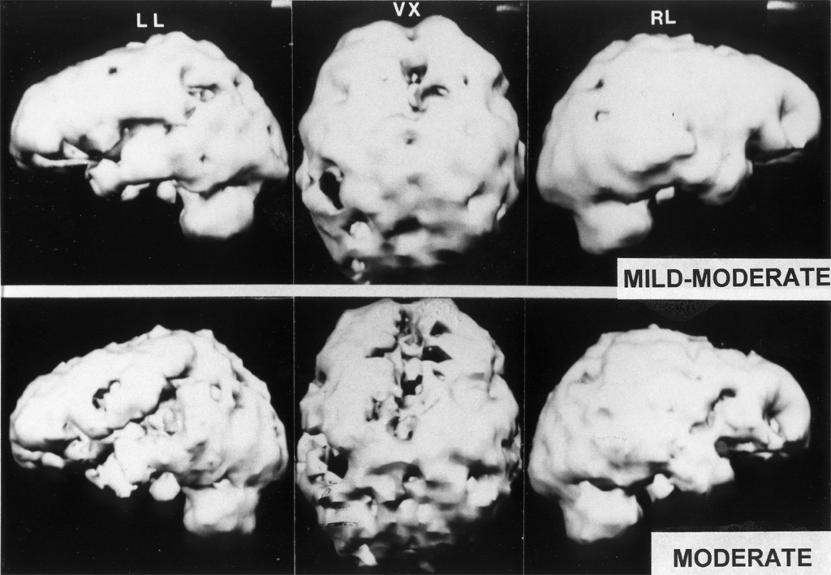

Slide 17
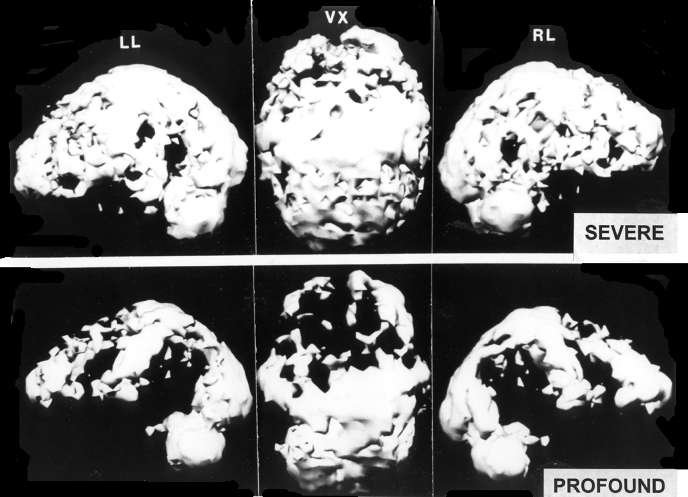

Slide 18
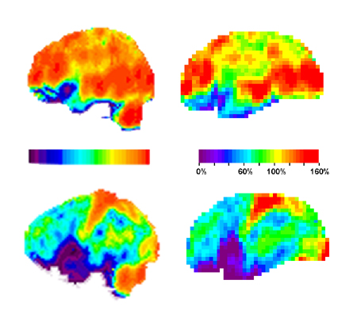

Slide 19

Data from CERAD – MMSE scores 6 months apart
Ashford & Schmitt, 2001

Slide 20
Time-Index model
of the course of Alzheimer’s disease
(calculated from the CERAD data set)
The best model to fit the progression,
both mathematically and biologically,
is the Gompertz survival curve
(99.7% fit to mean changes over time):
S(t) = exp(Ro/alpha *(1- exp (alpha * t)))
- Time-Index Scale -
AAMI / MCI/ early AD -- DEMENTIA
Ashford et al., 1995

Slide 21
Mini-Mental State Exam items
Shows that AD is primarily a condition of episodic memory (retention of information)
Using the Gavrilov & Gavrilova explanation of the Gompertz curve, AD is a progressive failure of the massively redundant memory storage mechanism of the brain
Ashford et al., 1989
Ashford et al., 1995
Ashford, 2008

Slide 22
Relation of SPECT severity to duration of dementia (years)
Shih, Ashford et al., 2000
SPECT severity | SPECT grade | Dementia Duration
Normal | 0 | start= 0 years
Near-Normal | 1 | 1
Mild | 2 | 2
Mild-moderate | 3 | 3
Moderate | 4 | 4
Moderate-severe | 5 | 5
Severe | 6 | 6
Severe-profound | 7 | 7
Profound | 8 | 8

Slide 23
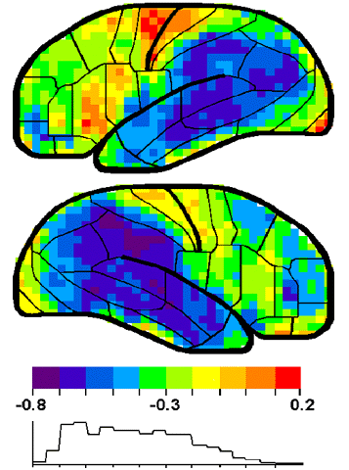
Correlation of decreases in cerebral blood flow (ECD-SPECT) with Time-Index metric (derived from MMSE scores).
Note correspondence with distribution of tau pathology in posterior temporal parietal regions.
Ashford et al, 2000

Slide 24
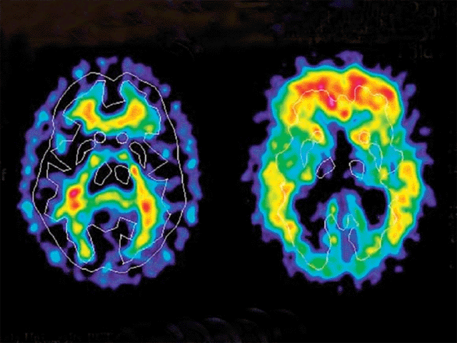
67-year-old control
Alzheimer patient
PET brain images
2-(4’-methylamino-phenyl)-6-hydroxybenzothiazole (Pittsburgh Compound)

Slide 25
CSF in Alzheimer’s Disease, both MCI and Dementia patients:
Low Aβ and High Tau
Concentration (pg/mL)
Aβ
Tau
Sunderland T, et al. JAMA. 2003;289:2094-2103.
Notes:
25

Slide 26
ADNI CSF Data – total Abeta, TAU
Number of participants that provided CSF at baseline
Ages +std of participants that provided CSF at baseline
APOE genotype | Normal | MCI | Mild AD
33 | 67 (72%) | 82 (44%) | 29 (31%)
34 | 24 (26%) | 81 (44%) | 42 (45%)
44 | 2 (2%) | 22 (12%) | 22 (24%)
APOE genotype | Normal | MCI | Mild AD
33 | 75.8 ± 5.0 | 75.4 ± 8.4 | 76.3 ± 8.6
34 | 75.8 ± 6.0 | 73.9 ± 6.7 | 75.6 ± 6.6
44 | 77.0 ± 1.4 | 72.2 ± 6.0 | 69.8 ± 7.0
CSF ABeta levels ± std
CSF tau levels ± std
APOE genotype | Normal | MCI | Mild AD
33 | 212.4 ± 48.4 | 189.1 ± 59.8 | 168.8 ± 52.3
34 | 156.0 ± 47.8 | 148.4 ± 42.4 | 139.0 ± 27.2
44 | 126.0 ± 2.8 | 119.8 ± 23.5 | 116.2 ± 22.3
APOE genotype | Normal | MCI | Mild AD
33 | 67.8 ± 26.9 | 83.6 ± 40.8 | 123.8 ± 68.6
34 | 81.8 ± 42.6 | 122.4 ± 72.7 | 113.3 ± 42.0
44 | 71.0 ± 2.8 | 110.6 ± 45.9 | 128.9 ± 53.1
Ashford et al., 2011 – JAD, Handbook of Imaging the Alzheimer Brain
Notes:
26

Slide 27
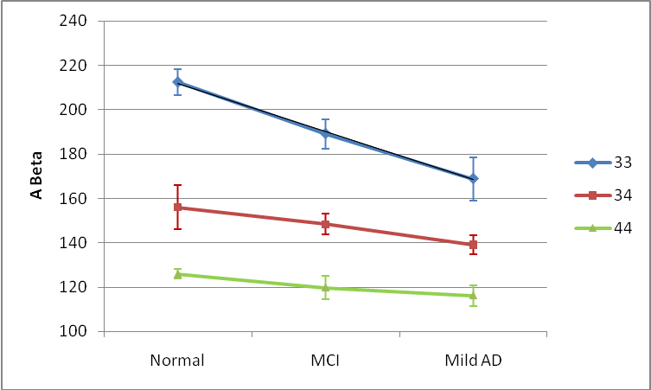
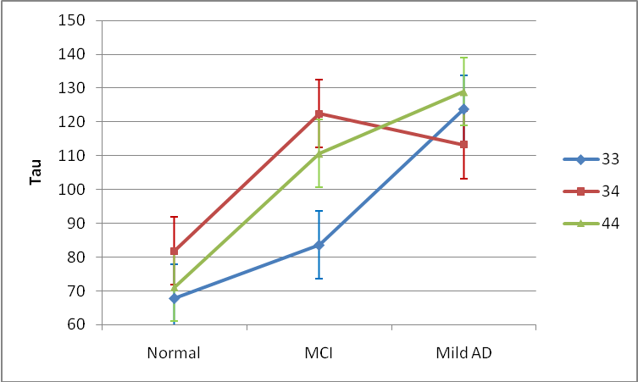
ADNI Data – CSF ABeta, total tau
Comparison | p-value
33 vs 34 | <.0001
33 vs 44 | <.0001
34 vs 44 | 0.08
Normal vs MCI | 0.57
Normal vs Mild AD | 0.15
MCI vs Mild AD | 0.20
Comparison | p-value
33 vs 34 | 0.07
33 vs 44 | 0.67
34 vs 44 | 0.99
Normal vs MCI | 0.05
Normal vs Mild AD | <.01
MCI vs Mild AD | 0.06
Ashford et al., 2011, JAD, Handbook of Imaging the Alzheimer Brain
Notes:
27

Slide 28
Role of Amyloid Protein Precursor (APP) in Alzheimer’s disease
APP is located on chromosome 21
Trisomy 21 (Down Syndrome) is associated with high levels of brain amyloid and Alzheimer pathology in nearly all cases by age 40 (50% excess APP)
All of the early onset AD genetic factors affect APP, near the beta-secretase cleavage site, or the gamma-secretase (presenilins) which can cleave APP
APP cleavage by beta- then gamma-secretase forms beta-amyloid and AICD (APP intra-cellular domain)
Beta-amyloid is toxic to synapses
AICD causes tau hyperphosphorylation (? critical issue in AD)
APP may be critical mechanism in neuroplasticity
Management of this protein may be central for AD prevention

Slide 29
β-Amyloid Cascade Hypothesis a total failure
This hypothesis has dominated the field and led to tens of billions$ in research that has provided no benefit to patients
The problem is the focus on β-Amyloid:
It does not explain the lack of a clear relationship between Aβ measures and
AD dementia or other AD-related pathology
Aβ has been shown to be a highly turned-over normal protein
Aβ is increased during neuronal repair and decreased in AD
Since Aβ decreases in the CSF with AD risk, it is unlikely to cause AD
Aβ deposits are predominantly in the frontal lobes, not the temporo-parietal lobes
Anti-bodies against Aβ remove the protein but do not slow the course of AD
It does not explain how Aβ selectively affects neuroplasticity, memory
APP (the amyloid protein precursor) likely has a central role in neuroplasticity and the formation of memories and should be the target of explanatory and therapeutic investigations.
Notes:
29

Slide 30
AD is Under-diagnosed
Early Alzheimer’s disease is subtle, the diagnosis continues to be missed
  it is easy for family members to avoid the problem and compensate for the patient
  physicians tend to miss the initial signs and symptoms
Less than half of AD patients are diagnosed
  Estimates are that 25% to 50% of cases remain undiagnosed
  Diagnoses are missed at all levels of severity: mild, moderate, severe
Undiagnosed AD patients often face avoidable social, financial, and medical problems
Early diagnosis and appropriate intervention may lessen disease burden
  Early treatment may improve overall course substantially
No definitive laboratory test for diagnosing AD exists
  Efforts to develop biomarkers, early recognition by brain scan
Evans DA. Milbank Quarterly. 1990; 68:267-289

Slide 31
Benefits of Early Alzheimer Diagnosis
Social
Undiagnosed AD patients face avoidable problems
    social, financial
Early education of caregivers
    how to handle patient (choices, getting started)
Advance planning while patient is competent
    will, proxy, power of attorney, advance directives
Reduce family stress and misunderstanding
    caregiver burden, blame, denial
Promote safety
    driving, compliance, cooking, etc.
Patient’s and Family’s right to know
    especially about genetic risks
Promote advocacy
    for research and treatment development

Slide 32
Benefits of Early Alzheimer Diagnosis
Medical
Early diagnosis and treatment and appropriate intervention may:
  improve overall course substantially
  lessen disease burden on caregivers / society
Specific treatments now available
  (anti-cholinesterases, memantine)
  Improve cognition
  Improve function (ADLs)
  Delay conversion from Mild Cognitive Impairment to AD
  Slow underlying disease process, the sooner the better
  Decreased development of behavior problems
  Delay nursing home placement, possibly over 20 months
  Delay nursing home placement longer if started earlier

Slide 33
Alzheimer Warning Signs
Top Ten (moderate dementia)
Alzheimer Association
1. Recent memory loss affecting job
2. Difficulty performing familiar tasks
3. Problems with language
4. Disorientation to time or place
5. Poor or decreased judgment
6. Problems with abstract thinking
7. Misplacing things
8. Changes in mood or behavior
9. Changes in personality
10. Loss of initiative

Slide 34
Issues for Alzheimer Measurement
The problem in Alzheimer’s disease is dementia
The build up of plaques and tangles and the loss of blood flow is a sign of an underlying process, not the cause of the dementia
Dementia is most related to loss of synapses, but the loss selectively affects the most neuroplastic synapses
Accurate, relevant assessment of dementia must directly measure episodic memory

Slide 35

The Global Clinical Scale (GCS) provides about 4 times the precision and reliability as the MMSE.
For the GCS change measure to show change more than zero within 2 standard deviations takes measures 1.5 years apart.
For the MMSE, it takes more than 5 years to achieve the same statistical reliability.
Ashford et al., 1992
Ashford & Schmitt, 2001
The question is whether a “biomarker” can provide such precision for measures over time, and at what level of severity could a marker be effective.

Slide 36
Defining the temporal progression of Alzheimer dementia
DSM-V | CDR-level | CDR | GDS-FAST | MMSE | Time-Index years
Normal | normal | 0 | 0-1 | 29-30 | before -9
Minor NeuroCognitive Disorder | questionable impairment | 0.5 | 2-3 | 24-28 | -8 to -0
Major Neurocognitive Disorder | mild dementia | 1 | 4 | 21-23 | 0 to 2
 | moderate | 2 | 5 | 11-20 | 2 - 4
 | severe | 3 | 6 | 3 -11 | 4 - 6
 | profound | 4 | 7 a-c | 1-2 | 6 - 8
 | complete | 5 | 7 d-f | 0 | 8 +
Ashford, Schmitt, Kumar, 2019

Slide 37
Issues for Memory Testing
Current testing for memory problems is based on having a tester sit in front of a subject for a prolonged period of time and administer unpleasant tests
Testing must be
  Extensively and frequently administered
  Inexpensive (minimal need for administrator)
  Fun (so people will return for frequent testing)
  More precise, reliable, and valid
    To improve sensitivity
    To improve specificity

Slide 38
Current Memory Assessments are Inadequate
Problems
  Large practice effects over time
  Lack precision of analysis
  Require trained experts to administer
  Require special equipment/environment
  Time intensive (for rater and subject)
  Not tech or mobile friendly
  Limited, or no ability to customize
Limited ability for individuals, healthcare providers, and researchers to precisely measure & monitor memory

Slide 39
To Screen and Quantitate Dementia, and Test Therapeutic Modalities, Need Rapid Assessment of Episodic Memory Function
Importance of episodic memory assessment
  Disruption in many conditions – Alzheimer’s disease, cerebral hypoxia, etc.
  Major concerns for driving, TBI, anesthesia, chemobrain, ICU psychosis
Challenges
  The precise measurement of memory
  Lack of short assessment tools
  Cognitive assessment tools that can be used in a variety of settings (on-line)
  Test stability across administrations
  Test-retest learning
  Tiredness, confusion with repeated testing
  Engagement

Slide 40
Need for Mass Screening
Alzheimer’s disease, dementia, and memory problems are difficult to detect when they are mild
  about 90% missed early
  about 25% are still missed late
There are important accommodations and interventions that should be made when there are cognitive impairments
  (like needing glasses or having driving restrictions if you have vision problems)

Slide 41
Memory Assessment System – based on a continuous performance task (CPT)
50 pictures will be shown.
When you see a picture for the first time, look at it carefully and try to remember it.
If you see a picture that you have seen before, indicate that your recognize it.

Slide 42
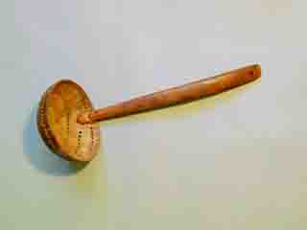
1

Slide 43

2

Slide 44
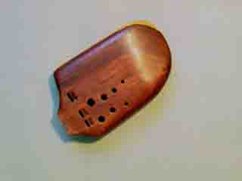
3

Slide 45
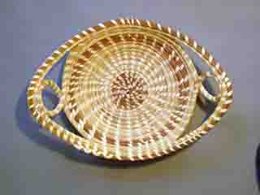
4

Slide 46
5

Slide 47
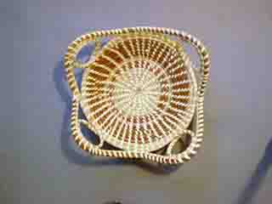
6

Slide 48

7

Slide 49
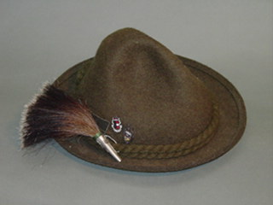
8

Slide 50
9

Slide 51
10

Slide 52
11

Slide 53
12

Slide 54
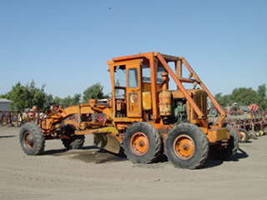
13

Slide 55
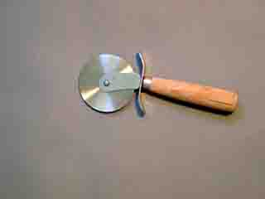
14

Slide 56
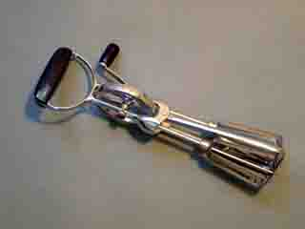
15

Slide 57
16

Slide 58
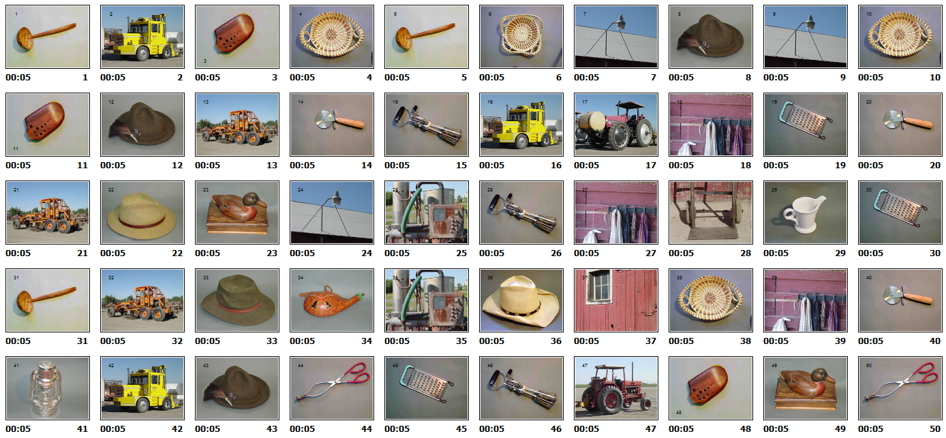
MEMTRAX Memory Test
116 subjects – mostly elderly normals, some young, some dementia patients
False positive errors (false recognition) – 33(64);6(58);47(27)—4,18,23,34(1);1,2,8(0)
False negative errors (failure to recognize) – 35(33);27(20);5(16)—32(4);24(3);45(3)

Slide 59
Test Performance for 1018 subjects
82 (8%) had perfect scores,
230 (23%) made 1 error (98% correct),
700 (69%) made 5 or fewer errors (>90% correct),
132 (13%) made 6 – 10 errors (80 – 88% correct),
186 (18%) made > 10 errors (<80% correct).
--------------------------------------------------------------------
70 (7%) scored < 80% correct for True Negatives
  19 (6%) males, 51 (8%) females
    (false positive responses = saying a picture is repeated when not),
79 (8%) scored < 80% correct for True Positives
  25 (7%) males, 54 (8%) females
    (false negative responses = failure to recognize/recall repeat picture).
Ashford, Gere, Bayley, 2011

Slide 60
What you can’t measure you can’t treat
Need better measurement systems for screening, longitudinal assessment, outcome evaluation
Major push by NIA to develop better systems for cognitive and memory measurement
  www.detectcid.org
  www.memtrax.com
Development of on-line registry programs to assemble populations at risk for dementia and Alzheimer’s disease
Monitor change over time

Slide 61
Screening for Dementia and Alzheimer’s Disease and Memory Impairment Using MemTrax
Dementia and Alzheimer’s disease, differential diagnosis
Diagnosis and pathology of Alzheimer’s disease
The attack of Alzheimer pathology on neuroplasticity
Memory deterioration and Alzheimer progression
Screening for memory impairment, dementia, and AD
Development of the MemTrax test for memory
MemTrax performance metrics
Implications of the availability of an on-line memory test

Slide 62
MemTrax - Memory Test (on-line version)
Test to screen for memory function and change
Available on any platform
Determines percent correct and recognition time
Measures episodic memory, inhibition, reaction time
Test takes 1 to 2 minutes
Test can be repeated often (even multiple times daily, minimal learning over repeated tests)
High test-retest consistency
Change over time sensitively detected
Captures 64% of the variance of the MoCA
www.memtrax.com
www.brainhealthregistry.com
Ashford et al., 2019; Hoek et al., 2019

Slide 63

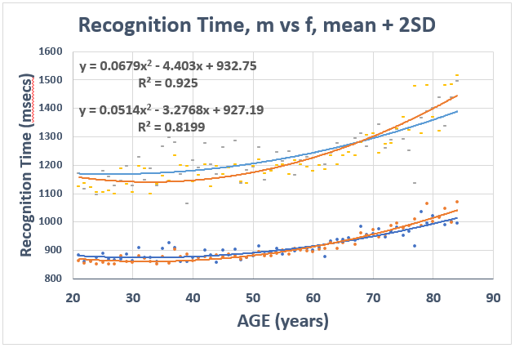

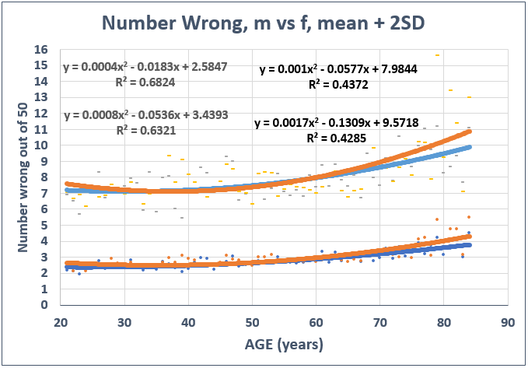
To test neuroplasticity:
Highly precise measures of memory performance required
www.memtrax.com A 2-minute Continuous Recognition Task

Slide 64
MemTrax-HAPPYneuron Test Data
Data collection period: September 2011 - August 2013
Collected in collaboration with HAPPYneuron, Inc. (Lyon, France)
4,800 repeat administrations (over 24 months, up to 24 times)
Analysis approved by Stanford IRB
Total number of tests taken: 30,435
Tests excluded: 12,153
  Repeat administrations: 4,800 (over 24 months, up to 24 times)
  Age below 21: 4,999 (no IRB approval for under 21 analyses)
  Age above 100: 1,573 (unrealistic number)
  Performance outliers: 780 (invalid scores - less than 70% correct
Total valid, initial tests: 18,282
  Females: 12,445
  Males: 5,837
Mean age: 50.28 years, SD: 15.23, Range 21-99 years
Ashford et al., 2019

Slide 65
Data Analysis
(25 initial presentations, 25 repeats)
(males, females separated)
Number of subjects by age
Total number responses (similar to beta)
Number of correct responses (similar to d’)
Cumulative number of correct responses
Percent correct versus age
Recognition time versus age
Recognition time versus percent correct
Number wrong and +2STDs versus age
Recognition time and +2STDs versus age

Slide 66
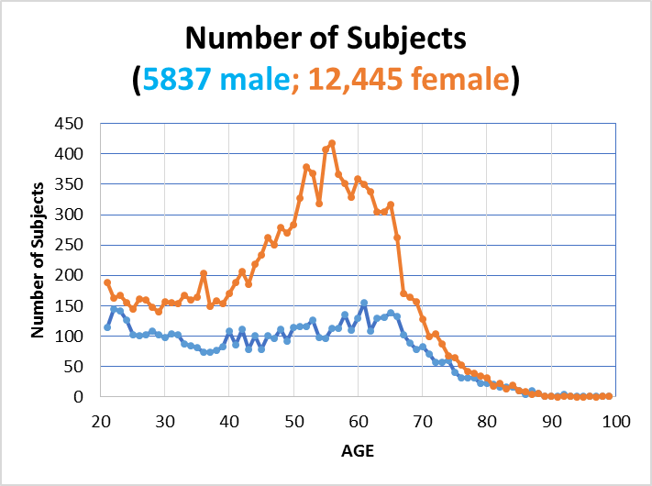

Slide 67
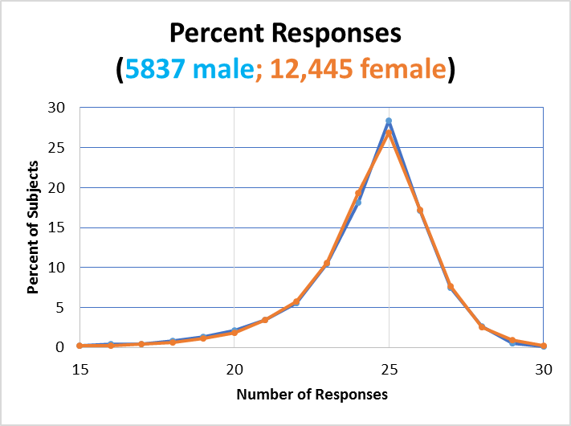

Slide 68
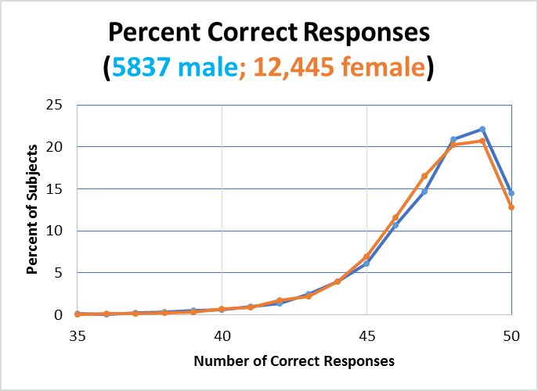

Slide 71
MemTrax data from Brain Health Registry
www.memtax.com
www.brainhealthregistry.org

Slide 72
36,021 unique subject enrolled in www.brainhealthregistry.org
Brain Health Registry subjects from MemTrax download
Average age = 58 y/o; Standard Deviation = 13 years, range = 18 – 90 y/o
- select dates 9/3/2015 - 3/26/2017 = 37,969
- remove percent correct less than 60% = 36,115
- reaction times less than 364 msec removed (there is one individual who had 96% correct at that RT) = 36,093
- slowest RT = 2.547 secs.
- 72 duplicates removed = 36,021

Slide 73
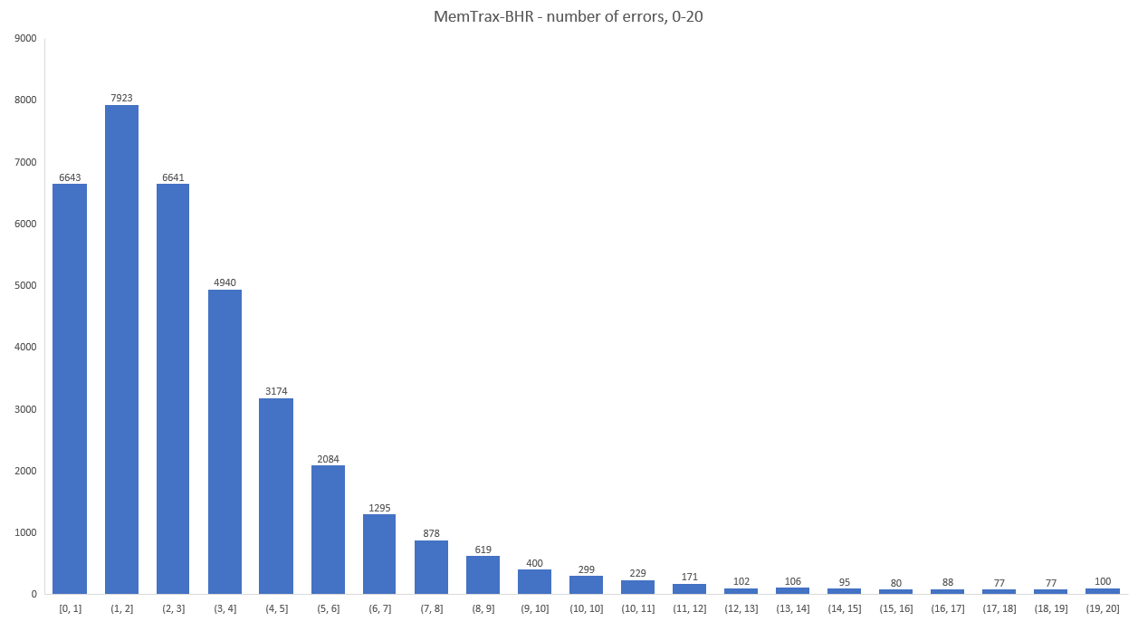

Slide 75
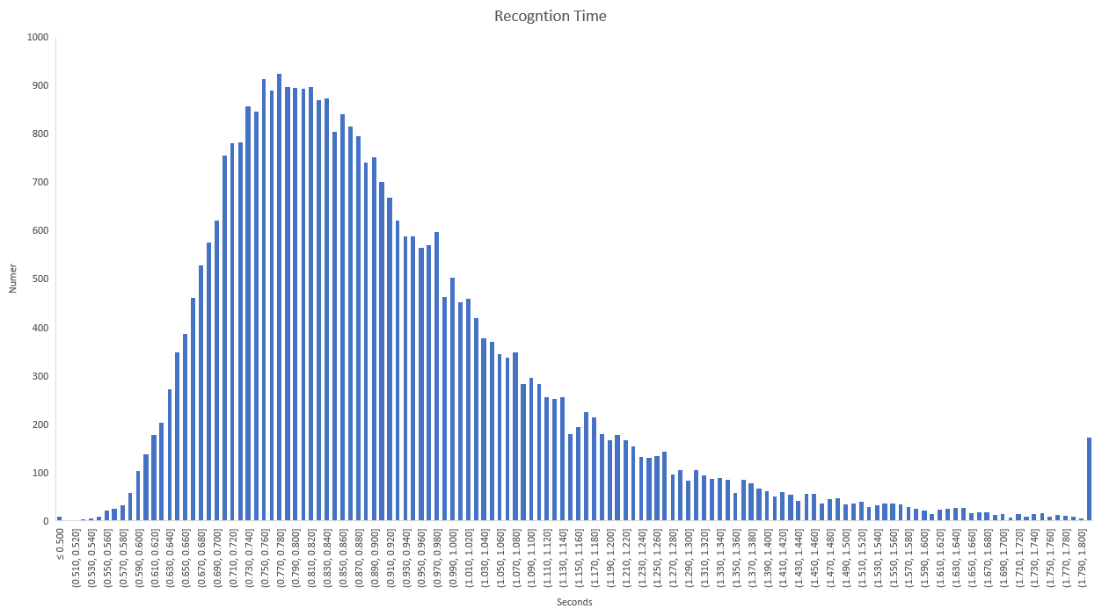

Slide 77
Recognition Time vs Percent Correct

Slide 78
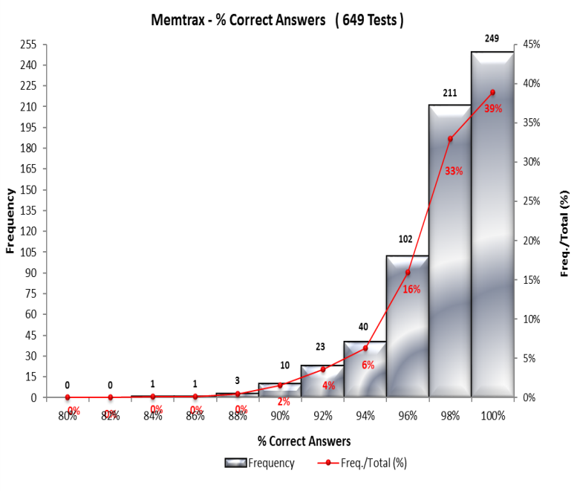
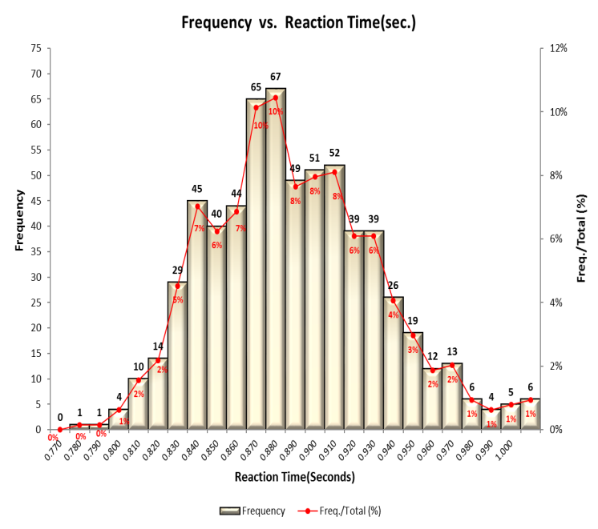
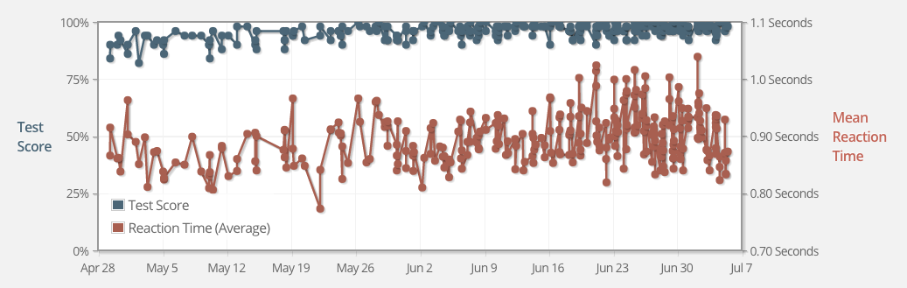
72 y/o male MemTrax customer – self reported, 2016 – average 6 times per day:

Slide 79
Data from the University of Wageningen, Holland 2015 – 27 elderly
van der Hoek et al., 2019

Slide 80

MemTrax® in China
The web-version of MemTrax ® went online on December 24, 2017 and requires an email address for registration (which has not been popular with Chinese users).
To increase usage, the China MemTrax team developed a WeChat mini program version of MemTrax which went online on January 27, 2018 (and has been very popular).

Slide 81
MemTrax-China Data-Update www.memtrax.com.cn
Two sets of data:
  The web-version of MemTrax was used to performed a memory screening trial in diabetic patients in Nanchong, Sichuan in comparison with MMSE and AD8. Three hundred forty-five patients were screen from Jan 15-19, 2018 and the data was presented at an International Conference in March 2018.
    Additional data are being collected in Kunming
  WeChat mini program version (ongoing): Jan 27, 2018 - present
All data were collected after obtaining signed informed consent forms
As of Aug 10, 2018, the total number of tests taken on WeChat mini-program: 19,137 by 5,445 registered users
Values of normal ranges for different age and gender groups were obtained and analyzed

Slide 82
MemTrax WeChat Results for 4011 Subjects
 | AGE | MALE | FEMALE |  | MALE | FEMALE | MALE | FEMALE |  | MALE | FEMALE | MALE | FEMALE
 |  | Sample size |  |  | Mean Percent Correct |  | - 2 STD |  |  | Mean Recognition Time |  | + 2 STD
 | <=20 | 135 | 135 |  | 95.7 | 94.9 | 88.2 | 85.8 |  | 0.938 | 0.923 | 1.236 | 1.165
 | 20-30 | 638 | 800 |  | 95.4 | 95.5 | 87.3 | 87.8 |  | 0.923 | 0.897 | 1.169 | 1.129
 | 30-40 | 457 | 555 |  | 94.6 | 95.2 | 86.5 | 87.5 |  | 0.938 | 0.94 | 1.164 | 1.169
 | 40-50 | 274 | 400 |  | 93.5 | 93.5 | 84.0 | 83.9 |  | 1.011 | 0.998 | 1.289 | 1.287
 | 50-60 | 178 | 237 |  | 90.0 | 91.4 | 75.5 | 79.4 |  | 1.126 | 1.073 | 1.503 | 1.395
 | 60-70 | 64 | 76 |  | 88.7 | 91.0 | 74.7 | 79.3 |  | 1.151 | 1.127 | 1.606 | 1.441
 | 70-80 | 29 | 24 |  | 86.5 | 88.7 | 72.2 | 74.9 |  | 1.249 | 1.202 | 1.7 | 1.655
 | >80 | 5 | 4 |  | 76.9 | 89.5 | 65.4 | 83.5 |  | 1.401 | 1.298 | 1.839 | 1.836

Slide 83
Pros
Under development
Very Fast: less than 2 minutes
Easy: explanation can be understood
Innovative: based on extensive memory studies
Tests complex encoding unlike any other available test
Engaging: subjects very willing to retake tests frequently
Reliable: test works on many platforms
Inexpensive: after development, cost is negligible
Infinite number of repeatable test: test-retest reliability
Validity - face, construct (measures memory encoding)
Normative data: collected in large quantities
Cultural sensitivity: large range of pictures
On-line automatically translates into most languages
Does not test remote memory
Requires access to internet enabled device
Relationship to any diagnosis not established
Discriminant/concurrent validity in progress
Distraction can influence test results

Slide 84
Conclusions for an on-line CPT
Data from large datasets shows comparability for on-line data collection from relatively reliable individuals:
  French company with a reliable clientele taking brain training
  A registry which is a leader in recruiting for Alzheimer, MCI studies
  A Chinese group
For individuals less than 60 years of age, performance across age is relatively stable
  2 standard deviations are more than 10 errors and slower than 1.2 sec
  These values have less than a 16% relationship, so evaluate different areas
Cut-off as an indication for further assessment must be cost-worthy
Continue to establish construct validity, population parameters
Implement in evaluations of causative agents, therapeutic modalities

Slide 85
Future Directions for Testing
Precise assessment of cognition from normal to moderate dementia
Expansion to measure numerous functions
Analysis of tests for risk/benefit (cost-worthiness)
Expansion of applications – driving (alcohol, THC, any toxic substance, dementia), various types of cognitive impairment, side-lines concussion assessment, hospital monitoring
Use for recruitment of subjects for AD research
  (being used by a health registry: www.brainhealthregistry.org )
  Need more registries, genetic testing companies

Slide 86

www.memtrax.com www.memtrax.com.cn www.brainhealthregistry.org

Slide 87
Relative Risk Factors for Alzheimer’s Disease (after age, early onset genotypes)
APOE-e4 genotype vs e3/3 1 allele x 4; 2 alleles x 16
Family history of dementia 3.5 (2.6 - 4.6)
Family history - Downs 2.7 (1.2 - 5.7) (rare)
Family history - Parkinson’s 2.4 (1.0 - 5.8)
Obese, large abdomen 3.6
Maternal age > 40 years 1.7 (1.0 - 2.9)
Head trauma (with LOC) 1.8 (1.3 - 2.7)
History of depression 1.8 (1.3 - 2.7)
History of hypothyroidism 2.3 (1.0 - 5.4)
History of severe headache 0.7 (0.5 - 1.0)
History of “statin” use 0.3 (and hypercholesterolemia)
NSAID use 0.2 (0.05 – 0.83) (and arthritis)
Use of NSAIDs, ASA, H2-blockers 0.09
Exercise – high versus low .1
Anti-cholinergic medications depends on degree of Ach blockage
Roca, 1994; ‘t Veld et al., 2001, Breitner et al., 1998, Wolozin et al., 2000; Holter et al., 2018; Fox et al., 2018

Slide 88
Aging
The process of growing old
The cause of aging – TIME
Non-living things decay (decay curve)
In the living, age-related increases in mortality rates after maturity are exponential (survival curve)
  (Gompertz, 1825)
Age-related changes render all living beings progressively more likely to die with time (mortality)
  (Medawar, 1952).
The survival curve is produced by the evolution of organisms composed of imperfect cells with massive redundancy at all system levels (the secret of survival is redundancy)
  (Gavrilov & Gavrilova, 1991)

Slide 90
For the last 160 years, life expectancy
has increased by 5 years every 20 years.
Since the likelihood of Alzheimer’s disease doubles
every 5 years, that suggests that the proportion
of Alzheimer cases has doubled every 20 years
over this period of time, a 256-fold increase.
Alzheimer incidence
doubles with every
5 years of increasing age.
Follows Gompertz kinetics
Exponential increase
JW Ashford, MD PhD, 2003; See: Raber et al., 2004
(Incidence for a to a + 1 year)

Slide 91
U.S.
2018 estimates:
Prevalence:
5.5 million cases
Incidence:
690,000 / year
JW Ashford, MD PhD, 2003; See: Raber et al., 2004
Notes:
91

Slide 92
Data from Cache Country
Study, 2002
From Riedel et al., 2016

Slide 93
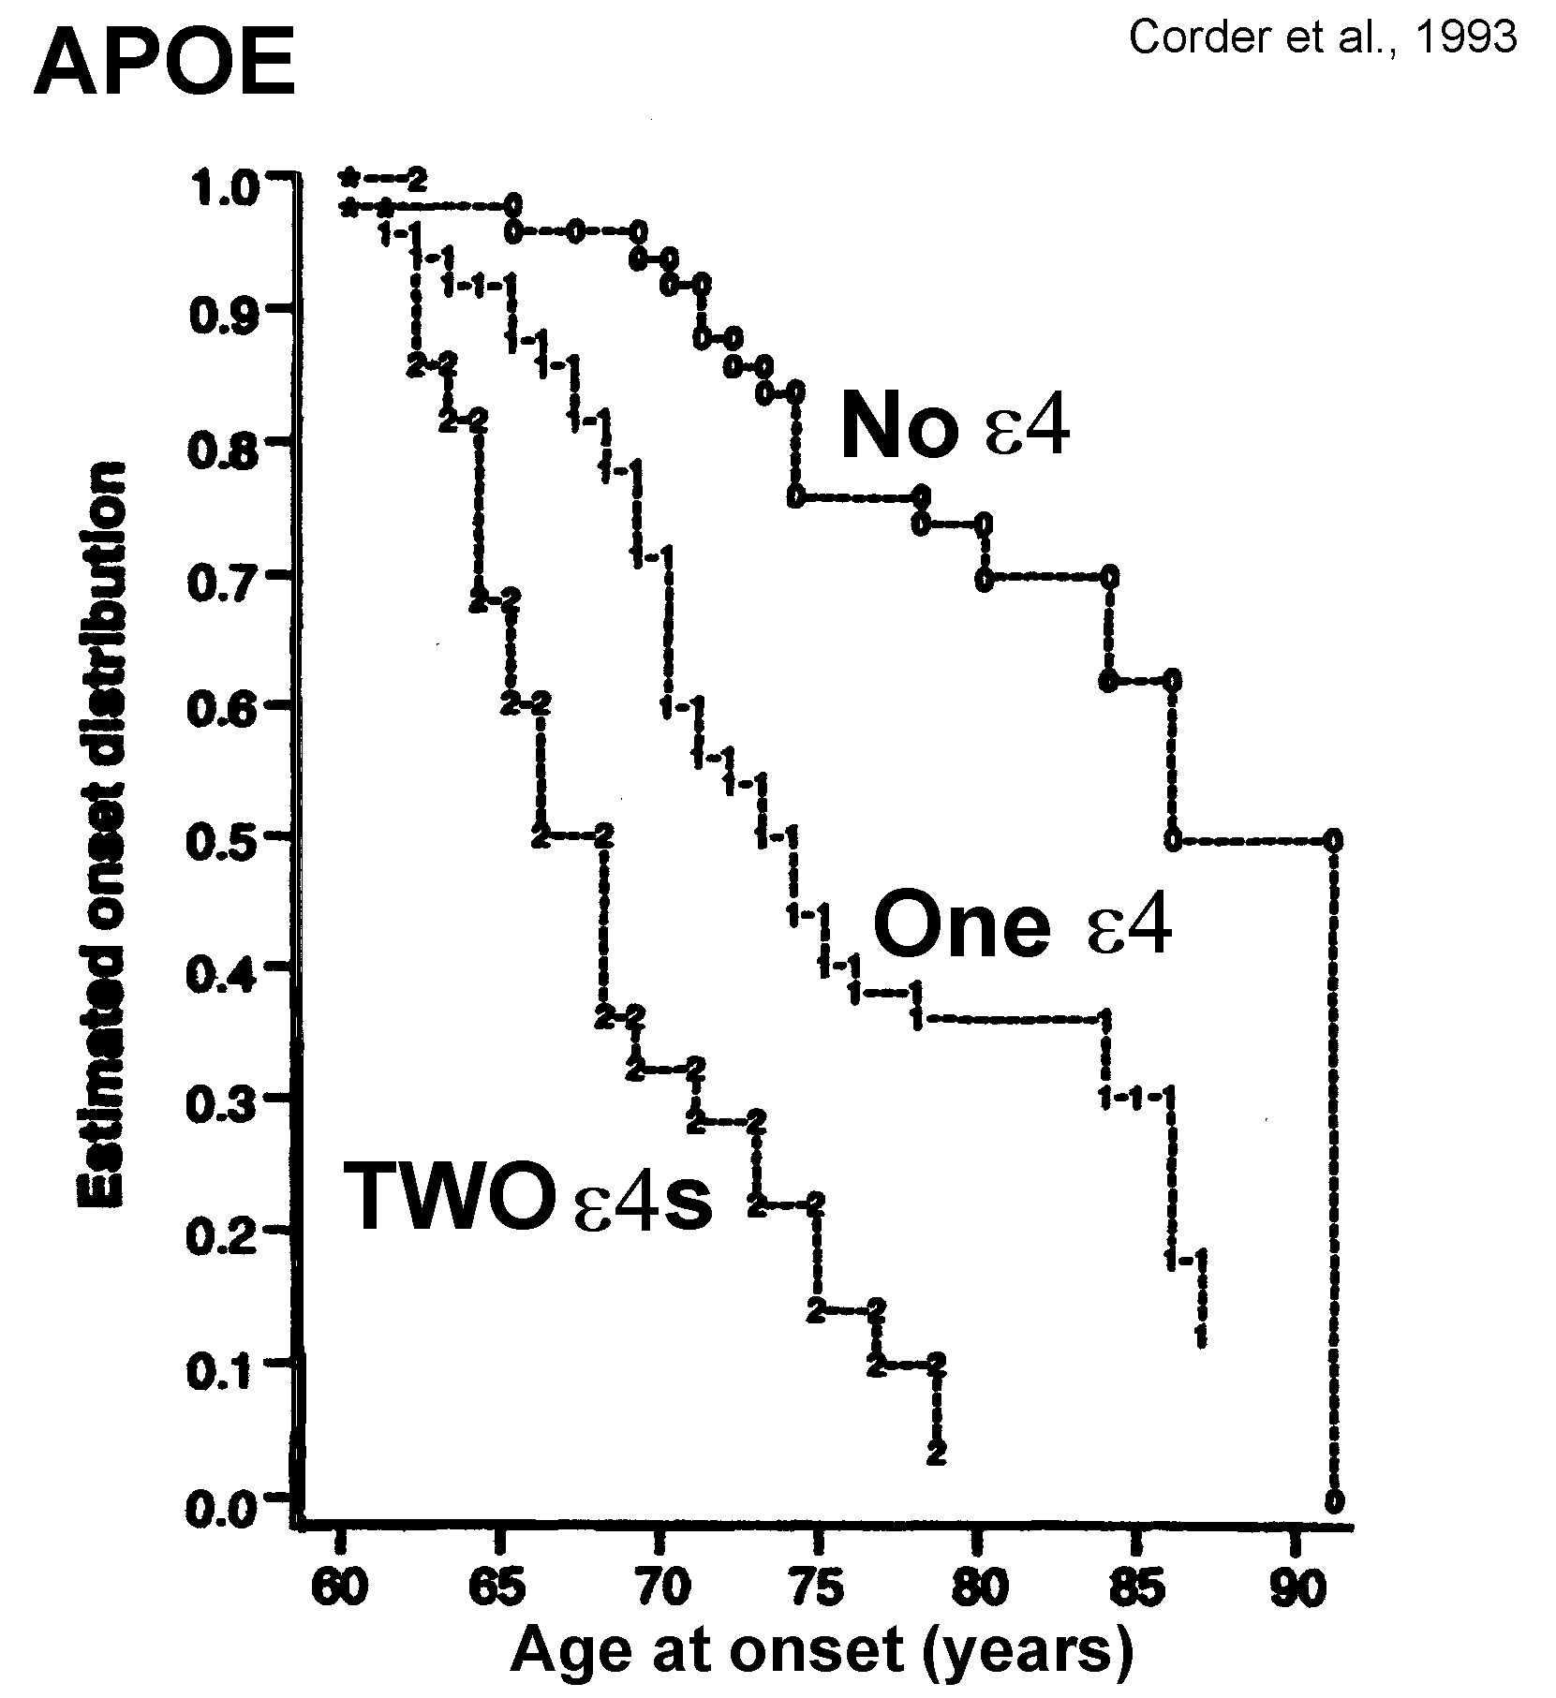

Slide 94
Using the Gompertz equation
to model rate of dementia
increase with age:
U(t) = Ro * exp (alpha * t)

Slide 95
Using a Gompertz survival
curve to model probability of
not having dementia with age:
S(t) = exp(Ro/alpha *(1- exp (alpha * t)))

Slide 96
Using Gompertz equations
to model probability of
dementia with age:
D(t) = U(t) * S(t)

Slide 97
e4/4 – 2% of pop, 20% of cases
e3/4 - 20% of pop, 40% of cases
e3/3 - 65% of pop, 35% of cases
JW Ashford, MD PhD, 2000
Notes:
97

Slide 98
APOE has been shown to play many roles.
Which one is relevant for Alzheimer Causation??
APOE (apo-lipo-protein E) is a cholesterol chaperone
  Cholesterol metabolsim is a central part of synaptic plasticity (Koudinov & Koudinov, 2001)
  APOE may play a critical role in neuroplasticity, moving cholesterol from synapses being removed to new synapses
Younger APOE-e4 carriers may have better memory, but burn out the neurons most involved in neuroplasticity, leading to Alzheimer pathology
APOE may affect APP transcription (Huang…Sudhof, 2018)
APOE may play a role in Abeta clearance
The KLOTHO KL-VS gene (longevity) blocks adverse affect of APOE-e4
APOE affects as many as 1700 different genetic factors (Rao, 2017)
CAVEAT – the role of APOE protein variations (e2, e3, e4) in the causation of Alzheimer pathology has not been clarified
  FDA approval of 23&me for providing results may be a tremendous benefit for scientists seeking to understand the role of APOE in AD

Slide 99
Alzheimer Genetic Risk Factors
  GENE Location SNP OR (Frequency)
    Major risk factor
  APOE 19q13.32 rs429358 3 - 5 per e4 allele (frequency ~ 14%)
  Population attributable fraction (%) = 30.8
  APOE 19q13.32 rs7412 .5 to 0 for 1, 2 e2 alleles
  APOE-3 TOMM40 – repeat (not a SNP) risk may related to number of repeats
    Early onset - autosomal dominant ~200 (less than 1%, onset < 60 years of age)
  APP 21q21.3 rs63750847
  PSEN1 14q24.3
  PSEN2 1q31-q42
    Minor risk factor
  TREM2 6p21.1 rs75932628 4.5 (frequency = .001)
    20 SNPs associated with AD – total less than half of the variance of APOE genotype

Slide 100
20 SNPs associated with AD
- all can be related to synaptic plasticity/memory
GENE LOCATION SNP Com/Path Min/Path OddsRatio Frequency Pop-attrib-frac %
ABCA7 19p13.3 rs3764650 T/G 1.23 0.09 2.8
CR1 1q32.2 rs6656401 G/A 1.21 0.19 3.5
BIN1 2q14.3 rs744373 A/G 1.15 0.30 8.2
FERMT2 14q22.1 rs17125944 T/C 1.14 0.09 1.2
CD2AP 6p12.3 rs9349407 G/C 1.12 0.28 2.6
HLA-DRB5/1 6p21.32 rs9271192 A/C 1.11 0.26 3.0
PTK2B 8p21.2 rs28834970 T/C 1.10 0.36 3.6
CELF1 11p11.2 rs10838725 T/C 1.08 0.32 2.5
INPP5D 2q37.1 rs35349669 C/T 1.08 0.47 3.8
MEF2C 5q14.3 rs190982 A/G 0.93 0.59 2.8
NME8 locus 7p14.1 rs2718058 A/G 0.93 0.62 2.5
CD33 19q13.41 rs3865444 C/A 0.91 0.69 1.8
EPHA1 7q35 rs11771145 G/A 0.91 0.81 3.3
MS4A6A locus 11q12.2 rs983392 A/G 0.91 0.58 3.8
SLC24A4/RIN3 loc 14q32.12 rs10498633 G/T 0.91 0.80 1.9
ZCWPW1 7q22.1 rs1476679 T/C 0.91 0.66 2.5
CASS4 20q13.31 rs7274581 T/C 0.88 0.91 1.0
PICALM 11q14.2 rs3851179 C/T 0.86 0.65 4.5
CLU 8p21.1 rs11136000 C/T 0.85 0.60 5.1
SORL1 11q24.1 rs11218343 T/C 0.77 0.95 0.91
Flanders-Belgian population: Sleegers et al., 2015; Cauwenberghe et al., 2016Carmona et al., 2018

Slide 101
Do women have an age-specific increase in AD risk according to APOE genotype?
No study appears to adequately adjust for age using the exponential increase of AD risk with age – which is critical for this comparison
Most studies use 5-year cohorts, in which longer-living women will automatically have twice the incidence by having more older individuals
One meta-analysis (Neu et al., 2017) suggests:
  Women with e3/e4 have increased AD risk relative to men just 65-75 years of age:
    OR=4.37 vs 3.14 respectively
  Women with e2/e3 have a decreased risk of AD relative to men:
    OR=0.51 vs 0.71 respectively
  No other gender differences were found
Complex interactions of gender differences in health behaviors, fat metabolism, and female changes-of-life make comparisons difficult

Slide 102
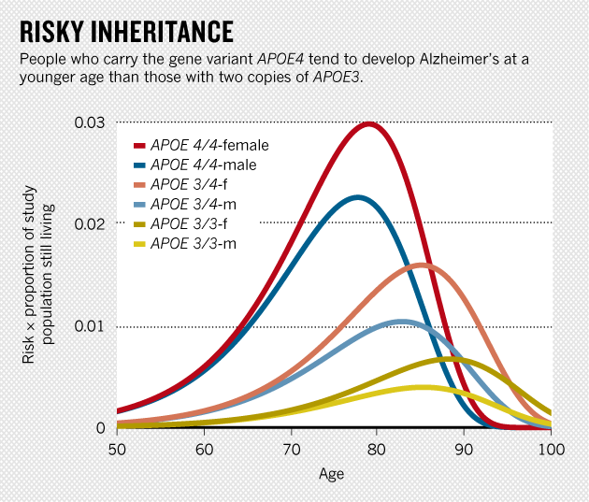
Jun 4, 2014 |By Laura Spinney and Nature magazine; Scientific American, Lancet-Neurology
Credit: Raber, Huang, Ashford. Neurobiol. Aging 25, 641–650 (2004)

Slide 103
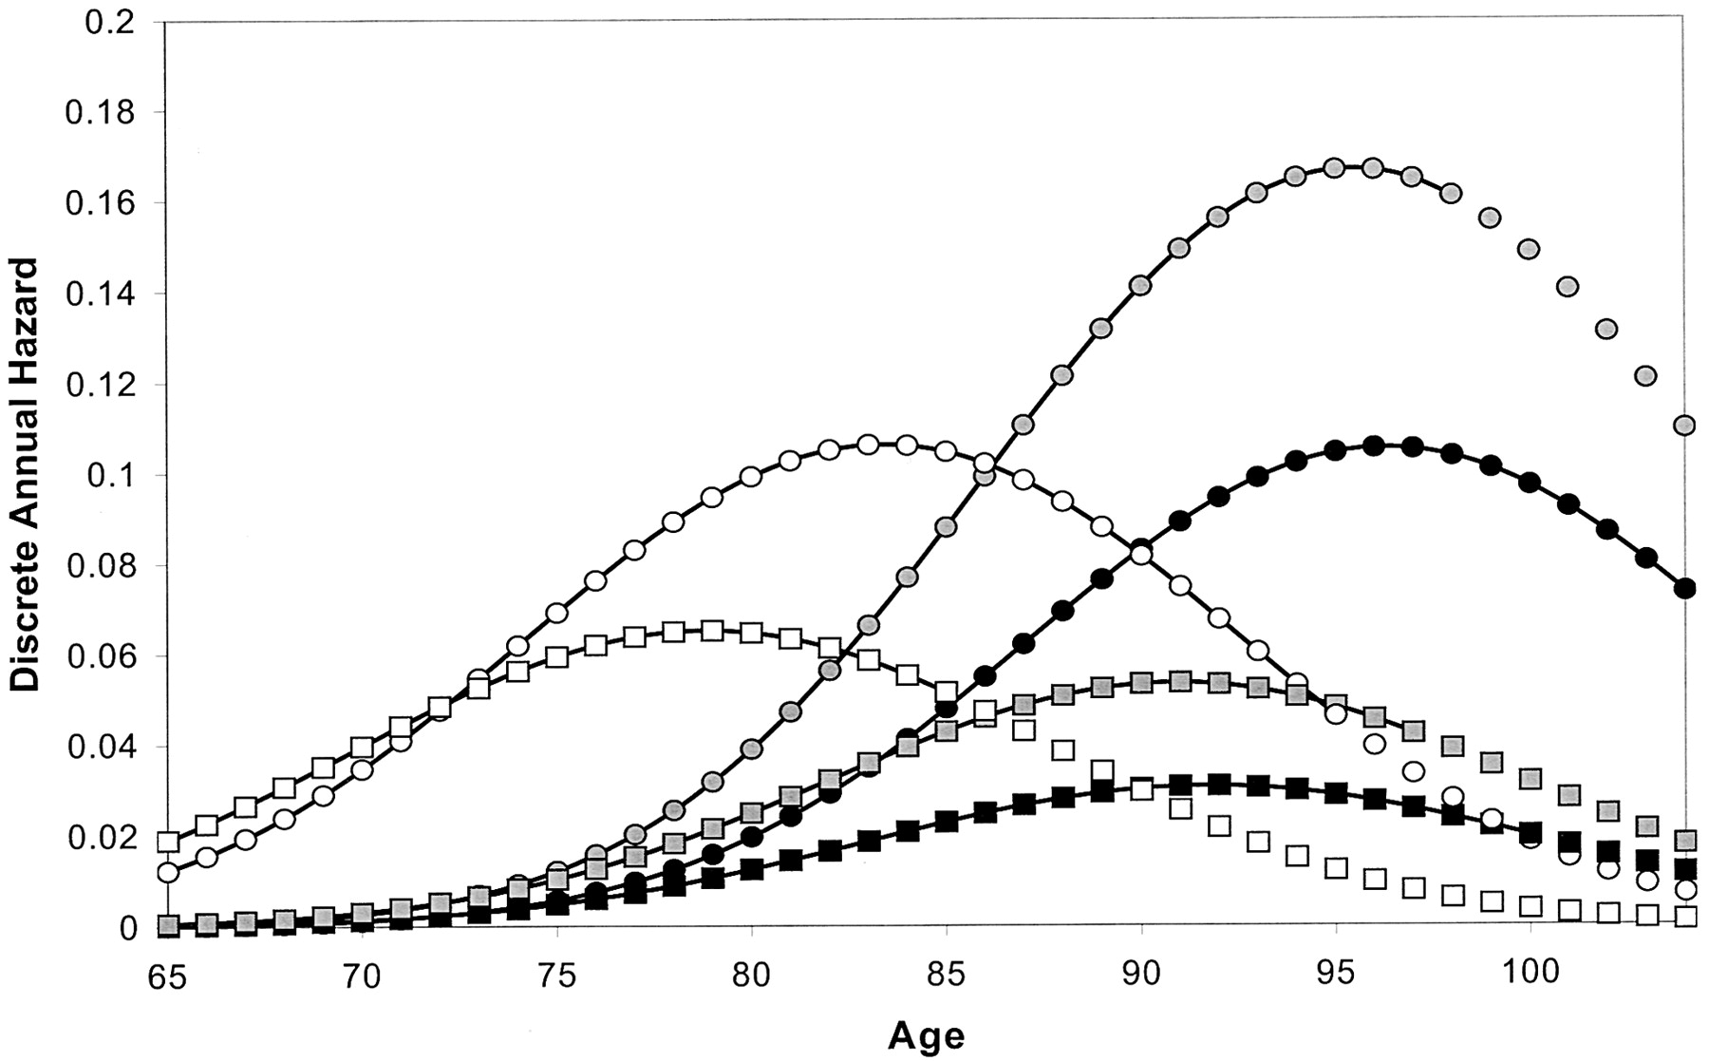
Cache County, probability
of incident dementia
Circles – females
Squares - males
Open – ApoE-e44
Gray – ApoE-e4/x
Black – ApoE-ex/x
Miech et al., 2002

Slide 104
Variations of Dementia by Race, Country
There have been reports of increase rates of dementia and Alzheimer’s disease is African-Americans and Hispanics
There is less Alzheimer’s disease in Asians
Since Alzheimer’s disease is related to APOE genotype, and the e4 allele is more prevalent in Africans, this variation could be genetic
  But this association is complicated and may be neutralized in this group
Asians have a lower prevalence of the e4 allele
Dementia and Alzheimer’s disease are also related to education, though the basis of this difference is unknown
The variation could be related to medical predispositions (hypertension), diet, unhealthy behaviors, increased head trauma, decreased life-time cognitive stimulation, poor performance on tests.

Slide 105
Are we ready to do genetic testing to predict AD?
How much danger is involved, is genetic counselling needed?
  Does genotype knowledge have adverse effects – anxiety, depression, suicide?
Are recommendations against genetic testing “paternalistic”?
  Like not telling someone they have cancer or another untreatable disease
The family members may want to know (but may not have a choice)
Informed individuals can make more powerful financial decisions based on this knowledge
  Should insurance companies implement changes in actuarial calculations
Those at risk can seek more frequent testing
  This is the best opportunity for early recognition
  Those at decreased risk can focus on other issues
Those at risk will be better advocates for research (like HIV)
Specific preventive treatments can be developed by genetic factor

Slide 106
Neuroplasticity Hypothesis of Alzheimer’s Disease
At all Bio-Psycho-Social System Levels, the Alzheimer Process Attacks Mechanisms Associated with Memory
SOCIAL SYSTEMS REQUIRING MEMORY
    INSTRUMENTAL ADLs - EARLY
    BASIC ADLs - LATE
PSYCHOLOGICAL MEMORY SYSTEMS
    PRIMARY LOSS OF SHORT-TERM MEMORY
      LEARNING PROCESSES – CLASSICAL, OPERANT
    LATER LOSS OF LEARNED SKILLS
NEURONAL MEMORY SYSTEMS
    CORTICAL
      GLUTAMATERGIC LARGE NEURONS
      SOMATOSTATINERGIC GABA NEURONS
    SUBCORTICAL
      acetylcholine, norepinephrine, serotonin neurons
    CELLULAR-LEVEL PLASTIC PROCESSES
      (tau phosphorylation, amyloid pre-protein processing, APOE)
Ashford & Jarvik., 1985; Ashford et al., 1989; 1992; 1995; 1998; Teter & Ashford, 2002

Slide 107
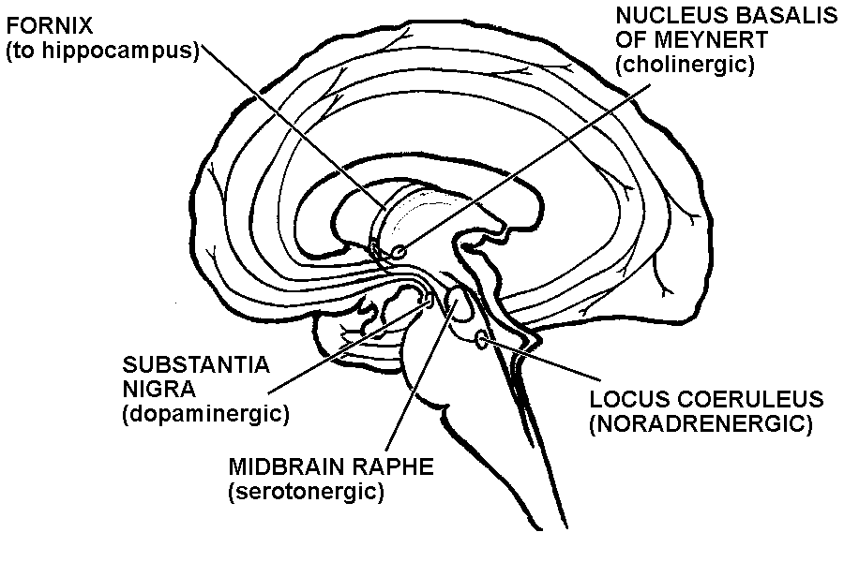
Cortex
- Glutamate neurons
- highly affected by AD
- detail memory
- Rx: memantine
GABA neurons
- Somatostatinergic
neurons affected by AD
– memory modulation
-memory-write signal
-related to dementia severity
Rx:
cholinesterase inhibitors
(not affected - movement)
Affected by AD
-operant conditioning)
-may be earliest AD pathology
Affected by AD early
- Classical conditioning

Slide 108
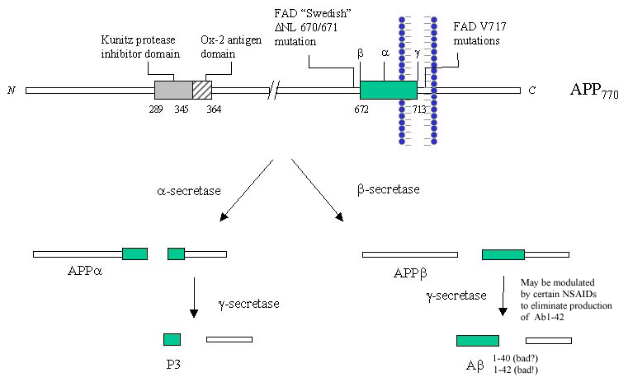
extra cellular or in endosome
intracellular
APP – formed
during learning
- ? XS in APOE-e4
Iceland mutation
APP-673 – no AD
Lipid raft
Formed by cholesterol
-Transported by APOE
(from macroglia)
ADAM-10 - Stimulated by acetylcholine
through muscarinic receptor, norephinephrine, and serotonin
APP
switch
Pathway to build new synapses
Pathway to remove old synapses
NEXIN to stimulates new synapse growth
vs. ADAM-10 activating neurexin
NO
Amyloid –beta:
? Free-radical generator
? To destroy old synapses
Turn-over – 8 hours
Clearance – IDE, APOE
?
AICD
JW Ashford, MD PhD, 2002 - 2018
Favored when
lipid raft too thick

Slide 109
AD Spectrum
Genetic factors: Age of onset (not rate of progression)
Pathology:
    In 1968, Blessed, Tomlinson, and Roth showed that counts of neurofibrillary tangles correlated with dementia severity in older individuals
    They did not find a correlation between counts of senile plaques and dementia severity
        a direct relationship between dementia and senile plaques or their amyloid constituents has never been demonstrated!!
Cognitive/memory/ADL deterioration:
    Global Deterioration Scale
    Clinical Dementia Rating Scale
    Global Clinical Scale (composite, MMSE+, ADL+, CDRx)

Slide 110
Future directions for Alzheimer genetics: prevention and early treatment
Understanding the Genes is the key to treating and preventing AD
Genotyping – GWAS will soon be done on all newborns
Large population studies will redefine risk-factors by genotype
Preventive measures based on genetics – life-time intervention
Modify APOE protein to mimic e2
  Transfection, decrease APP transcription, or block APOE action
Treatments based on genetics – could be dietary modification
Specific treatments for APOE modulation
  May be related to statin effects, diet, DHA (omega-3-FA for brain)
  Leptin may modulate APOE formation, lipid raft thickness

Slide 111
TOP 10 HEALTHY BEHAVIORS to Prevent AD
Exercise – walking, running, swimming, bicycling, yoga, Pilates
  Increase osteocalcin
  Increase BDNF
Diet (continually monitor and improve your diet)
  Mediterranean
  Omega-3-fatty acids
Maintain a healthy Body Mass Index (BMI)
Maximize mental stimulation - Education – early and continued
Socialization – attend to your social network
Sunlight (keep your vitamin D up)
Avoidance of intoxicating substances
Safety – avoid traumatic brain injuries (for contact sport – use helmet)
Sleep – (6-8 hours per night, consider use of melatonin)
Monitor your physical health (BP, cholesterol, glucose, B12) and your mental, cognitive, and memory health (monitor on-line)
(Ashford, since 2000)

Slide 112
Future Developments to Prevent AD
NMDA receptor modulators (memantine, may soon consider ketamine, Epsom Salts – magnesium sulfate)
  Early treatment may prevent excitotoxic neuron damage, extend life
Prevention of beta-amyloid-42 cleavage
  Certain NSAIDs may prevent formation – modulation of gamma-secretase
  Statins may keep lipid-raft membranes thinner
Therapy to change processing of amyloid protein precursor
  Abeta immunologic therapy removes deposits – but no slowing of dementia
  Bryostatin may stimulate alpha-secretase to decrease beta products
Specific treatments for APOE modulation
  May be related to statin effects, diet (from birth), DHA (omega-3-FA for brain)
  Leptin may modulate APOE formation, lipid raft thickness
Brainstem neurotransmitter augmentation to activate alpha-secretase, decrease beta-cleavage
  Norepinephrine (locus coeruleus) neuron protection – formoterol as beta-agaonist
  Serotonin neuron (mid-line raphe nuclei) trazodone to stimulate 5HT receptors
  Cholinergic augmentation - Anti-cholinesterase treatments
  May need to be started early at very low doses, build up progressively – short acting galanatamine
Medication to prevent tau hyperphosphorylation
  Lithium and valproic acid, which inhibit GSK-3beta may be helpful
  Need medications to block AICD induction of tau hyperphosphorylation

Slide 113
Future directions for Alzheimer genetics: prevention and early treatment
Understanding the Genes is the key to treating and preventing AD
Genotyping – GWAS will soon be done on all newborns
Large population studies will redefine risk-factors by genotype
Preventive measures based on genetics – life-time intervention
Modify APOE protein to mimic e2
  Transfection, decrease APP transcription, or block APOE action
Treatments based on genetics – could be dietary modification
Specific treatments for APOE modulation
  May be related to statin effects, diet, DHA (omega-3-FA for brain)
  Leptin may modulate APOE formation, lipid raft thickness
  Did APOE-e3/e2 appear because of the addition of meat to the diet 300,000 years ago

Slide 114
Future directions for standardized memory testing: prevention, recognition, and early treatment
Baseline testing for children – for sports, concussions
Large population studies to redefine risk-factors
Preventive measures based on memory ability
Treatments based on memory ability, risk factors
Specific assessments for possible impairment
  Anesthesia (post-op cognitive confusion assessment – mnemometer)
  Head injuries (mild TBI)
    Explosions (battle), motor vehicle accidents, contact sports, biking
  Chemotherapy
    One study started in Kunming on “chemobrain”
  Driving
    Age-related safety
    Immediate check of intoxication: alcohol, marijuana, etc.
    Motor vehicle accident head-injury assessment

Slide 115
MemTrax Provides Better Memory Assessment
Empowering personal brain health
Enabling telehealth brain assessment
Measuring brain treatment outcomes
Lowering risk from brain-related issues

Slide 116
Accessible and Easy Memory Testing & Monitoring
Open
Repeatable
Available on major platforms & devices
Long-term performance tracking
Quick
Engaging
Only takes about 3 minutes per session
Millions of unique test permutations
Simple
Customizable
Easy and intuitive for anyone to use
Adjustable for clinicians & researchers

Slide 117
How the MemTrax Assessment Works
User navigates to
test
Test downloaded
client-side from server
Instructions presented
User starts test
(3s count down)
User recognizes repeat
pictures & responds
Results sent back to server
(displaying results optional)

Slide 118


Continued Innovation for Measuring Brain Health
MemTrax Roadmap
PRO
Professional version for healthcare & research administration
Assessments to measure more brain health domains
Advanced reporting and analysis
Native apps for
iOS & Android
Notes:
Analytics based on Item Response Theory and Computerized Adaptive Testing

Slide 119








Partnerships Advancing Research and Distribution
Research Partners
Business Partners
SJN Biomed LTD

Slide 120
Publications and Research Directions
Published Works: see PubMed: Ashford JW
Ongoing Studies
Ashford J. W., Gere E., & Bayley P. J. (2011). Measuring Memory in Group Settings Using a Continuous Recognition Test. Journals of Alzheimer's Disease. 27(4): 885-895.
van der Hoek MD, Nieuwenhuizen A, Keijer J, Ashford JW. The MemTrax Test Compared to the Montreal Cognitive Assessment Estimation of Mild Cognitive Impairment. J Alzheimers Dis. 2019;67(3):1045-1054. doi: 10.3233/JAD-181003.
Ashford JW, Tarpin-Bernard F, Ashford CB, Ashford MT. A Computerized Continuous-Recognition Task for Measurement of Episodic Memory. J Alzheimers Dis. 2019;69(2):385-399. doi: 10.3233/JAD-190167.
Cholerton B, Weiner MW, Nosheny RL, Poston KL, Mackin RS, Tian L, Ashford JW, Montine TJ. Cognitive Performance in Parkinson's Disease in the Brain Health Registry. J Alzheimers Dis. 2019;68(3):1029-1038. doi: 10.3233/JAD-181009.
Bergeron MF, Landset S, Tarpin-Bernard F, Ashford CB, Khoshgoftaar TM, Ashford JW. Episodic-Memory Performance in Machine Learning Modeling for Predicting Cognitive Health Status Classification. J. Alzheimers Dis. 2019 (in press).
ALZHEIMER’S DISEASE, 2019 publications
Ashford JW. The Dichotomy of Alzheimer's Disease Pathology: Amyloid-β and Tau. J Alzheimers Dis. 2019;68(1):77-83. doi: 10.3233/JAD-181198.
Smith CJ, Ashford JW, Perfetti TA. Putative Survival Advantages in Young Apolipoprotein ɛ4 Carriers are Associated with Increased Neural Stress. J Alzheimers Dis. 2019;68(3):885-923. doi: 10.3233/JAD-181089.
Ashford JW. Treatment of Alzheimer's Disease: Trazodone, Sleep, Serotonin, Norepinephrine, and Future Directions. J Alzheimers Dis. 2019;67(3):923-930. doi: 10.3233/JAD-181106.
UCSF Brain Health Registry includes MemTrax in cognitive testing battery along with self-report data (>30K participants)
China, 30,000 subjects, with MoCA
Alzheimer’s Foundation of America, memory screening
Analyzing MemTrax data from over 20,000 individuals to norm across age bands, gender and education levels
Notes:
Listed as a cognitive test as part of the Medicare Annual Wellness, visit: https://www.nia.nih.gov/research/cognitive-instrument/search?title=Continuous+Recognition+Test+&field_ct_abbreviation_value

Slide 121


Slide 122
Let’s End Alzheimer’s Disease
J. Wesson Ashford, M.D., Ph.D.
Clinical Professor (affiliated), Department of Psychiatry and Behavioral Sciences
Stanford University
Director, War Related Illness & Injury Study Center (WRIISC)
VA Palo Alto Health Care System
Wes.Ashford@va.gov washford@medafile.com ashford@Stanford.edu
June 10, 2019
www.warrelatedillness.va.gov www.medafile.com www.memtrax.com

