Slide 1
Dementia Update Memory Problems, Dementia, Alzheimer’s Disease Screening, Diagnosis, Treatment, Prevention
J. Wesson Ashford, M.D., Ph.D.
Clinical Professor (affiliated), Department of Psychiatry and Behavioral Sciences
Stanford University
Director, War Related Illness & Injury Study Center (WRIISC)
VA Palo Alto Health Care System
washford@medafile.com ashford@Stanford.edu Wes.Ashford@gmail.com
December 1, 2021
www.memtrax.com www.medafile.com www.afamemorytest.com
www.memtrax.org/n.html www.brainhealthregistry.org
Slides can be viewed simultaneously at: www.medafile.com/GSdementia-2021.pptx

Slide 2
Disclosures
Dr. Ashford is an unpaid consultant to MemTrax, LLC, which provides an on-line screening test for memory function.
Dr. Ashford has applied for patent protection for a continuous performance memory test which he developed.
Dr. Ashford is the Chair of the Medical, Scientific, and Memory Screening Advisory Board of the Alzheimer’s Foundation of America, which provides the MemTrax memory test: www.afamemorytest.com
Dr. Ashford is a full-time employee of the VA.
The views expressed by Dr. Ashford do not represent the official views of the VA.

Slide 3
Dementia Definition
Multiple Cognitive Deficits:
Memory dysfunction
especially new learning, a prominent early symptom
At least one additional cognitive deficit
aphasia, apraxia, agnosia, or executive dysfunction
Cognitive Disturbances:
Sufficiently severe to cause impairment of occupational or social functioning and
Must represent a decline from a previous level of functioning

Slide 4
Need for Mass Screening, Early AD Detection
AD, dementia, and memory problems are difficult to detect when they are mild
especially Alzheimer’s disease (AD)
the problem is subtle –
MCI – mild cognitive impairment,
minor neurocognitive disorder
family members avoid the problem and compensate for the patient
physicians tend to miss the initial signs and symptoms
about 90% missed early, especially early AD
about 25% - 50% are still missed late, at moderate and severe levels
There is no efficient laboratory test – brain scan, CSF, blood – to accurately and efficiently diagnosis dementia or AD
There are important accommodations and interventions that should be made when there are cognitive impairments
(like needing glasses or having driving restrictions if you have vision problems)

Slide 5
Why Screening is Important to Consider
Cognitive impairment is disruptive to human well-being and psychosocial function
Cognitive Impairment is potentially a prodromal condition to dementia and Alzheimer’s disease
Dementia is a tremendously costly condition
With the aging of the population (even beyond the baby-boom) there will be a progressive increase in the proportion of elderly individuals in the world
Screening will lead to more diagnoses which will advance the understanding of Alzheimer’s disease and foster the development of better treatments

Slide 6
Benefits of Early AD Diagnosis Social
Undiagnosed AD patients face avoidable problems
social, financial
Early education of caregivers
how to handle patient (choices, getting started)
Advance planning while patient is competent
will, proxy, power of attorney, advance directives
Reduce family stress and misunderstanding
caregiver burden, blame, denial
Promote safety
driving, compliance, cooking, etc.
Patient’s and Family’s right to know
especially about genetic risks
Promote advocacy
for research and treatment development

Slide 7
Benefits of Early AD Medical
Early diagnosis and treatment and appropriate intervention may:
improve overall course substantially
lessen disease burden on caregivers / society
Specific treatments now available
(anti-cholinesterases, memantine) (aducanumbab of questionable benefit)
Improve cognition
Improve function (ADLs)
Delay conversion from Mild Cognitive Impairment to AD
Slow underlying disease process, the sooner the better
Decreased development of behavior problems
Delay nursing home placement, possibly over 20 months
Delay nursing home placement longer if started earlier

Slide 8
Issues for Memory Screening
Current testing for memory problems is based on having a tester sit in front of a subject for a prolonged period of time and administer unpleasant tests
Testing must be
Inexpensive (minimal need for administrator)
Fun (so people will return for frequent testing)
More precise, reliable, and valid
To improve sensitivity
To improve specificity

Slide 9
DSM-5 (APA Diagnostic and Statistical Manual) Inventory for Neurocognitive Impairment and Global Assessment of Severity
I) Learning and memory
A) Recent memory
B) Remote memory
C) Orientation
II) Complex Attention
III) Executive Function, planning, decision-making, inhibition,
judgement, problem solving, abstract thinking
IV) Language function, aphasia (dominant hemisphere)
V) Perceptual-motor function
A) Visuospatial organization, agnosia (non-dominant hemisphere)
B) Home activities, motor coordination, praxis
VI) Social Cognition
A) Community affairs, social function, and interactions with others
B) Personal care, habits, hygiene, fully incontinent.
http://www.medafile.com/AFA/DSM5-NCI.htm

Slide 10
Differential Diagnosis (mnemonic device: AVDEMENTIA)
Alzheimer Disease (pure ~40%, + mixed~70%)
Vascular Disease, MID (5-20%)
Drugs, Depression, Delirium
Ethanol (5-15%)
Medical / Metabolic Systems
Endocrine (thyroid, diabetes), Ears, Eyes, Environment
Neurologic (other primary degenerations, etc.)
Tumor, Toxin, Trauma
Infection, Idiopathic, Immunologic
Amnesia, Autoimmune, Apnea, AAMI
Adapted from Yesavage, 1979

Slide 11
Alzheimer’s Disease
First described by Alois Alzheimer, a German neuropathologist, in 1907
Observed in a 51-year-old female patient with paranoia, memory loss, disorientation, and hallucinations
Postmortem studies characterized senile plaques and neurofibrillary tangles (NFTs) in the cerebral cortex
Senile plaques: Extracellular accumulation of insoluble fragments of beta-amyloid (Aβ₁₋₄₂)
NFTs: Intracellular accumulation of hyperphosphorylated tau strands
Notes:
Purpose:
To introduce Alzheimer’s disease and the discovery of senile plaques and neurofibrillary
tangles
Key Points:
Frau Auguste D. was brought by her husband to Alois Alzheimer at a German mental asylum. The husband complained that she had changed drastically over the last few years, that she had become insanely jealous, had severe memory loss, fits of screaming, and hallucinations. He no longer recognized the woman he was married to.
Upon her death, Alois Alzheimer examined her brain and observed abundant senile plaques and strange neurofibrillary formations in the cerebral cortex, which he determined were responsible for her dementia.
As we now know, senile plaques, made up of insoluble amyloid beta fragments, and neurofibrillary tangles of hyperphosphorylated tau are the hallmarks of Alzheimer’s disease.

Slide 12
Cholinergic Changes in AD – 1976 (Davies & Maloney, 1976; Bowen et al., 1976; Perry et al., 1977;
The most prominent neurotransmitter abnormalities in AD are cholinergic
Reduced activity of choline acetyltransferase (synthesis of acetylcholine)¹
Reduced number of cholinergic neurons in late AD (particularly in basal forebrain)²
Selective loss of nicotinic receptor subtypes in hippocampus and cortex^{1,3}
1. Bartus RT et al. Science. 1982;217:408-414.
2. Whitehouse PJ et al. Science. 1982;215:1237-1239.
3. Guan ZZ et al. J Neurochem. 2000;74:237-243.
Notes:
The associated decline of cognitive function in AD with decreased cholinergic neurotransmission in the cortex, hippocampus, and amygdala is the basis for what is known as the cholinergic hypothesis of AD

Slide 13
Problems with the Cholinergic Hypothesis
Many cholinergic neurons throughout brain, spinal cord, but only discrete groups of ACh neurons in the nucleus basalis of Meynert are affected in AD
Numerous other neurotransmitter systems are affected in AD, the earliest are norepinephrine neurons of the LOCUS COERULEUS
Cholinergic agents are only modestly effective in treating AD, slowing progression
No clear relationship between acetylcholine and microscopic neuropathological features

Slide 14
Norepinephrine changes occur first in AD.
Bondareff, Mountjoy, Roth, 1981
Braak & Tredici, 2011
Trillo et al., 2013
Theofilas et al., 2018
(see Ashford, 2019, JAD for review)
Serotonin neuron loss in AD
ALL BB≥0 – dorsal raphe + 22.5% BB 0 – dorsal raphe +
Dorsal raphe – BB 0.5???
Grinberg et al., 2009
Notes:
14

Slide 15
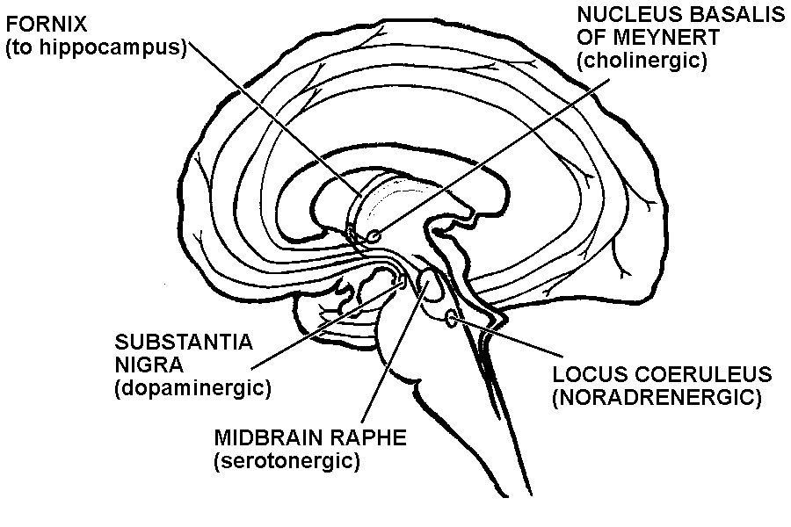
Specific groups of cholinergic, serotonergic, and noradrenergic that project
to the cortex, and glutamatergic and somatostatinergic GABA neurons of
discrete cortical regions are selectively affected in Alzheimer’s disease
Cortex
- Glutamate neurons
- highly affected by AD
- detail memory
- Rx: memantine
GABA neurons
- Somatostatinergic
neurons affected by AD
– memory modulation
Affected by AD
-memory-write signal
Rx:
cholinesterase inhibitors
(not affected by AD - movement)
(Affected by AD
- Operant conditioning)
(Affected by AD early
- Classical conditioning)

Slide 16
Neurotransmitter therapies
Cholinergic system –
Modest clinical benefit of cholinesterase inhibitors, improvement, slowing of progression
Marked, rapid decline frequent on discontinuation
No benefit from any other treatments
No evidence of benefit in early AD or mild cognitive impairment
Serotonergic system – none shown effective
Noradrenergic system – none shown effective
Dopaminergic system – none shown effective
Glutamate system
NMDA modulator memantine
Slight improvement in moderate to severe AD
May improve behavior or make it worse
May increase life-expectancy to near normal
GABA system – none effective (e.g., benzodiazepines – exacerbate)

Slide 17
ALZHEIMER CORTICAL PATHOLOGY AFFECTS LOCATIONS OF HIGH MEMORY STORAGE

Slide 18
Discrete regions of the cerebral cortex are selectively affected by Alzheimer pathology
Brun & Englund, 1981, 1986

Slide 19
Braak & Braak, 1985; 1991; Braak et al., 2006

Slide 20
MRI scans of brain, coronal sections
Normal Alzheimer
Ashford, 1988

Slide 21
Time-Index model
of the course of Alzheimer’s disease
(calculated from the CERAD data set)
The best model to fit the progression,
both mathematically and biologically,
is the Gompertz survival curve
(99.7% fit to mean changes over time):
S(t) = exp(Ro/alpha *(1- exp (alpha * t)))
- Time-Index Scale -
Ashford et al., 1995
Ashford & Schmitt, 2001
AAMI / MCI/ early AD -- DEMENTIA

Slide 22
AD COGNITIVE PATHOLOGY REFLECTS FAILURES OF MEMORY STORAGE
Shown on the next slide is an “Item Response Theory” analysis of the items of the Mini-Mental State Exam (MMSE). The results show that items which are more involved in memory processing are affected earlier in AD (Ashford et al., 1989, 1995).

Slide 23
Mini-Mental State Exam items
Shows that AD is primarily a condition of episodic memory (retention of information)
Using the Gavrilov & Gavrilova explanation of the Gompertz curve, AD is a progressive failure of the massively redundant memory storage mechanism of the brain
Ashford et al., 1989
Ashford et al., 1995
Ashford, 2008

Slide 24
a
Correlation of SPECT scan measures of cerebral blood flow across cerebral cortical regions with Time-Index estimation of severity, calculated from MMSE scores
The areas of highest correlation are those with the highest demands from neuroplasticity
Ashford et al,
2000

Slide 25
ALZHEIMER PATHOLOGY AND NEUROPLASTICITY AD ATTACKS NEUROPLASTIC MECHANISMS NEUROPLASTICITY AS THE FOCUS OF THE ALZHEMER ATTACK FOCUS ON NEUROPLASTIC MECHANISMS TO TREAT ALZHEIMER’S DISEASE
Scheibel, 1982
Ashford & Jarvik, 1985
Geddes et al., 1985
Geddes & Cotman, 1986
Crutcher, 1986
Flood & Coleman, 1986
Mattson, 1988
Ashford et al., 1989
Teter & Ashford, 2002
Ashford & Bayley, 2013
Ashford, 2015, 2019
2021 – PubMed: 3,618 results

Slide 26
Neuroplasticity Hypothesis of Alzheimer’s Disease At all Bio-Psycho-Social System Levels, the Alzheimer Process Attacks Mechanisms Associated with Memory
SOCIAL SYSTEMS REQUIRING MEMORY
INSTRUMENTAL ADLs - EARLY
BASIC ADLs - LATE
PSYCHOLOGICAL MEMORY SYSTEMS
PRIMARY LOSS OF SHORT-TERM MEMORY
LEARNING PROCESSES – CLASSICAL, OPERANT
LATER LOSS OF LEARNED SKILLS
NEURONAL MEMORY SYSTEMS
CORTICAL
GLUTAMATERGIC LARGE NEURONS
SOMATOSTATINERGIC GABA NEURONS
SUBCORTICAL
acetylcholine, norepinephrine, serotonin neurons
CELLULAR-LEVEL PLASTIC PROCESSES
(tau phosphorylation, amyloid pre-protein processing, APOE)
Ashford & Jarvik., 1985; Ashford et al., 1989; 1992; 1995; 1998; Teter & Ashford, 2002

Slide 27
NEUROPLASTICITY HYPOTHESIS OF ALZHEIMER PATHOLOGY
AD ATTACKS NEUROPLASTIC MECHANISMS OF THE BRAIN
SENILE PLAQUES AND NEUROFIBRILLARY TANGLES ARE THE VISIBLE SCARS OF THE ATTACK, NOT THE PATHOGENIC AGENTS
THERE IS NO EVIDENCE THAT THE BETA-AMYLOID PROTEIN IS HARMFUL TO THE BRAIN, AND AMYLOID DEPOSITS ARE POORLY CORRELATED WITH THE DEMENTIA, NOT LIKELY IN A CAUSATIVE CHAIN
NEUROFIBRILLARY TANGLES ARE CORRELATED WITH THE DEMENTIA, BUT NOT CAUSAL OF DEMENTIA
EARLY CAUSAL GENETIC FACTORS CAN ALL BE RELATED TO THE AMYLOID PRE-PROTEIN AND EITHER ITS OVER-PRODUCTION, OR MODULATION OF BETA- OR GAMMA-SECRETASE CLEAVAGE
LATE CAUSAL GENETIC FACTORS, MOSTLY APOE (>50%), ARE RELATED TO CHOLESTEROL MANAGEMENT AND NUMEROUS OTHER BRAIN NEUROPLASTICITY, METABOLIC, AND PROTECTIVE FACTORS
THE HARMFUL EVENT IS THE HYPER-PHOSPHORYLATION OF THE MICROTUBULE-ASSOCIATED PROTEIN TAU, LEADING TO PAIRED HELICAL FILAMENTS, NEUROPIL THREATS, AND LOSS OF SYNAPSES, WITH PROLONGED DEGENERATION OF NEURONS WITH HIGH NEUROPLASTICY

Slide 28
Alzheimer Neuroplasticity Cascade Hypothesis
Genetic Factors – all related to APP
SNPs - related to APP/beta (strongest factors, but rare), APP 50% excess – Down Syndrome
APOE genotype – related to management of cholesterol in neuronal membranes (most common)
High energy, membrane processing demand of neuroplasticity stresses vulnerable neuroplastic neurons
APP cleavage control (neuroplasticity – APP switch)
Alpha stimulation failure (inadequate stimulation by norepinephrine, serotonin, acetylcholine)
Resulting Beta degradation over-activity (caused by stress, excess new information)
Excess Beta-cleavage then Gamma-cleavage of APP increases AICD - APP-intracellular domain
Gamma secretase modulation prevents AD (NSAIDs, statins), decreases Abeta 42/40 ratio
AICD-42 stimulates tau-hyperphosphorylation causing synapse retraction
Excess AICD-42 causes Tau hyperphosphorylation – pTau
Hyperphosporylated pTau causes Paired helical filament (PHF) formation
PHF aggregation leads to Neuropil Thread formation, which cause dendritic amputation, breakage
Dendritic amputation causes massive synapse loss and dementia
Synapse formation disruption leads to episodic memory failure, then rote memory failure
Neuropil threads migrate back to cell body to cause tangles (leads to neuron death, not memory loss)
For treatment assessment, need to measure episodic memory more precisely

Slide 29
The Energy Demands of Neuroplasticity
Brainstem energy management – serotonin, norepinephrine, acetylcholine
Sleep issues – lower beta-amyloid levels while sleeping
Exercise – muscle/BDNF; bone/osteocalcin
Lipid management – Leptin, insulin
Synapse creation, destruction decision pathway – APP
Large energy requirements, requires huge movement of membrane components, cholesterol
Management from brainstem by serotonin, norepinephrine, acetylcholine •
Cholesterol / membrane management proteins
omega-3-FAs, DHA – APOE
Energy generation systems – mitochondria, TOMM-40
Endosomal trafficking proteins – SORL1
Inflammatory mechanism – for glia to manage synaptic debris – TREM2
TAU phosphorylating, dephosphorylating proteins (GSK-3beta, phosphatases)

Slide 30
CSF in Alzheimer’s Disease, both MCI and Dementia patients: Low Aβ and High Tau
Concentration (pg/mL)
Aβ
Tau
Sunderland T, et al. JAMA. 2003;289:2094-2103.
Notes:
30

Slide 31
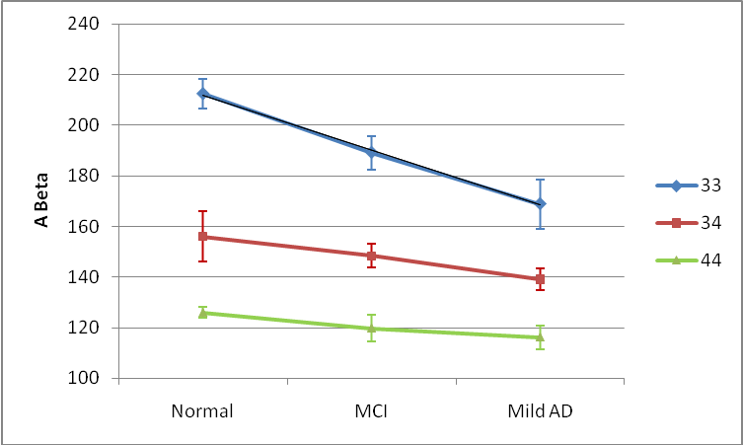
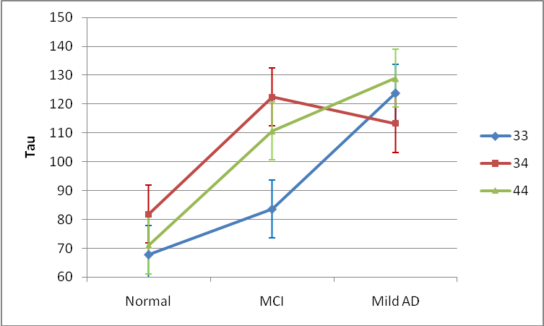
ADNI Data – CSF ABeta, total tau
CSF beta-amyloid
Comparison | p-value
33 vs 34 | <.0001
33 vs 44 | <.0001
34 vs 44 | 0.08
Normal vs MCI | 0.57
Normal vs Mild AD | 0.15
MCI vs Mild AD | 0.20
CSF TAU
Ashford et al., 2011, JAD, Handbook of Imaging the Alzheimer Brain
Comparison | p-value
33 vs 34 | 0.07
33 vs 44 | 0.67
34 vs 44 | 0.99
Normal vs MCI | 0.05
Normal vs Mild AD | <.01
MCI vs Mild AD | 0.06
Notes:
31

Slide 32
High cerebrospinal amyloid-b 42 is associated with normal cognition in individuals with brain amyloidosis
Andrea Sturchioa,b , Alok K. Dwivedic , Christina B. Youngd , Tarja Malme , Luca Marsilia , Jennifer S. Sharmaa , Abhimanyu Mahajana , Emily J. Hilla , Samir EL Andaloussif , Kathleen L. Postond , Fredric P. Manfredssong , Lon S. Schneiderh , Kariem Ezzatf,1 , Alberto J. Espaya, * ,1
a James J. and Joan A. Gardner Family Center for Parkinson’s disease and Movement Disorders, Department of Neurology, University of Cincinnati, Cincinnati, OH, USA b Department of Clinical Neuroscience, Neuro Svenningsson, Karolinska Institute, 171 76 Stockholm, Sweden c Division of Biostatistics & Epidemiology, Department of Molecular and Translational Medicine, Texas Tech University Health Sciences Center, El Paso, TX, USA d Department of Neurology and Neurological Sciences, Stanford University School of Medicine, Stanford, CA, USA e A.I. Virtanen Institute for Molecular Sciences, University of Eastern Finland, Kuopio, Finland f Department of Laboratory Medicine, Clinical Research Center, Karolinska Institutet, Stockholm, Sweden g Department of Neurobiology, Barrow Neurological Institute, Phoenix, AZ, USA h University of Southern California Keck School of Medicine, Los Angeles, CA, USA
:Normal cognition and hippocampal volume are associated with preservation of high soluble Ab42 levels despite increasing brain amyloidosis.

Slide 33
Role of Amyloid Protein Precursor (APP) in Alzheimer’s disease
APP is located on chromosome 21
Trisomy 21 (Down Syndrome) is associated with high levels of brain amyloid and Alzheimer pathology in nearly all cases by age 40 (50% excess APP)
All of the early onset AD genetic factors affect APP, near the beta-secretase cleavage site, or the gamma-secretase (presenilins) which can cleave APP
APP cleavage by beta- then gamma-secretase forms beta-amyloid and AICD (APP intra-cellular domain)
Beta-amyloid is toxic to synapses
AICD causes tau hyperphosphorylation (? critical issue in AD)
APP may be a critical mechanism in neuroplasticity
Management of this protein may be central for AD prevention

Slide 34
β-Amyloid Cascade Hypothesis a total failure
This hypothesis has dominated the field and led to tens of billions$ in research that has provided no benefit to patients (now adacanumab)
The problem is the focus on β-Amyloid:
It does not explain the lack of a clear relationship between Aβ measures and
AD dementia or other AD-related pathology
Aβ has been shown to be a highly turned-over normal protein
Aβ is increased during neuronal repair and decreased in AD
Since Aβ decreases in the CSF with AD risk, it is unlikely to cause AD
Aβ deposits are predominantly in the frontal lobes, not the tempero-parietal lobes
Anti-bodies against Aβ remove the protein but do not slow the course of AD
This hypothesis does not explain how Aβ selectively affects neuroplasticity, memory
APP (the amyloid protein precursor) likely has a central role in neuroplasticity and the formation of memories and should be the target of explanatory and therapeutic investigations.
Notes:
34

Slide 35
extra cellular or in endosome
intracellular
APP – formed
during learning
- ? XS in APOE-e4
Iceland mutation
APP-673 – no AD
Lipid raft
Formed by cholesterol
-Transported by APOE
(from macroglia)
ADAM-10 - Stimulated by acetylcholine
through muscarinic receptor, norephinephrine, and serotonin
APP
switch
Involvement of cholesterol suggests
possible benefit of statins
Pathway to build new synapses
Pathway to remove old synapses
NEXIN to stimulates new synapse growth
with ADAM-10 activating neurexin
NO
Amyloid –beta:
? Free-radical generator
? To destroy old synapses
Turn-over – 8 hours
Clearance – IDE, APOE
NSAIDS reduce
AD risk
?
AICD
JW Ashford, MD PhD, 2002 - 2018
Favored when
lipid raft too thick

Slide 36
Evidence that the Amyloid-beta Protein Precursor Intracellular Domain (AICD)
Derives From beta-Secretase-Generated C-Terminal Fragment
Brice Flammang, Raphaelle Pardossi-Piquard, Jean Sevalle, Delphine Debayle, Anne-Sophie ¨ Dabert-Gay, Aurelie Thevenet, Inger Lauritzen and Frederic Checler ´ ∗
Journal of Alzheimer’s Disease 30 (2012) 145–153 DOI 10.3233/JAD-2012-112186 IOS Press 145
Universit´e de Nice-Sophia-Antipolis, Institut de Pharmacologie Mol´eculaire et Cellulaire, UMR6097CNRS, team labeled “Fondation pour la Recherche M´edicale” and “Excellence Laboratory Distalz”, Sophia-Antipolis, Valbonne, France
The gamma-secretase complex exhibits a better efficiency toward C99 yielded after beta-cleavage in the amyloidogenic pathway, compared to C83 that is produced following alpha-cleavage of APP in the non-amyloidogenic pathway. This result is consistent with recent data from Goodger et al. 2009 showing that AICD production mostly occurs through the endosome-mediated –secretase-linked pathway and was reinforced by Belyaev et al., 2010, who confirmed that beta- and gamma- but not alpha-secretase inhibitors abolished AICD mediated up-regulation of neprilysin, one of the AICD target genes.

Slide 37
Ashford et al., 1998
J Neuropathol Exp Neurol.57:972

Slide 38
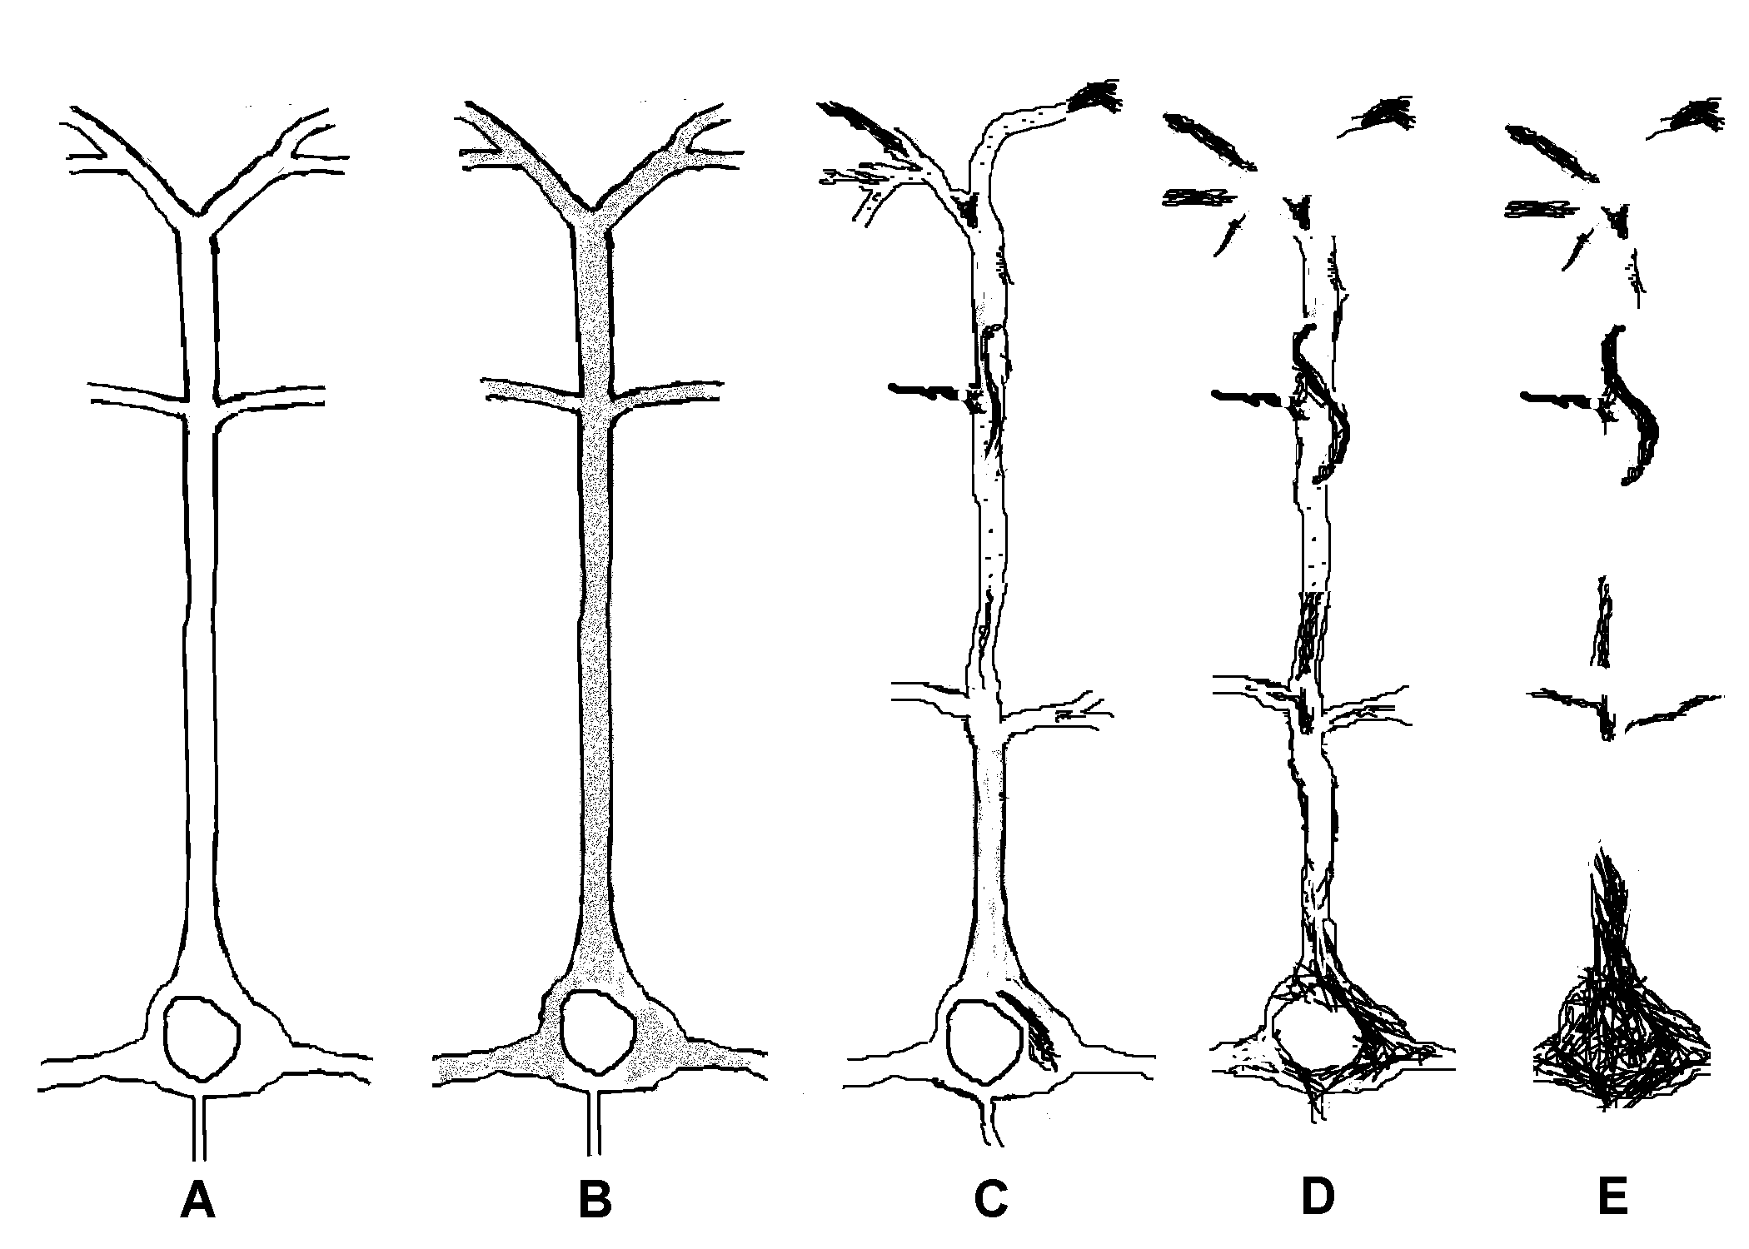
Progression of tau hyperphosphorylation to neuropil threads and neurofibrillary tangles
Ashford et al., 1998, J Neuropathol Exp Neurol.57:972

Slide 39
To Screen and Quantitate Dementia, and Test Therapeutic Modalities, Need Rapid Assessment of Episodic Memory Function
Importance of episodic memory assessment
Disruption in many conditions – Alzheimer’s disease, cerebral hypoxia, etc.
Major concerns for driving, TBI, anesthesia, chemobrain, ICU psychosis
Challenges
The precise measurement of memory
Lack of short assessment tools
Cognitive assessment tools that can be used in a variety of settings (on-line)
Test stability across administrations
Test-retest learning
Tiredness, confusion with repeated testing
Engagement

Slide 40
Issues for Memory Testing
Current testing for memory problems is based on having a tester sit in front of a subject for a prolonged period of time and administer unpleasant tests
Testing must be
Extensively and frequently administered
Inexpensive (minimal need for administrator)
Fun (so people will return for frequent testing)
More precise, reliable, and valid
To improve sensitivity
To improve specificity

Slide 41
Issues for Alzheimer Measurement
The problem in Alzheimer’s disease is dementia
The build up of plaques and tangles and the loss of blood flow is a sign of an underlying process, not the cause of the dementia
Dementia is most related to loss of synapses, but the loss selectively affects the most neuroplastic synapses
Accurate, relevant assessment of dementia must directly measure episodic memory

Slide 42
Current Memory Assessments are Inadequate
Problems
Large practice effects over time
Lack precision of analysis and huge data
Require trained experts to administer
Require special equipment/environment
Time intensive (for rater and subject)
High cost
Not tech or mobile friendly
Limited, or no ability to customize
Limited ability for individuals, healthcare providers, and researchers to precisely measure & monitor memory
Tsoy, Zygouris, Possin. 2021
Current State of Self-Administered Brief Computerized Cognitive Assessment for Detection of Cognitive Disorders in Older Adults: A Systematic Review.
J Prev Alz Dis. 3(8): 267-276

Slide 43
“What you can’t measure you can’t treat”
Need better measurement systems for screening, longitudinal assessment, outcome evaluation
Major push by NIA to develop better systems for cognitive and memory measurement
www.detectcid.org
www.memtrax.com
Development of on-line registry programs to assemble populations at risk for dementia and Alzheimer’s disease
Monitor change over time

Slide 44
Ideal Dementia Screening Test
Need test to screen patients for Alzheimer’s disease
Test needs to be on multiple platforms:
Doctor’s offices (6th VITAL SIGN)
Best if computerized for rapid, objective assessment
World-Wide Web – based testing,
Smart-phone, tablets (HTML-5, WordPress)
KIOSK administration – drug stores, shopping malls
Test needs to be very brief (less than 2-minutes)
Multiple test forms needed so it can be repeated often (quarterly)
Screening should be done yearly after age 50, and repeated every 3 months for individuals over 65 years of age or with concerns – variety of versions allow daily as an excercise
Any change over time needs to be detected (monthly if concern)
The test should be free initially, nominal cost available universally
Such a test is available: www.memtrax.com

Slide 45
MemTrax A Memory Assessment System based on a continuous performance task (CPT) which is widely used in episodic memory research
Shows 50 pictures – of a set of 3,000 pictures, 60 pictures in each of 50 categories, verbally foiled, colorful, interesting
25 pictures are unique, 20 are repeated once, 5 are repeated twice
The instruction is when a picture is seen for the first time, for the subject to look at it carefully and try to remember it (3 seconds).
The subject is instructed to respond (space-bar press, screen-touch) as quickly as possible when a repeated picture is seen.
The test takes 90 seconds for a fast and perfect performance and 150 seconds (2.5 minutes) if no responses are made.

Slide 46
MemTrax - Memory Test (on-line version)
Test to screen for memory function and change
Available on any platform
Determines percent correct and recognition time
Measures episodic memory, inhibition, reaction time
Test takes 1.5 to 2.5 minutes
Test can be repeated often (even multiple times daily, minimal learning over repeated tests)
High test-retest consistency
Change over time sensitively detected
Captures 64% of the variance of the MoCA, at least as good ROC
www.memtrax.com
www.brainhealthregistry.com
Ashford et al., 2019; Hoek et al., 2019; Bergeron et al., 2019

Slide 47
To test neuroplasticity:
Highly precise measures of memory performance required
www.memtrax.com A 2-minute Continuous Recognition Task

Slide 48
Primary MemTrax Metrics:
Percent Correct, Response Speed
Additional Calculations include Reaction Time Variability
Multiple repetitions reduce standard error of measurement

Slide 49
Others (of many)
MemTrax Advantage
Computerized cognitive tests
Easy, quick, and longitudinal
CANS-MCI
CAMCOG / CANTAB
CAMCI
CogState MCI/AD
CST (Computerized Self Test)
IN/WN (IntegNeuro/WebNeuro)
Mindstreams (NeuroTrax)
MC-CARE
Staying Sharp (AARP)
Easier to administer––established model of self-administration
Works across platforms
Faster to administer
More precise in measurement of episodic memory
Better ability to track memory performance over time
Manage huge data sets, low cost

Slide 50
Massive Internet Testing Using a Memory Health Registry
Initial test – recruiting one million participants, include genotyping (GWAS)
Assess compliance, progression – frequency, reliability, consistency of measures
Demographic, Clinical, Behavioral questionnaires
Determine health habits, medication usage, etc. - determine correlates of progression
Intervention testing
Request for participants to participate in selective intervention trials
Can set up trials for subjects anywhere - to receive randomly designated treatments by mail
Assess outcomes using MemTrax or similar on-line tool –
Encourage all subjects to take a large number of tests (many per day, daily, weekly, monthly)
Standard error drops by the square root of the number of tests taken
Large numbers of subjects and tests will provide accurate estimates of intervention effects

Slide 51
Secondary Screen: Specific Testing
More cognitive testing
Complete orientation testing
Ask for recall of 5 items
Test naming ability, animals, 1 min
Ask questions about Activities of Daily Living
Ask questions about depression, sleep
Talk with a knowledgeable informant
To confirm level of neurocognitive and daily function
Assess diagnostic factors (e.g., DSM5- neurocognition)
Provide estimate of function on TIME-INDEX continuum

Slide 52
Comprehensive Screening Plan
At age 50 – initial screen, review risks
Consider dementia family history
Review of Systems, Vital Signs
Brief Cognitive Evaluation
CBC, B12, cholesterol
Begin yearly assessments if high risk
At ages 55, 60 - Follow-up assessments
Review of Systems, Vital Signs
Brief Cognitive Evaluation
CBC, B12, cholesterol
At age 65 - Beginning annual assessments
Review of Systems, Vital Signs
Brief Cognitive Evaluation
CBC, B12, cholesterol

Slide 53
Path to Better Tools for Early AD Assessment
Genetic vulnerability testing (trait risk)
Vulnerability factors (education, occupation, head injury)
Early recognition (10 warning signs)
Activities of Daily Living (ADLs), behavior changes, forgetting
Developing suspicion - screening tools
Brief memory measure - 6th vital sign in elderly
Positive diagnostic tests
Blood tests – developing – tau levels, amyloid levels
CSF (cerebrospinal fluid) – tau levels elevated; amyloid levels low
Brain scan – PET – DDNP, Congo-red derivatives
Mild Dementia severity assessments
Detecting early change over time
measuring rate, predicting progression

Slide 54
Full Dementia Assessment – 1 hour
History Of Dementia Development (30 min)
Ask the Patient What Problem Has Brought Him to See You
Ask the Family, Companion about the Problem
Specifically Ask about Memory Problems
Ask about the First Symptoms
Enquire about Time of Onset
Ask about Any Unusual Events Around the Time of Onset, e.g., stress, trauma, surgery
Ask about Nature and Rate of Progression, Activities of Daily Living
Physical Examination (5 minutes)
Neurological Examination (5 minutes) (vibration sense)
Neuropsychological Assessment (20 minutes)
Routine Laboratory Tests
Brain Scan (CT at minimum, add PET optimally)

Slide 55
TOP 10 HEALTHY BEHAVIORS to Prevent AD
Exercise – walking, running, swimming, bicycling, yoga, Pilates
Increase osteocalcin
Increase BDNF
Diet (continually monitor and improve your diet)
Mediterranean
Omega-3-fatty acids (may be critical for APOE-e4 -Yassine)
Maintain a healthy Body Mass Index (BMI)
Maximize mental stimulation - Education – early and continued
Socialization – attend to your social network
Sunlight (keep your vitamin D in upper mid-range normal)
Avoidance of toxic and intoxicating substances
Safety – avoid traumatic brain injuries (for contact sports – use helmet)
Sleep – (6-8 hours per night, consider use of melatonin, trazodone)
Monitor your physical health (BP, cholesterol, glucose, B12) and your mental, cognitive, and memory health
(monitor on-line: www.memtrax.com )
(Ashford, since 2000)

Slide 56
None of the prevention suggestions have strong evidence supporting their use - Annals of Internal Medicine, 2018: 4 articles
Evidence for a benefit of physical activity interventions is largely insufficient, multi-domain intervention had low-strength evidence
Brasure et al. (but the FINGER study has some very encouraging evidence)
There is no support for studied pharmacologic interventions for cognitive protection in persons with normal cognition or MCI
Estrogen, raloxifene, anti-hypertensives, NSAIDs, statins, AChEIs
Fink et al.
There is insufficient evidence to support any over-the-counter supplement for cognitive protection
Omega-3-FA, soy, ginko biloba, B vitamins, vitamin D, C or beta-carotene
Butler et al. (but a 2021 report – CITAD – claims 60% protection with multivitamins)
Cognitive training improves performance only in the domain trained
Butler et al. (recent judgment against Lumosity for such claims)
The real problem may be studies with inadequate outcome measures
There is evidence that controlling Blood Pressure is beneficial (? vascular dementia)

Slide 57
Alzheimer prevention and early treatment focus: APP
Decrease APP transcription
Stabilize the APP Switch
Can the APP Switch be controlled by mental, physical exercise, better sleep, more education (probably minor effects)? (? BDNF), bryostatin (PKC, negative trial reported in 2019)
Augment alpha-secretase (ADAM-10) activity (neurotransmitter agents, leptin)
Modulation of beta-secretase effect at APP673 (Icelandic mutation)
BACE inhibitors – important idea, no evidence of benefit
Modify the gamma-secretase cleavage
Gamma-secretase inhibitors – important idea, no evidence of benefit
Can affects of certain NSAIDs (flurbiprofen, ibuprofen) have an early effect on gamma-secretase to prevent Abeta42 from forming and prevent AD, at least in APOE-e4 carriers?
Other gamma-secretase modulators under development
Use statins / Omega-3 fatty acids , DHA to decrease membrane thickness (over many years)
Stimulate Neuroplasticity, support synapses
Exercise to increase BDNF, osteocalcin (possibly repetitive Transcranial Magnetic Stimulation)
LEPTIN to modify central neuroplastic mechanisms, lipid configurations
Abeta deposit removal, anti-bodies, oligomer blockage – no evidence of benefit

Slide 58
Current Possibilities to Prevent AD
Anti-cholinesterase treatments to prevent AD
May need to be started early at very low doses, build up progressively
Has not had any clear benefits
Immunologic therapy to eliminate beta-amyloid
Preliminary trials appear to remove deposits – lower insulin levels
Aducanumab (Aduhelm) approved by FDA – 6/2021 - controversial
Removing brain amyloid deposits does not seem to stop cognitive decline
Specific treatments for APOE modulation
APOE may be related to statin effects, diet, DHA (omega-3-FA for brain)
Diet, exercise may help APOE-e4 carriers (FINGER study)
Leptin may modulate APOE formation, lipid raft thickness
Medication to prevent tau hyperphosphorylation
Lithium and valproic acid, which inhibit GSK-3beta may be helpful
Available and beneficial in open studies, no clinical trials to support

Slide 59
Pathways to Prevent / Treat AD (Dementia)
NMDA receptor modulators (memantine, may soon consider ketamine, Epsom Salts – magnesium sulfate)
Early treatment may prevent excitotoxic neuron damage, with anti-convulsant, extend life
Prevention of beta-amyloid-42 cleavage
Certain NSAIDs may prevent formation – modulation of gamma-secretase
Statins may keep lipid-raft membranes thinner
Therapy to change processing of amyloid protein precursor
Abeta immunologic therapy removes deposits – but no slowing of dementia
Bryostatin may stimulate alpha-secretase to decrease beta products (trial failed, may need to re-position)
Specific treatments for APOE modulation
May be related to statin effects, diet (from birth), DHA (omega-3-FA for brain)
Leptin may modulate APOE formation, lipid raft thickness
Brainstem neurotransmitter augmentation to activate alpha-secretase, decrease beta-cleavage
Norepinephrine (locus coeruleus) neuron protection – formoterol as beta-agaonist
Serotonin neuron (mid-line raphe nuclei) - trazodone to stimulate 5HT receptors
Cholinergic augmentation - Anti-cholinesterase treatments
May need to be started early at very low doses, build up progressively – short acting galanatamine
Medication to prevent tau hyperphosphorylation
Lithium and valproic acid, which inhibit GSK-3beta, may be helpful
Need medications to block AICD induction of tau hyperphosphorylation

Slide 60
Alzheimer prevention and early treatment - Non-APP, Psycho-Social interventions
Develop treatments to control AICD, prevent pTAU excess
(decrease CSF TAU) Lithium, valproic acid (GSK3-beta inhibitor)
Methylene blue (TAU binding),
fluoride (to bind aluminum)
Explore treatments of mitochondria, SIRT1, other proteins (GWAS-SNP):
Resveratrol (red wine - grape skin, CoQ10, curcumin)
Education - decreases Alzheimer risk, many explanations for why
(e.g, better diet, fewer traumatic brain injuries, more cognitive reserve, less stress on memory)
Computer tests to monitor memory, cognition, neuropsychiatric conditions
MemTrax - quick, fun, inexpensive, potentially adaptable to detect very early changes
(No evidence for computer games as benefit or treatment – recent judgement against Lumosity)
Exercise – walking (or running), swimming, bicycling, yoga, Pilates, dance
(increase BDNF vs osteocalcin) – exercise may need to be intense to have benefit
Brain Stimulation – repetitive Transcranial Magnetic Stimulation (rTMS)
Sleep – improvement may decrease AD pathology
Trazodone, melatonin, magnesium

Slide 61
Acetylcholine may prevent Alzheimer pathology
Lithium and valproic acid also inhibit glycogen-synthase-kinase 3-beta (GSK3β)

Slide 62
Future directions for Alzheimer genetics: prevention and early treatment
Understanding the Genes is the key to treating and preventing AD
Genotyping – GWAS will soon be done on all newborns
Large population studies will redefine risk-factors by genotype
Preventive measures based on genetics – life-time intervention
Modify APOE protein to mimic e2, life-time prevention, nutritional therapy? (Yassine)
Transfection, decrease APP transcription, or block APOE action
Treatments based on genetics – could be dietary modification
Specific treatments for APOE modulation
May be related to statin effects, diet, DHA (omega-3-FA for brain)
Leptin may modulate APOE formation, lipid raft thickness
Did APOE-e3/e2 appear because of the addition of meat to the diet 300,000 years ago

Slide 63
Publications and Research Directions
Published Works: see PubMed: Ashford JW or Wesson Ashford
Ongoing Studies
Ashford J. W., Gere E., & Bayley P. J. Measuring Memory in Group Settings Using a Continuous Recognition Test. Journals of Alzheimer's Disease. 2011;27(4): 885-895.
van der Hoek MD, Nieuwenhuizen A, Keijer J, Ashford JW. The MemTrax Test Compared to the Montreal Cognitive Assessment Estimation of Mild Cognitive Impairment. J Alzheimers Dis. 2019;67(3):1045-1054. doi: 10.3233/JAD-181003.
Ashford JW, Tarpin-Bernard F, Ashford CB, Ashford MT. A Computerized Continuous-Recognition Task for Measurement of Episodic Memory. J Alzheimers Dis. 2019;69(2):385-399. doi: 10.3233/JAD-190167.
Cholerton B, Weiner MW, Nosheny RL, Poston KL, Mackin RS, Tian L, Ashford JW, Montine TJ. Cognitive Performance in Parkinson's Disease in the Brain Health Registry. J Alzheimers Dis. 2019;68(3):1029-1038. doi: 10.3233/JAD-181009.
Ashford JW. The Dichotomy of Alzheimer's Disease Pathology: Amyloid-β and Tau. J Alzheimers Dis. 2019;68(1):77-83. doi: 10.3233/JAD-181198.
Smith CJ, Ashford JW, Perfetti TA. Putative Survival Advantages in Young Apolipoprotein ɛ4 Carriers are Associated with Increased Neural Stress. J Alzheimers Dis. 2019;68(3):885-923. doi: 10.3233/JAD-181089.
Ashford JW. Treatment of Alzheimer's Disease: Trazodone, Sleep, Serotonin, Norepinephrine, and Future Directions. J Alzheimers Dis. 2019;67(3):923-930. doi: 10.3233/JAD-181106.
Bergeron MF, Landset S, Zhou X, Ding T, Khoshgoftaar TM, Zhao F, Du B, Chen X, Wang X, Zhong L, Liu X, Ashford JW. Utility of MemTrax and Machine Learning Modeling in Classification of Mild Cognitive Impairment. J Alzheimers Dis. 2020;77(4):1545-1558.
Liu X, Chen X, Zhou X, Shang Y, Xu F, Zhang J, He J, Zhao F, Du B, Wang X, Zhang Q, Zhang W, Bergeron MF, Ding T, Ashford JW, Zhong L. Validity of the MemTrax Memory Test Compared to the Montreal Cognitive Assessment in the Detection of Mild Cognitive Impairment and Dementia due to Alzheimer's Disease in a Chinese Cohort. J Alzheimers Dis. 2021;80(3):1257-1267.
MemTrax, LLC is owned and managed by Curtis Ashford
www.memtrax.com - > one million tests taken
UCSF Brain Health Registry includes MemTrax in cognitive testing battery along with self-report data (>30K participants): www.brainhealthregistry.org
China, 30,000 subjects, with MoCA (Liu et al.)
Alzheimer’s Foundation of America, memory screening: www.afamemorytest.com
Analyzing MemTrax data from over 20,000 individuals to norm across age bands, gender and education levels
Notes:
Listed as a cognitive test as part of the Medicare Annual Wellness, visit: https://www.nia.nih.gov/research/cognitive-instrument/search?title=Continuous+Recognition+Test+&field_ct_abbreviation_value

Slide 64
Let’s End Alzheimer’s Disease
J. Wesson Ashford, M.D., Ph.D.
Clinical Professor (affiliated), Department of Psychiatry and Behavioral Sciences
Stanford University
Director, War Related Illness & Injury Study Center (WRIISC)
VA Palo Alto Health Care System
Wes.Ashford@gmail.com washford@medafile.com ashford@stanford.edu
December 1, 2021
www.medafile.com www.memtrax.com www.memtrax.org/n.html
Slides at: http://www.medafile.com/GSdementia-2021.pptx

