Slide 1
Gulf War Illnesses (GWI)
Acetyl-cholinesterase inhibitor withdrawal hypothesis: Tardive Dysautonomia
Research Advisory Committee on Gulf War
August 4, 2021
Health Outcomes Military Exposures (HOME)
J. Wesson Ashford, MD, PhD
Director, WRIISC-CA
VA Palo Alto Health Care System
wes.ashford@va.gov
www.warrelatedillness.va.gov

Slide 2
What is Gulf War Illness (GWI)?
A condition that affects 30-40% of Veterans who were deployed to Operations Desert Shield/Storm/Sabre (ODS/S/S)
Collection of symptoms
Weak diagnostic criteria
No accepted pathophysiological explanation
Variety of unestablished biomarkers
No specific treatment

Slide 3
Results of Iowa Study – 3,695 Veterans:
Symptoms, % Prevalence
 | GW Veterans |  | Non-GW Veterans
Fibromyalgia | 19.2 |  | 9.6
Cognitive Dysfunction | 18.7 |  | 7.6
Alcohol Abuse | 17.4 |  | 12.6
Depression | 17.0 |  | 10.9
Asthma | 7.2 |  | 4.1
PTSD | 1.9 |  | 0.8
Sexual Discomfort | 1.5 |  | 1.1
Chronic fatigue | 1.5 |  | 0.3
Iowa Persian Gulf Study Group, 1997

Slide 4
Most Frequent Symptoms, Affected Systems of Veterans from Gulf War 1
Frequency of Symptoms of 53,835 Participants in VA Registry (1992–1997)
Symptoms Percentage
  Fatigue 20.5
  Skin rash 18.4
  Headache 18.0
  Muscle and joint pain 16.8
  Loss of memory 14.0
  Shortness of breath 7.9
  Sleep disturbances 5.9
Systems
  Musculoskeletal and connective tissue 25.4
  Mental disorders 14.7
  Respiratory system 14.0
  Skin and subcutaneous tissue 13.4
  Digestive system (irritable bowel syndrome) 11.1 SOURCE: Murphy
  Chest pain 3.5 et al., 1999
Symptoms of fibromyalgia

Slide 5
2012-2013 VA Follow-up Study on
30,000 Gulf War Veterans
44% still reported symptoms consistent with unexplained multi-symptom illness
Deployed Veterans continue to report:
  Joint stiffness and chronic pain (fibromyalgia?)
  Fatigue (chronic fatigue syndrome?)
  Gastrointestinal (irritable bowel syndrome?)
  Respiratory concerns (shortness of breath, asthma, respiratory concerns)
  Skin rashes
  Sleep issues (insomnia, loss of circadian rhythm, waking during the night)
  Mental Health (depression, anxiety, mood changes)
  Cognitive dysfunction and memory complaints
Dursa EK, Barth SK, Schneiderman AI, Bossarte RM, 2016
Notes:
Check dursa/schneiderman

Slide 6
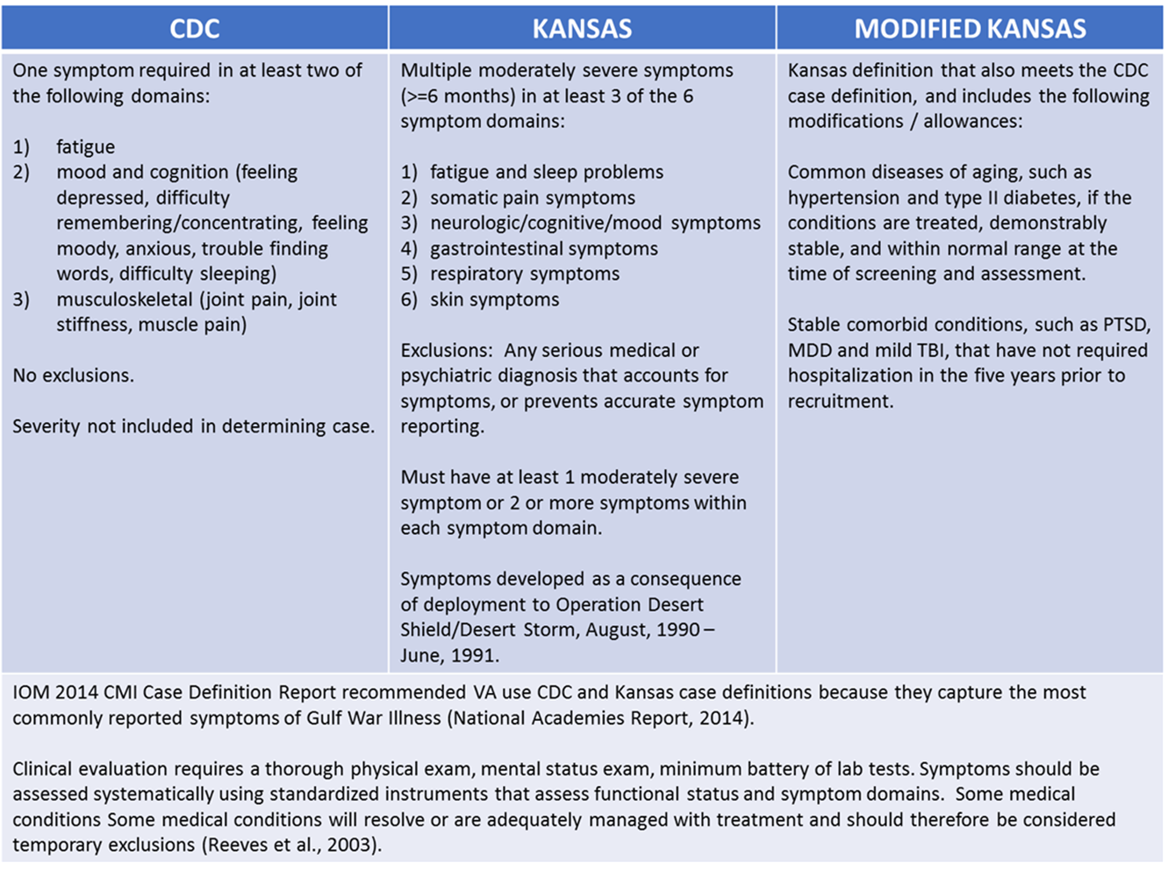
Gulf War Illness criteria for In-Depth Study (NIH/WRIISC DC)

Slide 7
Gulf War Illness Findings
No Identified Diagnostic Entity
Somatic Medical – chronic pain (normal x-rays of joints)
Gastro-intestinal – irritable bowel syndrome (no path changes)
Psychiatric –
  Chronic Fatigue, Sleep Problems, Depression (brainstem disorders)
  neuropsychological dysfunction – borderline but complaints common
Neurological -
  peripheral electrophysiological abnormalities
  normal MRI, PET scans
  abnormal SPECT, MR spectroscopy, DTI of brain stem
Possible relation to other conditions
  chronic fatigue syndrome, fibromyalgia, multiple chemical sensitivity

Slide 8
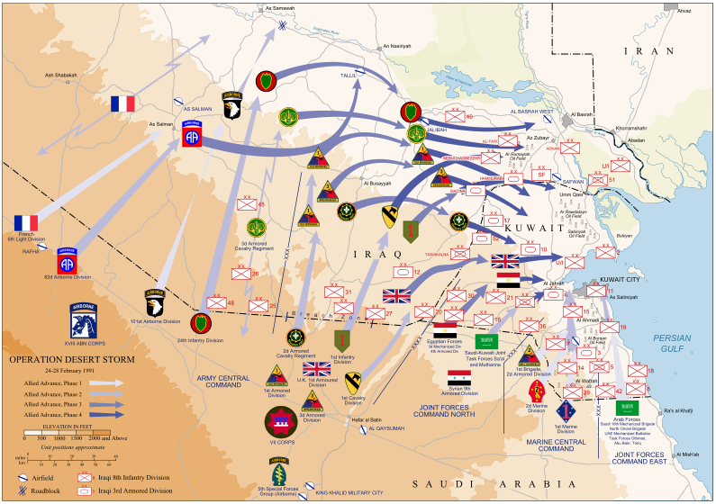
Summary of the Offensive Ground Campaign – troop location ID tool (Operation Desert Sabre)

Slide 9
Operation Desert Shield/Desert Storm
Exposures
CARC Paint
Chemical and Biological Weapons
Depleted Uranium
Harsh living conditions
Incoming fire, explosive events
Industrial solvents and chemicals
Infections
Injuries, musculoskeletal wear and tear
Oil Well Fires, Smoke, and Petroleum
Loud noises
Pesticides
Physical and Mental Stressors
Pyridostigmine Bromide
Sand, Dust, Airborne Particulate Matter
Vaccinations
  Multiple in short period of time
REF: WRIISC Clinical Reports

Slide 10
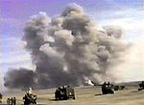
Possible ODS/S/S Chemical
Weapon Exposures
Many chemical alarms sounded, troops told to put on MOPP suits as protection – feared life-threatening attacks
  Anecdotal reports of isolated chemical weapon exposures to nerve agents, however no cases of acute poisoning were documented
  U. S. destroyed ammunition depot in Khamisiyah containing sarin and cyclosarin nerve agents
    DoD notified 100,000 Veterans that they
    may have been exposed to low levels of
    chemical agents
    There were several detonations
  No specific tests available to detect
  sarin or cyclosarin exposure
Initial Cloud from Khamisiyah Explosion
Notes:
MOPP (Mission Oriented Protective Posture)

Slide 11
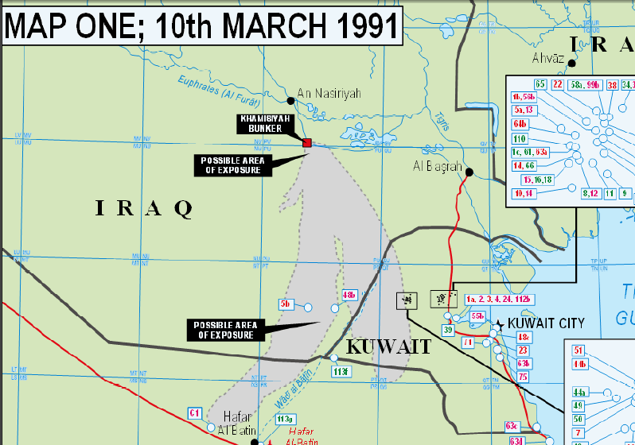
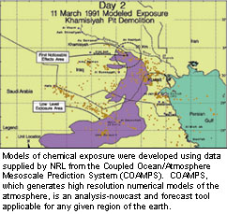
Model of Sarin Exposure from Khamisiyah
DGIA Ministry of Defense, UK, 2004
(several detonations in March)
Due to the fear of sarin exposure, pyridostigmine bromide (PB pills) was given emergency approval for use as a nerve-gas protection and was widely used in this same region.
PB is commonly used as a treatment for myasthenia gravis by neurologists.

Slide 12
Some of the Causes Considered
Chemical Weapons and other chemical exposures
  Acetyl-cholinesterase inhibitors: Sarin and Cyclosarin, Pyridostigmine Bromide (PB), Organophosphate Pesticides, other chemical pesticides
  Other potentially neurotoxic agents: CARC - Chemical Agent Resistant Coating, fuel, decontamination solutions, oil fire smoke
Infectious Diseases
  Leishmaniasis, traveler’s diarrhea, sandfly fever, malaria, and viscerotrophic leishmaniasis found in 12 U.S. veterans
Multiple vaccinations
  Anthrax vaccine containing squalene as an adjuvant (normal skin fat)
  Many vaccinations given close together inducing neural inflammation
Depleted Uranium (no evidence or plausible link)
Aspartame/Methanol Poisoning
  At 85 °F, aspartame breaks down into methanol, formaldehyde
Biological Weapons
  mycoplasma fermentans – may be combined with part of the AIDS virus
    (cover of Popular Science Magazine April 1999 – no support since 2002)

Slide 13
FUNDAMENTAL PROBLEMS
Gulf War Illness is considered to exist
    (Institute of Medicine, 2009)
There has been no recognized “Gulf War Syndrome” since there is no known disease process
    Definition of “syndrome”: “a combination of symptoms and signs that together represent a disease process”
There have been at least 40 theories that have been considered, but none has yielded an acceptable explanation

Slide 14
Nervous System Sites as Possible Attack-points of Gulf War Illness Pathophysiology
Peripheral nerves – sensory, pain, small fiber neuropathy
Autonomic Nervous System - dysautonomia
  Parasympathetic: brainstem (esp: vagus nerve), base of spinal cord
  Sympathetic – spinal cord
Brainstem - Central control of body energy
  Energy feelings/motivation/fatigue/sleep
  Respiration control, respiration during sleep (OSA), lung management
  Cardiac, blood pressure control, blood flow control including brain
  Bowel activity (note highly sensitive to cholinergic, anti-cholinergic drugs)
  Temperature control, skin dilation, blood flow to skin, sweating
  Pain management, control (peri-aqueductal gray)
  Management of anxiety, mood, memory
  Vigilance, awareness of the environment, consciousness (dorsal, RAS, PTSD)
Cortex, basal ganglia
  Direct injury versus compromise of blood flow

Slide 15
Small Fiber Neuropathy
  Can be caused by diabetes, HIV, Erythromelalgia, postherpetic neuralgia, CRPS, alcoholism, and many other nerve pain conditions
  Cause is also commonly idiopathic
  There are no known causes for most cases and most tests do not identify it
  Peripheral nerve fibers that can be affected include peripheral autonomic neurons (acetylcholine, epinephrine)
  Central small nerve fibers could also be affected (acetylcholine, norepinephrine, serotonin)

Slide 16
Plausible biological explanations for small nerve fiber damage
Anti-cholinesterase agents (sarin exposure, combinations, PB predisposal, insecticides, flea collar use, not permethryn).
Spider Bites – biological toxin that could damage small neurons (not infectious agent)
Immunological response – chronic response to infectious agent attacking small neurons (like Guillan-Barre syndrome)
Reaction of body to severe diarrhea or agent that caused severe diarrhea (local fruits, vegetables given to soldiers deployed early, those soldiers deployed later did not seem to get the condition)

Slide 17
Dysautonomia
Dysautonomia is common in fibromyalgia, chronic fatigue syndrome, and irritable bowel syndrome, raising the possibility that such dysautonomia could be their common clustering underlying pathogenesis.
BUT, GWI occurs late in Gulf War Veterans, usually after return
  (tardive; not a dystrophy –may be an excess of connections)
The Gulf War Veterans have many symptoms
  usually unexplained (most have possible autonomic relationship)
  conditions with a clear cause get specific treatment recommendations)
The autonomic nervous system is under control of the brain stem, so dysautonomia can be caused by disruption of the brain stem.

Slide 18
Tardive Dysautonomia in GWI
Acetyl-cholinesterase inhibitor withdrawal hypothesis:
Dysautonomia can account for all GWI symptoms
Since the autonomic nervous system is controlled by the brain stem, any condition affecting the brainstem could explain the condition
Tardive means developing later (tardy), and this term describes the late onset of symptoms associated with GWI, i.e., weeks, months, or even years after return
Acetyl-cholinesterase is an enzyme which breaks down the neurotransmitter acetylcholine, which is the primary neurotransmitter of the autonomic nervous system (including the Vagus Nerve), the neurons which innervate all muscles (including smooth muscles).
There are acetylcholine neuronal cell bodies in several nuclei of the brainstem and the basal ganglia
Many ODS/S/S soldiers took pyridostigmine bromide (PB tablets) a peripherally acting inhibitor of acetyl-cholinesterase (to protect against fatality if exposed to sarin nerve gas, also a cholinesterase inhibitor), including most of those reporting symptoms suggestive of GWI. Some of the insecticides the soldiers were exposed to were also cholinesterase inhibitors (not DEET).

Slide 19
Tardive Dysautonomia in GWI (cont.)
Acetyl-cholinesterase inhibitor withdrawal hypothesis:
While exposed to cholinesterase inhibitors, the cholinergic synapses will have an excess of acetylcholine
PB tablets (pyridostigmine is a cholinesterase inhibitor which is a “polar compound” that tends not to enter the brain) will increase the acetylcholine at peripheral synapses. PB effects include increase bowel motility, slowing of the heart rate, and many other changes
In response to excess acetylcholine, neurons will down-regulate the neurotransmitter receptors (muscarinic in the case of the autonomic nervous system) and increase production of acetyl-cholinesterase molecules
When the cholinesterase inhibitor is removed (e.g., PB, other), there is an excess of acetyl- cholinesterase and decrease cholinergic activation. So, target neurons responsively produce “nerve growth factor” (NGF), which is retrogradely transported to the neuronal cell bodies (in the brain stem) to stimulate the acetylcholine neurons to grow more connections
The excess sprouting of autonomic nervous system axons (nerve fibers) can explain the excess pains, the chronic fatigue (constant efforts to conserve energy), and the irritable bowel syndrome (Vagus Nerve) as well as neurocognitive and dermatologic conditions (skin blood flow is managed by the autonomic nervous stem)

Slide 20
NGF (nerve growth factor)
Autonomic neurons leaving the brain and spinal cord are all cholinergic, as are post-ganglionic parasympathetic neurons, but sympathetic post-ganglionic neurons are noradrenergic
NGF stimulates the outgrowth of sympathetic (norepinephrine) post-ganglion fibers
NGF is required by acetylcholine neurons of the brain for survival
NGF injections cause chronic pain syndromes
  (seen in Alzheimer’s disease subjects in a clinical trial)
NGF genetic abnormalities are associated with a lack of pain sensation (Carvalho et al., 2014)
Sympathetic neurons also moderate gut motility and blood flow everywhere, including the brain, and pathways to the pineal gland moderate sleep and energy levels

Slide 21
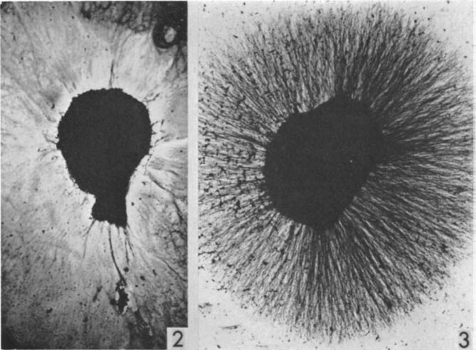
Nerve Growth Factor (NGF) effect (Right) on sympathetic ganglion
Levi-Montalcini, Booker, PNAS, 1960
Levi-Montalcini won the Nobel prize for this image in 1986

Slide 22
Autonomic Nervous System

Slide 23
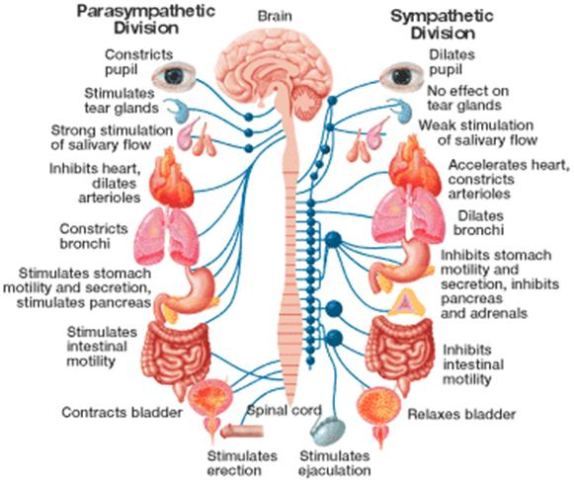

Slide 24
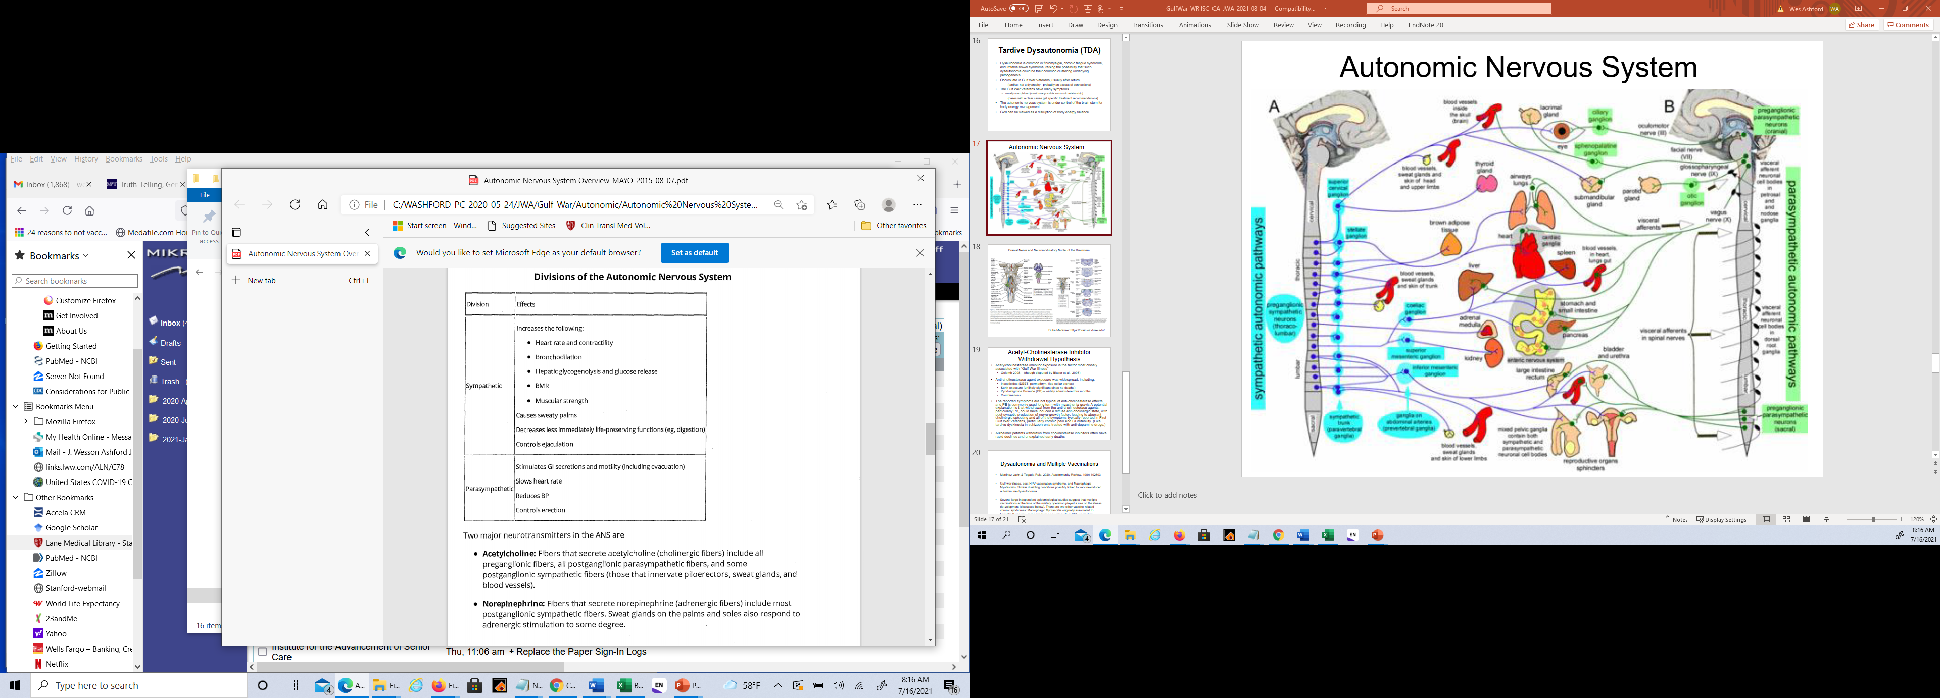
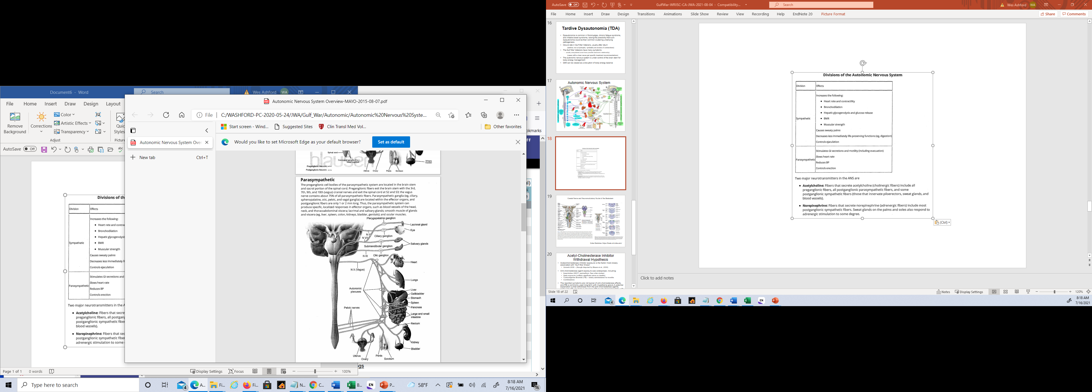
The two major neurotransmitters in the ANS are:
Acetylcholine: Fibers that secrete acetylcholine (cholinergic fibers) include all preganglionic fibers, all postganglionic parasympathetic fibers, and some postganglionic sympathetic fibers (those that innervate piloerectors, sweat glands, and blood vessels).
Norepinephrine: Fibers that secrete norepinephrine (adrenergic fibers) include most postganglionic sympathetic fibers. Sweat glands on the palms and soles also respond to adrenergic stimulation to some degree.

Slide 25
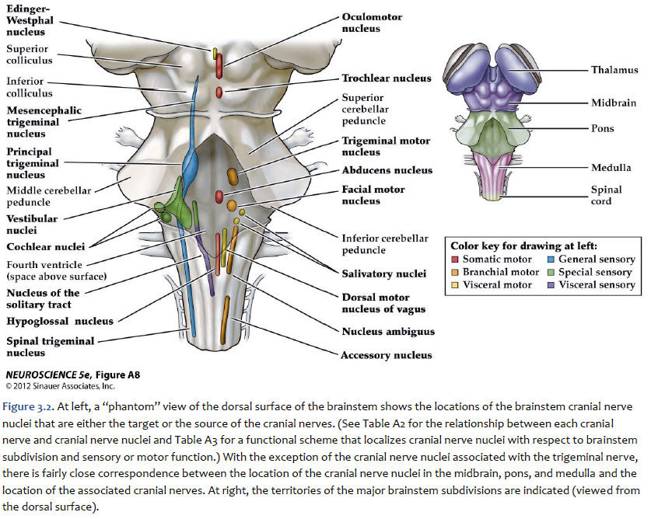
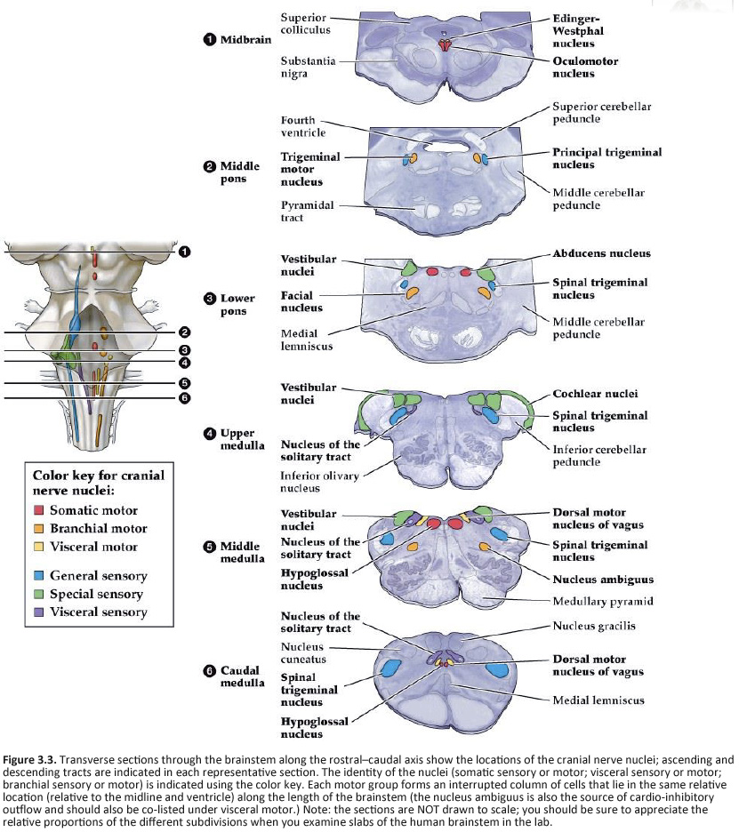
Cranial Nerve and Neuromodulatory Nuclei of the Brainstem
Duke Medicine: https://brain.oit.duke.edu/

Slide 26
Chronic Pain Syndromes
Chronic Regional Pain Syndrome (CRPS)
(described as the most painful long-term condition)
  Type 1: Reflex Sympathetic Dystrophy (RSD)
      No demonstrable nerve lesions
  Type 2: Causalgia
      Related to specific nerve injury – presumably sympathetic nerve pathways
Chronic Pervasive Pain Syndrome (CPPS)
  Tardive Sympathetic Dysautonomia (TSD)
      possibly NGF related – excess connections
      Difficult to determine histopathologically

Slide 27
SPECT Brain Scans
SPECT (single photon emission computed tomography) shows cerebral blood flow, which is controlled by the autonomic nervous system and local neural activity.
Comparisons of normal, PTSD, Alzheimer patients with
10 Veterans (1-10) of ODS/S/S with GWI symptoms including memory complaints.

Slide 28
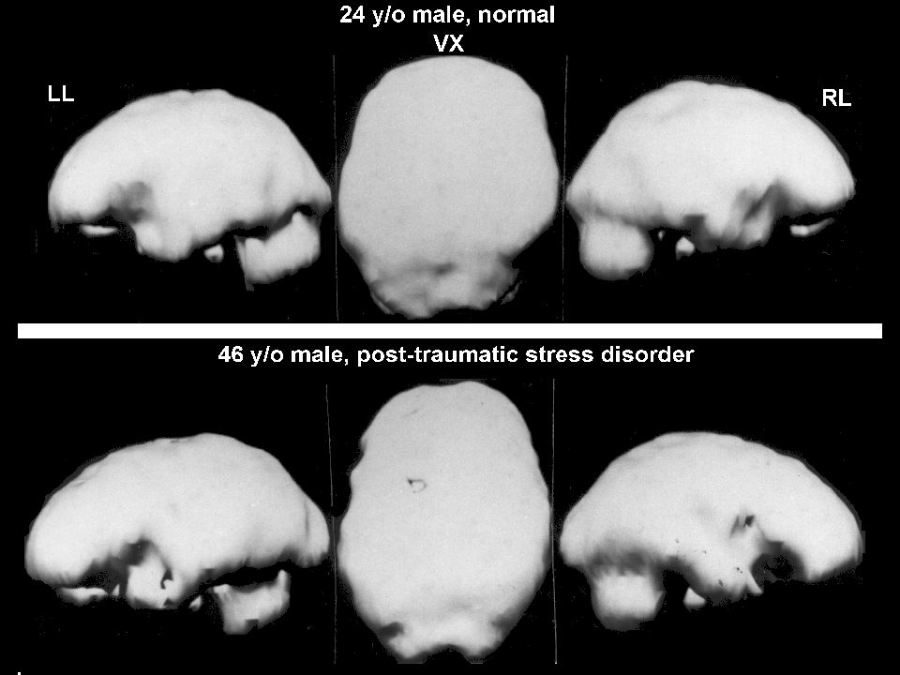

Slide 29
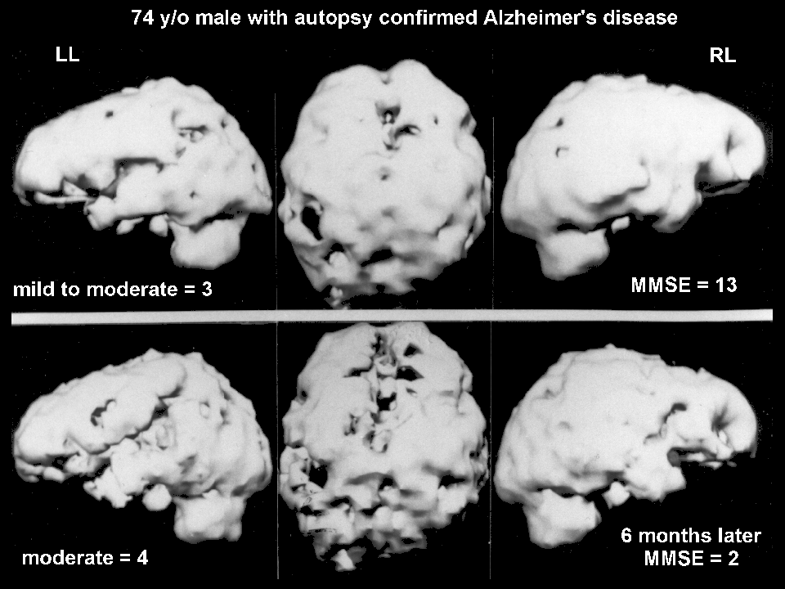

Slide 30
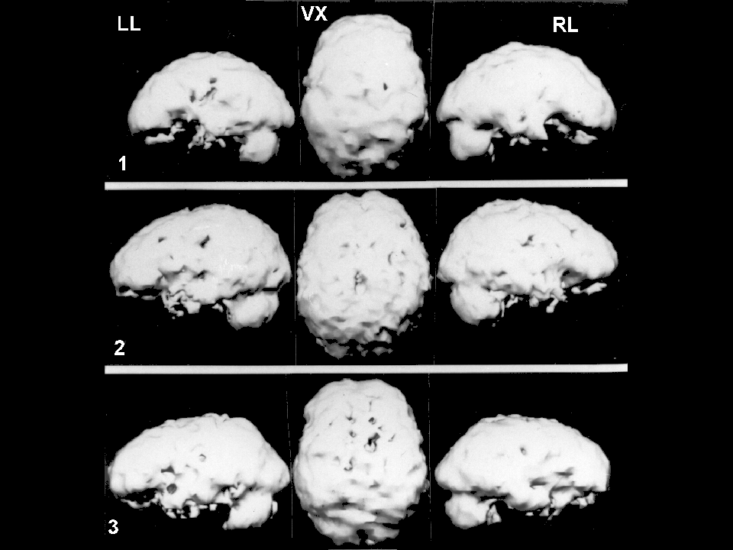

Slide 31
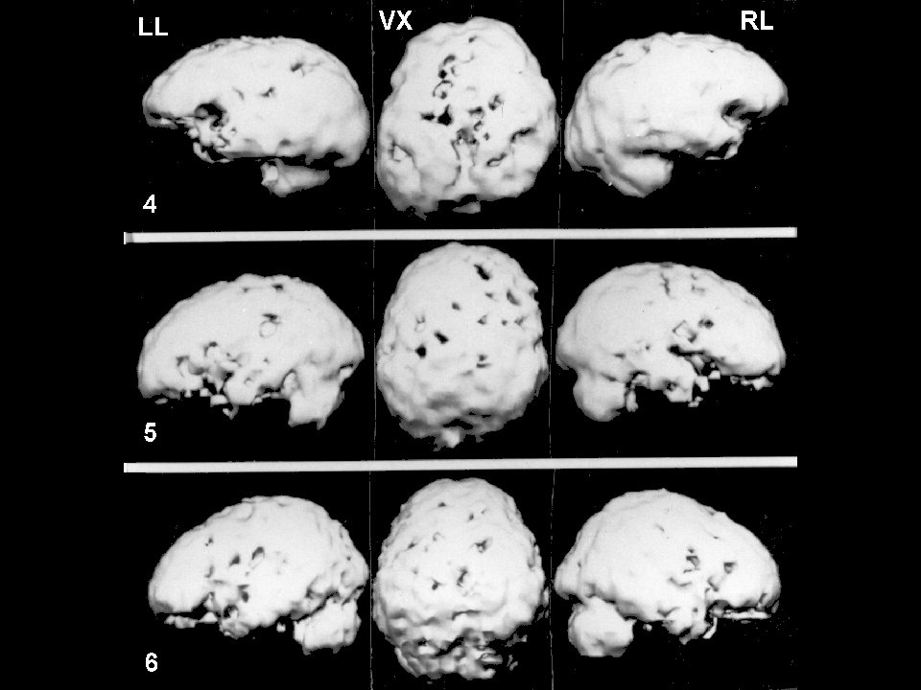

Slide 32
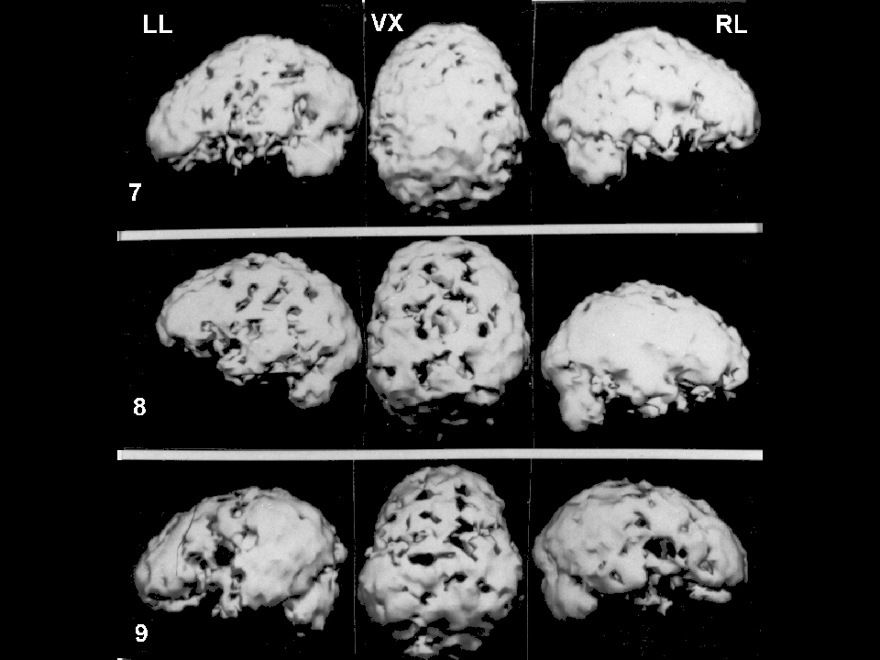

Slide 33
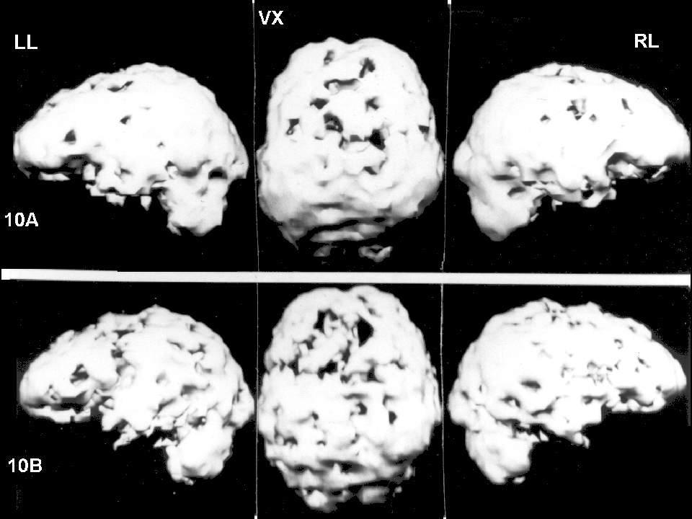

Slide 34
Brain Function Changes in Veterans of ODS/S/S Referred for Memory Complaints
SPECT gradations (n=49)
SPECT grade N Average Age
0 (normal) 4 38 years
1 (near norm) 4 36
2 (mild) 14 40
3 (mild-mod) 17 36
4 (moderate) 4 40
5 (mod-severe) 3 29
6 (severe) 3 31
(All Veterans had normal MRI brain scans)
Ashford & Shih, VA Lexington, 2002, unpublished

Slide 36
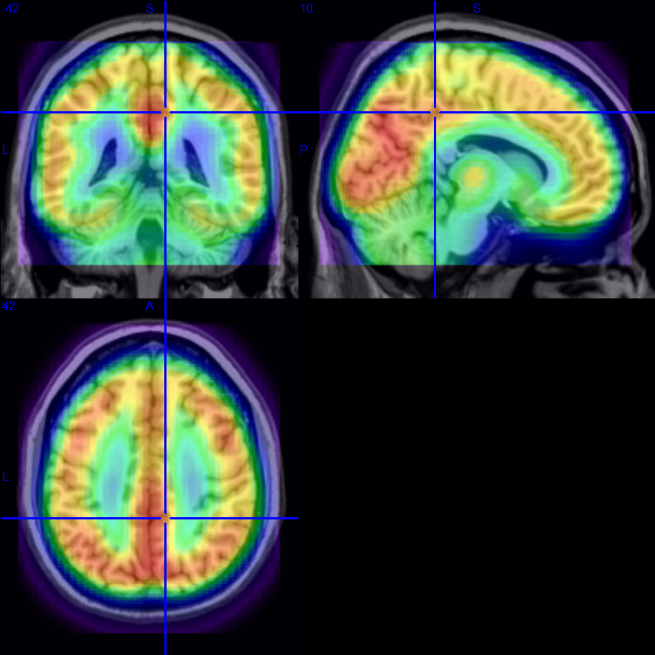
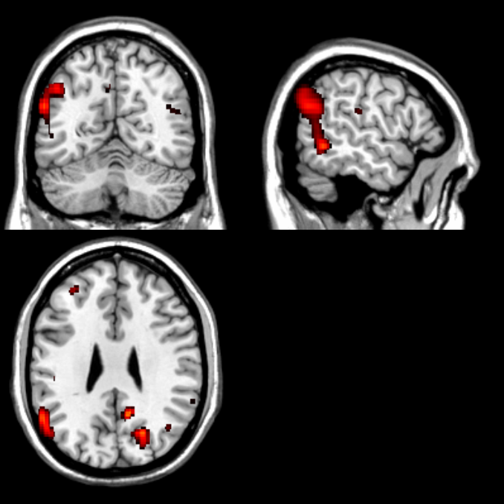
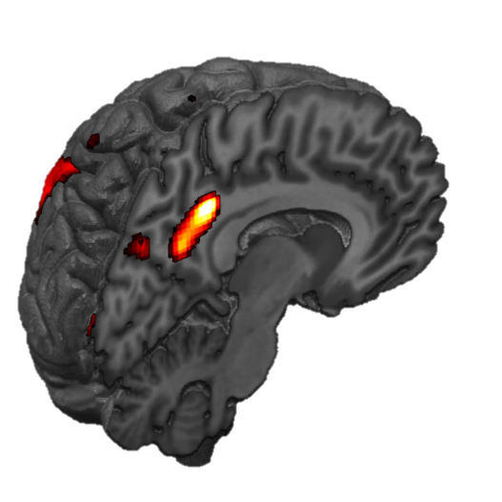
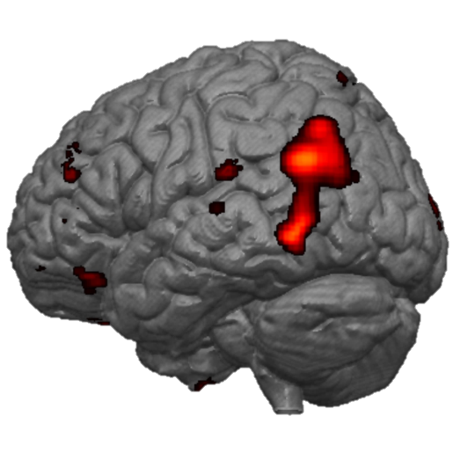

PET scan in WRIISC Veterans with TBI
Evaluation of WRIISC Veterans (n=50, mean age 46), with history of varying degrees of TBI (mild=27, moderate=5; GW1=15) or not (18; GW1=11) demonstrating areas of hypometabolism in precuneus and angular gyrus when controlling for age, CAPS score.

Slide 37
Significance of SPECT changes in Gulf Vets with memory complaints
Cortical gradations relative to normal elderly:
  significance of abnormality: p < 10⁻⁹
The pattern of changes on the cortex involve all, including primary, cortical regions, unlike Alzheimer’s disease.
Decreased perfusion in thalamus, basal ganglia
Smaller changes on PET scans
  (PET scans may reflect metabolism, which is less affected)
Difference suggests that problems are due to cerebral blood flow dysregulation, symptom of brainstem dysfunction and dysautonomia, not a metabolic problem

Slide 38
Brain Volume Changes in GWI
Two Subgroups with Altered Brain Structure and Function
  Post-exertional malaise with orthostatic tachycardia correlates with brainstem atrophy
  Post-exertional malaise with exercise induced hyperalgesia correlates with cortical atrophy
  Rakib U. Rayhan, Benson W. Stevens, Megna P. Raksit, Joshua A. Ripple, Christian R. Timbol, Oluwatoyin Adewuyi, John W. VanMeter, James N. Baraniuk. PlosOne (2013)
Subcortical brain atrophy in Gulf War Illness
  Highest atrophy was observed in the brainstem
  Graded atrophy of regions anatomically connected through the brainstem via the crossed superior cerebellar peduncle (left cerebellum → right thalamus, right cerebellum → left thalamus)
  Distribution of atrophy and systematic reduction in volume of other subcortical areas (basal ganglia, amygdala and diencephalon), resembles the distribution of atrophy seen in toxic encephalopathy
  Peka Christova, Lisa M. James, Brian E. Engdahl, Scott M. Lewis, Adam F. Carpenter & Apostolos P. Georgopoulos. Experimental Brain Research (2017)
Brainstem atrophy in Gulf War Illness
  Significant subcortical atrophy, but no cortical differences, in the GWI group relative to controls
  Largest effect in the brainstem, followed by ventral diencephalon, the thalamus
  Smaller brainstem volumes were significantly correlated with increased severities of fatigue and pain symptoms.
  Yu Zhang, Timothy Avery, Andrei A. Vakhtina, Danielle C. Mathersul, Eric Tranvinh, Max Wintermark, Payam Massaband, J. Wesson. Ashford, Peter J. Bayley, Ansgar J. Furst. NeuroToxicology (2020)

Slide 39
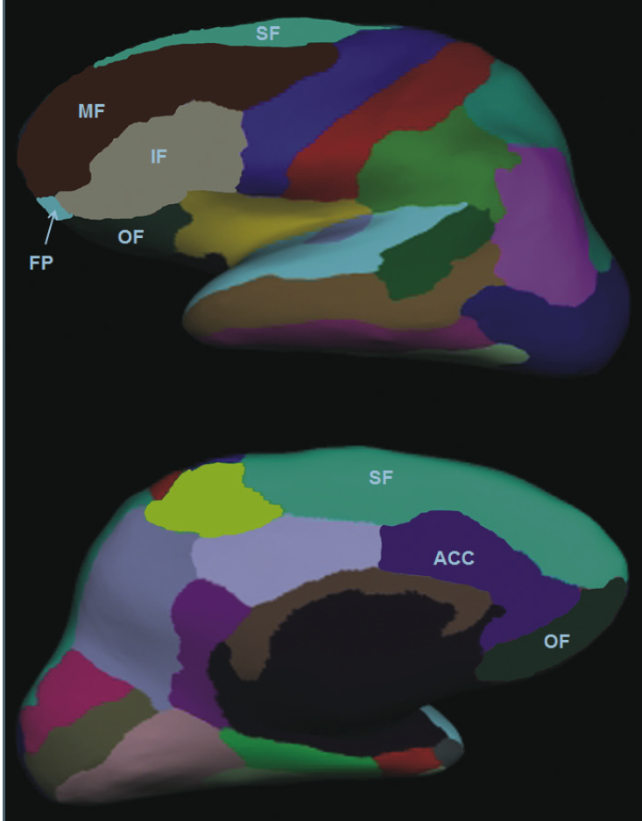
Gulf War Veterans’ Pittsburgh Sleep Quality Index declines with gray matter loss
total
frontal
Freesurfer analysis
L.L. Chao; BS. Mohlenhoff; M.W. Weiner; T.C. Neylan, 2014

Slide 40
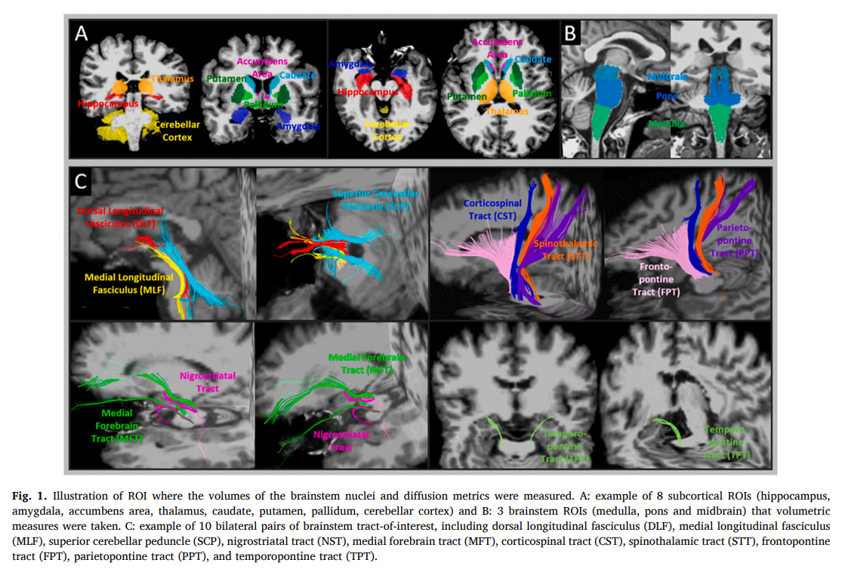
Brainstem damage is associated with poorer sleep quality and increased pain in gulf war illness veterans
Yu Zhang a,* , Andrei A. Vakhtin c , Jessica Dietch a,b , Jennifer S. Jennings a , Jerome A. Yesavage a,b , J. David Clark a,b , Peter J. Bayley a,b , J. Wesson Ashford a,b , Ansgar J. Furst a,b a - War Related Illness & Injury Study Center (WRIISC), VA Palo Alto Health Care System, Palo Alto, CA, United States b Stanford University, Stanford, CA, United States c The Mind Research Network, Albuquerque, NM, United States. Life Sciences 280 (2021) 119724.

Slide 41








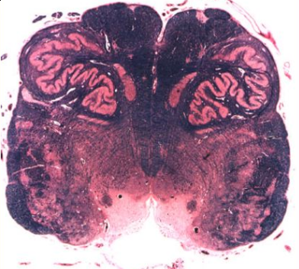
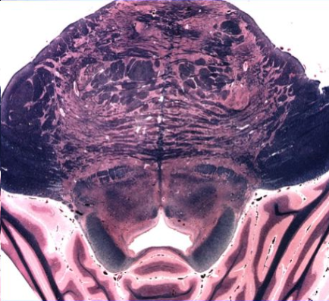
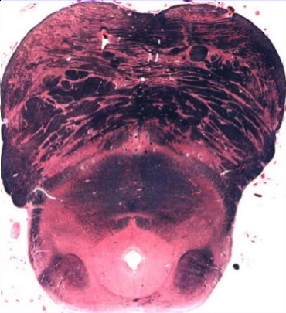
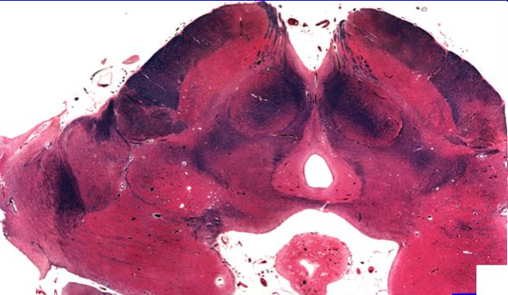
Axial sections of anatomic structures on reticular fiber maps, color-FA and atlas
MFT- medial forebrain tract
STT- spinothalamic tract
NS- nigrostriatal tract
SCP- superior cerebellar peduncle
DLF- dorsal longitudinal fasciculus
MLF- medial longitudinal fasciculus
CST- corticospinal tracts
TPF- transverse pontine fibers
ML- medial lemniscus
STT- spinothalamic tract
CTT- central tegmental tract
MCP- middle cerebellar peduncle
SCP- superior cerebellar peduncle
ICP- inferior cerebellar peduncle
DSCP- Decussation of superior cerebellar peduncle
Pym- Pyramid tract
CP- cerebral peduncle
IO- inferior olivary nucleus
ATR- anterior thalamic radiation
RaN- raphe nucleus
DRN- dorsal raphe nucleus
PAG- periaqueductal gray
TegN- tegmental nuclei
LC- locus coeruleus
HypoT- hypothalamus
RN- red nucleus
LG- lateral geniculate nucleus
CTR- cerebellotalamic tract
MLF
MLF
STT
MFT
STT
NS
MFT
NS
DLF
MFT
MLF
DLF
NS
STT
DLF
SCP
SCP
SCP
MCP
Pym
ML
CST
CST
IO
TPF
TPF
ATR
ML
CTT
DSCP
CP
STT
ML
CTT
ML
RN
ICP
MCP
MLF
STT
SN
ML
SCP
CTT
DLF
SCP
ML
ML
HypoT
RN
STT
CTT
DSCP
CTR
ML
MLF
SN
ICP
RN
STT
ML
SCP
CTT
LC
DLF
MLF
DRN/PAG
DLF
MLF

Slide 42

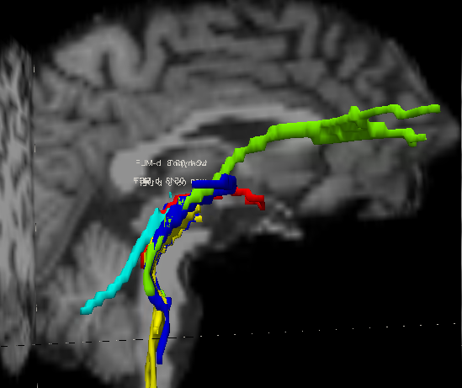
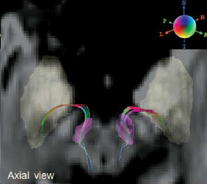
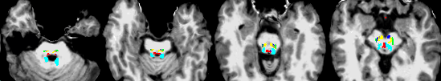
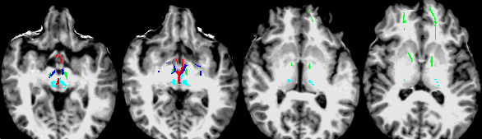
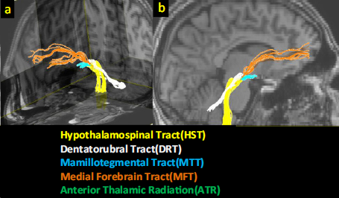
Consistency with literature
MLF
MFT
ns
DLF
ns
SCP
LC
MLF
Y. Zhang et al. 2015
SCP
PPN
DLF
MFT
MFT
DLF
NS
SCP
MLF
MFT = medial forebrain tract
SCP = superior cerebellar peduncle
NS = nigrostriatal tract
DLF = dorsal longitudinal fasciculus
MLF = medial longitudinal fasciculus
Pedunculopontine
PPN = Pedunculopontine nuclei
LC = locus coeruleus
J.F. Gálvez et al. 2015

Slide 43
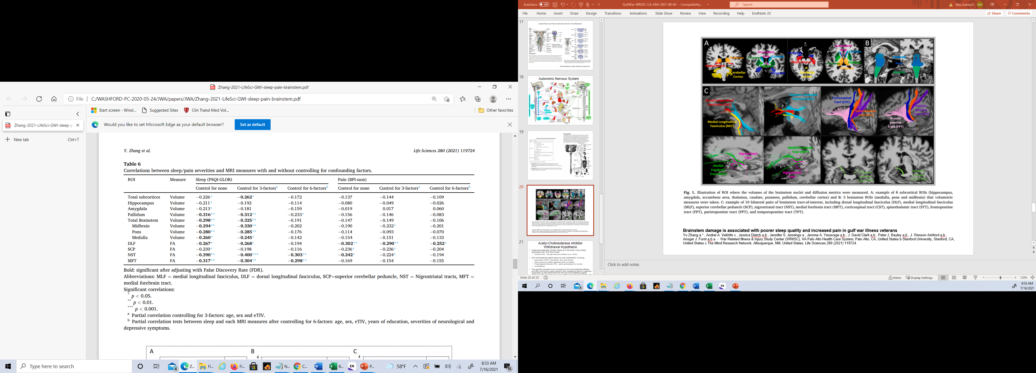
Brainstem atrophy and loss of FA in brainstem tracts
Such damage could cause dysautonomia

Slide 44
Explanation of DTI (diffusion tensor imaging) tractography
And relationship to brainstem functions affected in GWI
Reticular tracts – fibers project to deep nuclei and subcortical gm regions
 | Fiber name | Also includes or other names | Pathing (projecting) key regions | Functional pathway | Possible functions
MFT | Medial forebrain tract | anterior thalamic radiation; | Lateral tegmentum – hypothalamus and NAc – ATR – VMPFC, VLPFC | Cholinergic | Major depression, reward and pleasure
SCP | Superior cerebellar peduncle | Pedunculopontine projection | Cerebellar DN – PPN – SCP – Thalamus | cholinergic | sleep, cognition, mood, attention, arousal
NS | Nigrostriatal tract | VTA projections; mesocortical pathway | VTA and SNc – STN – Amygdala,HP – putamen | Dopamine, Serotonin | Motor function, mood, pleasure and reinforcement
DLF | dorsal longitudinal fasciculus | Mamillotegmental Tract, hypothalamospinal Tract, Rostral Raphe, | LC – PAG – hypothalamus – mamillary body | Serotonin, Noradrenaline, Histamine | sleep-waking cycle; consciousness, stress and reward;
MLF | medial longitudinal fasciculus | central tegmental tract, rubrospinal tract, medullary Raphe, | dorsal spinal cord – anterior to DLF – inferior to red nuclear | Serotonin, Noradrenaline | pain threshold; cardiovascular control
VMPFC = ventral medial prefrontal cortex
VLPFC = ventral lateral prefrontal cortex
ATR = anterior thalamic radiation
VTA = ventral tegmental area;
DN = dentate nucleus (cerebellum);
PAG = periaqueductal area
LC = locus coeruleus
SNc = substantia nigra compacta
STN = subthalamic nuclei
RN = red nuclei

Slide 45
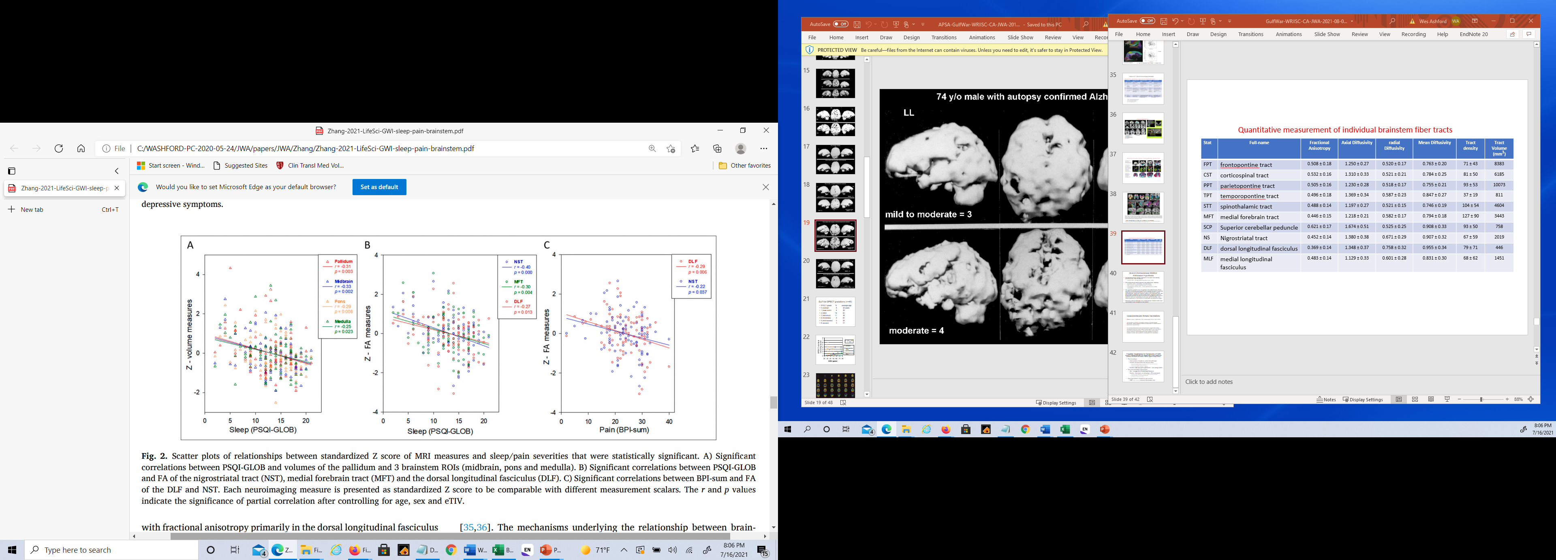
Zhang et al., 2021, Life Sciences

Slide 46
Acetyl-Cholinesterase Inhibitor Withdrawal Hypothesis:
Conclusions
Acetylcholinesterase inhibitor exposure is the factor most closely associated with “Gulf War Illness”
  Golomb, 2008 – (though disputed by Blazer et al., 2008)
Anti-cholinesterase agent exposure was widespread, including:
  Insecticides (organophosphates, flea collar stories)
  Pyridostigmine Bromide (PB) – widely administered for months
  Sarin exposure (unlikely significant since no deaths)
  Combinations
The excess sprouting of autonomic nervous system axons (nerve fibers) can explain the excess pains, the chronic fatigue (constant efforts to conserve energy), and the irritable bowel syndrome (Vagus Nerve) as well as neurocognitive and dermatologic conditions (skin blood flow is managed by the autonomic nervous stem).
The reported symptoms are not typical of anti-cholinesterase effects, and PB is commonly used long term with myasthenia gravis. However, a potential explanation is that withdrawal from the anti-cholinesterase agents, particularly PB, could have induced a diffuse anti-cholinergic state, with post-synaptic production of nerve-growth factor, leading to aberrant cholinergic sprouting and all of the symptoms typically reported in First Gulf War Veterans, particularly chronic pain, chronic fatigue, and GI irritability. (Like tardive dyskinesia in schizophrenia treated with anti-dopamine drugs.)

Slide 47
Dysautonomia and Other Possible Causes
See: Gean et al., 2021 – Life Sciences
  Title: “Biological measures and diagnostic tools for Gulf War Illness – A systematic review”
  Areas of focus – 56 included studies in field: mostly central nervous system, immune system
  Described 5 studies of the autonomic nervous system
  Central nervous system is controlled by brainstem and autonomic nervous system
  Immune system can affect brain and could be explanatory
Recent paper: Martinez-Lavin & Tegada-Ruiz, 2020, Autoimmunity Review, 19(9) 102603
  Title: “Gulf war illness, post-HPV vaccination syndrome, and Macrophagic Myofasciitis. Similar disabling conditions possibly linked to vaccine-induced autoimmune dysautonomia”
  This paper states, “Several large independent epidemiological studies suggest that multiple vaccinations at the time of the military operation played a role on the illness development (see their discussion). There are two other vaccine-related chronic syndromes: Macrophagic Myofasciitis originally associated to hepatitis B vaccine, and a syndrome occurring after HPV vaccination.”

Slide 48
Possible Treatments for Symptoms of GWI
In all cases, treatments must address the symptoms of the Veterans, minimize their discomfort, and maximize their function, emphasize strong healthy behaviors
Pharmacologic
  Avoid narcotics, tranquilizers, central anti-cholinergics
  Consider anti-depressants with anti-pain effects
    With anti-cholinergic effects: Nortriptyline, doxepin (stabilize GI symptoms)
    Without anti-cholinergic effects: duloxetine
    Anti-convulsant agents: gabapentin, pregabalin
  Consider cholinergic agents (galantamine – short acting), lecithin
Non-pharmacologic Approaches
  Diet – management of Irritable Bowel Syndrome (low FODMAP)
  Exercise – low-impact, non-exhausting, > 150 minutes/week:
    Swimming (higher water temperature – need more Masters Swimming Programs)
    Aerobic exercises - elliptical exercise machines
    Stretching and resistance routines (carefully graded to minimize fatigue)
New approaches needed for pain control
  CAM: Yoga, Acupuncture, meditation, mindfulness, etc.
  Noninvasive brain stimulation (TMS) – may help cognition, reorganize brainstem

Slide 49
Care for the Symptoms of Gulf War Veterans
Focus on Brainstem Treatments
Pain – MSK: Rehab/PT/exercise/CAM/acupuncture to help with pain management (?rTMS)
Cognition: Neurocognitive assessment and directed interventions
Fatigue: medical, endocrine evaluation, management, consider metabolic disorders, 24/7 routine, graded increase of exercise
GI: referral to GI Clinic, Dietician for management of Irritable Bowel Syndrome (IBS) (low-FODMAP diet) (? Glycopyrrolate)
Respiratory: Pulmonary or Cardiology for shortness of breath, autonomic dysfunction
Headache/migraine/Neurologic: Neurology assessment for TBI, migraine, balance
Sleep: Sleep clinic evaluation, sleep hygiene, 24/7 routine, exercise, CPAP as needed, ENT referral
Dermatologic: Dermatology for management of skin problems
Mood/PTSD: Evaluation, f/u by Mental Health, monitor for PTSD, depression, substance/opiate dependence and suicide risk

Slide 50
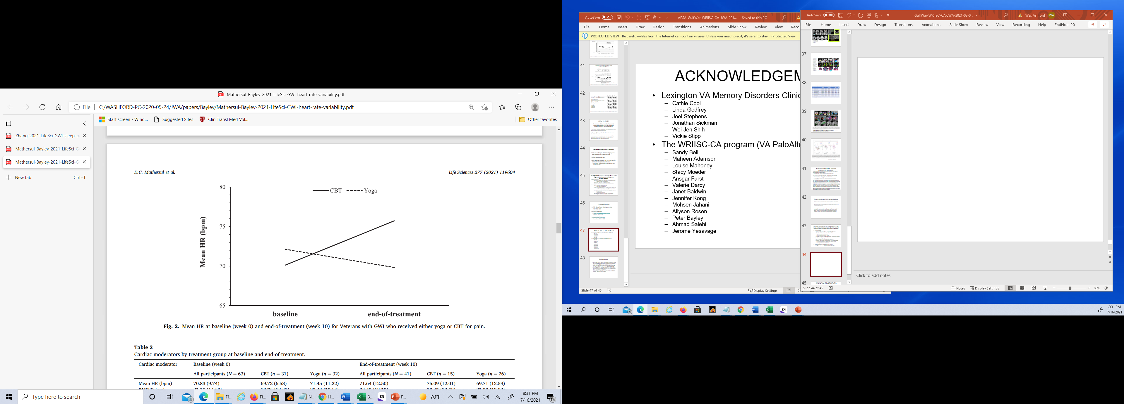
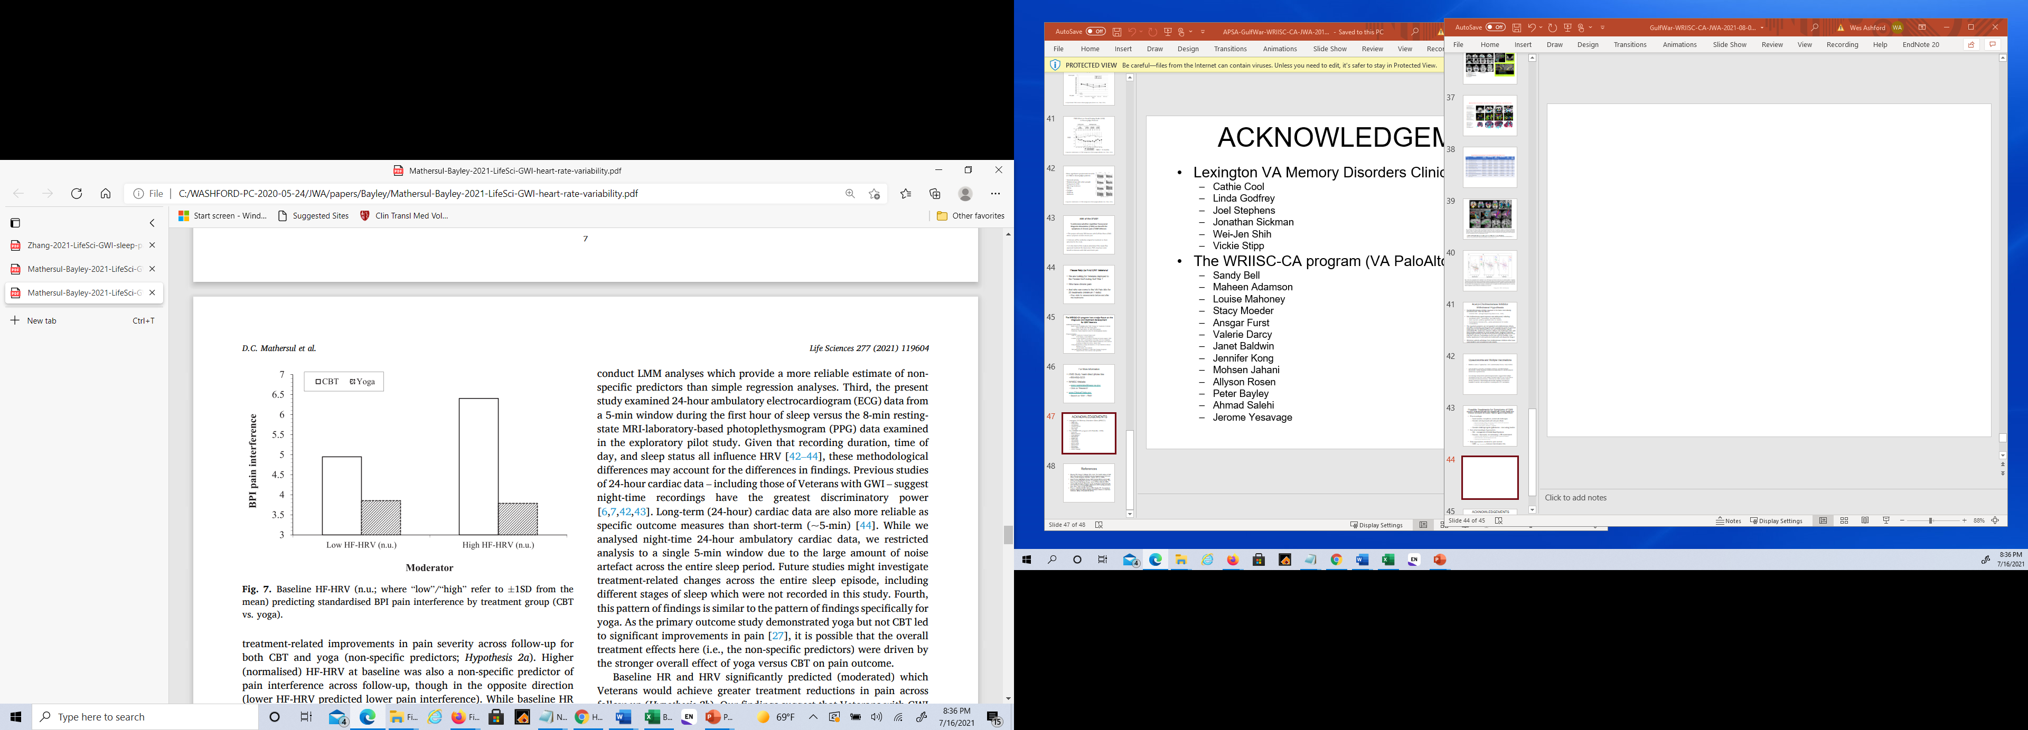
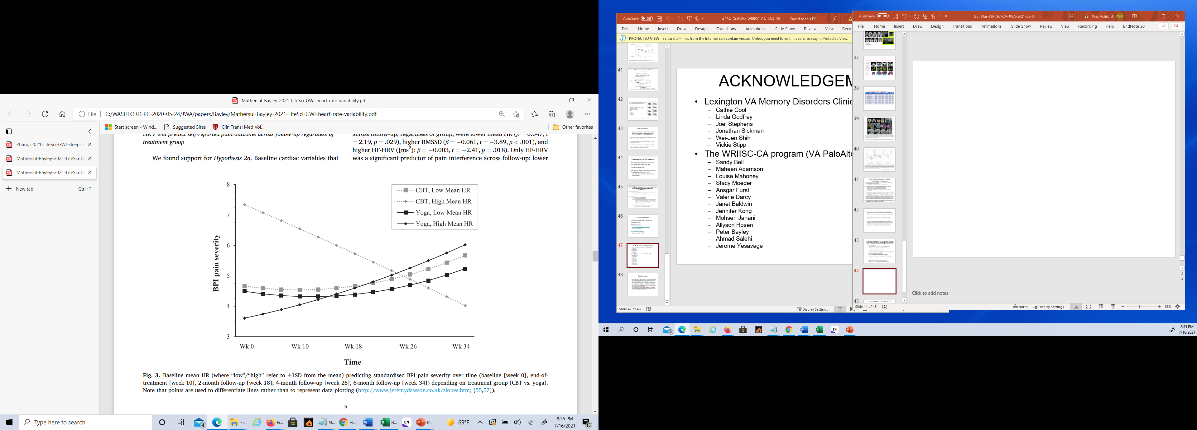
Trial of Yoga as a Treatment for GWI
Gulf War illness (GWI) is characterized by autonomic nervous system dysfunction (higher heart rate [HR], lower heart rate variability [HRV])
In a sample of Veterans randomized to CBT (cognitive behavioral therapy) or yoga, HR increases with CBT yet remains stable with yoga
BPI Pain Interference
Mean
Heart
Rate
BPI
Pain
Severity
HF-HRV = high frequency – heart rate variability
Mathersul et al. (2021), Life Sciences

Slide 51
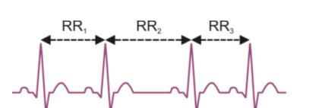
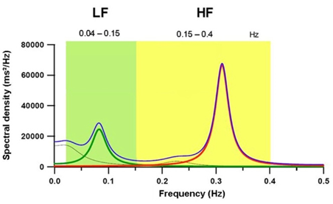
Heart Rate Variability predicted pain outcome following yoga treatment
Autonomic nervous system dysfunction may be a characteristic of GWI
ANS function can be measured using heart rate variability (HRV)
Baseline HRV calculated from beat-to-beat intervals (RR₁, RR₂, RR₃, etc)
in a 5 min time window in RCT of yoga vs CBT for Gulf War Illness
(Bayley et al, 2020)
Power spectral ranges computed to yield low, medium and high
frequency bands
Mathersul, Dixit, Avery, Schulz-Heik, Zeitzer, Mahoney, Cho, & Bayley (2021) Heart rate and heart rate variability as outcomes and longitudinal moderators of treatment for pain across follow-up in Veterans with Gulf War illness. Life Sciences

Slide 52
Heart Rate Variability predicted pain outcome following yoga treatment
HRV used as a predictor of treatment response
Low baseline HRV (Low RMSSD) associated with an increase in pain following yoga treatment
High baseline HRV (High RMSSD) associated with reduction in pain following yoga treatment
In conclusion, ANS function in Veterans with GWI moderated treatment outcome
RMSSD = √mean squared differences in beat-to-beat intervals

Slide 53
ACKNOWLEDGEMENTS
Lexington VA Memory Disorders Clinic (SPECT):
  Cathie Cool
  Linda Godfrey
  Joel Stephens
  Jonathan Sickman
  Wei-Jen Shih
  Vickie Stipp
The WRIISC-CA program (VA PaloAlto -HCS)
  Sandy Bell - Jennifer Jennings
  Maheen Adamson - Ronit Katz
  Louise Mahoney - Leah Eizadi
  Stacy Moeder - Angela Malenfant
  Ansgar Furst - Jauhtai Joseph Cheng
  Valerie Darcy - Yu Zhang
  Janet Baldwin - Vince Torres
  Jennifer Kong - Tamera Guess
  Mohsen Jahani - Rachel Cooper
  Allyson Rosen - Marina Vetlkamp
  Peter Bayley - Lindsey Proctor
  Ahmad Salehi - Miguel Robinson
  Jerome Yesavage - Andre Vahktin

Slide 54
HOME-WRIISC History
Health Outcomes of Military Exposures
    (until recently Post-Deployment Health Services -PDHS)
War Related Illness & Injury Study Center
WRIISC is a National VA Post-Deployment Health Program, established by Public Law 105-368, 105th Congress, 1998)
There are three WRIISC sites: Washington, DC (VISN 5), East Orange, NJ (VISN 2); Palo Alto, CA (VISN 21, since July, 2007)
The WRIISC develops and provides post-deployment health expertise to Veterans and their health care providers through clinical programs, education and risk communication, and research
Notes:
PL 105-368 directed VA to contract with the National Academy of Sciences (NAS) to develop a plan for establishing national centers for the study of war-related illnesses and post-deployment issues.
WRIISC as a VA foundational service from Dr. Erickson’s newsletter article:
These are exciting days for VA as we redesign and modernize all that our VA family does for Veterans. I’m particularly proud to announce that WRIISC-PDHS have now been officially designated as a “VA-Delivered Foundational Service.” This means that we provide an essential service to Veterans that cannot be found outside of VA in managing military-related conditions and disorders. We’re foundational because we provide clinical services, research, and education related to the management of military-related conditions. Our program will likely grow in size as we guide all of VA in delivering key aspects of world class care and services for Veterans.

Slide 55
WRIISC Clinical Services
Multi-disciplinary team approach to address complex symptoms related to deployment.
WRIISC E-Consults
Comprehensive Multidisciplinary Evaluations
Environmental Exposure
Assessments
  Thorough medical record review
  Diagnostic impressions
  Tailored recommendations for next steps
  Engages Provider(s) and Veteran
  3-5 day visit with WRIISC clinical team; Some diagnostic testing
  Provides diagnostic impressions and a “road map” of tailored recommendations to improve function and quality of life
  Assesses potential contribution of exposures to Veteran health concerns as a component of comprehensive evaluation
  Stand-alone service with telephone consults available
Notes:
1. The WRIISC clinical team is comprised of many individuals – including physicians, neuropsychologists, CAM instructors, SW, etc.
2. Reasons to refer:
-Complex health history with no known etiology (medically unexplained symptoms—MUS)
-History includes many tests and treatment with little to no symptom improvement
-Possible deployment-related environmental exposures
-Second opinion is not available locally
-Providers frustrated with lack in progress

Slide 56
WRIISC referrals – Who is Eligible
Any deployed Veteran with a complex health condition and no known cause (medically unexplained symptoms (MUS)
Veteran has been already been thoroughly evaluated by their Primary care provider, but specific questions remain unanswered
Any Veteran that has had many tests and/or treatments with little to no symptom improvement
Any Veteran with possible deployment-related environmental exposure problems or concerns possibly related to their health symptoms
Notes:
May remove this slide

Slide 57
Referral Process
Who Makes the Referral
Veteran’s VA Primary Care Provider
Referral Process
Uses the Inter Facility Consult process in the VA Computerized Patient Record System (CPRS)
Who Can I Contact for More Information
CA WRIISC
888-482-4376.
Refer to War Related Illness & Injury Center (WRIISC)
Referrals are automatically triaged to regional WRIISC based on VISN location
Patient Aligned Care Team
Post-deployment Health Champion
Environmental Health Provider
DC WRIISC
202-745-8249.
NJ WRIISC
973-676-1000 ext. 2500

Slide 58
Veterans' Top 3 Reported Symptoms
ODS/S Veterans seen at CA-WRIISC 7/2016 – 6/2018;
N=67 (20 were later in Somalia, OEF/OIF/OND)

Slide 59
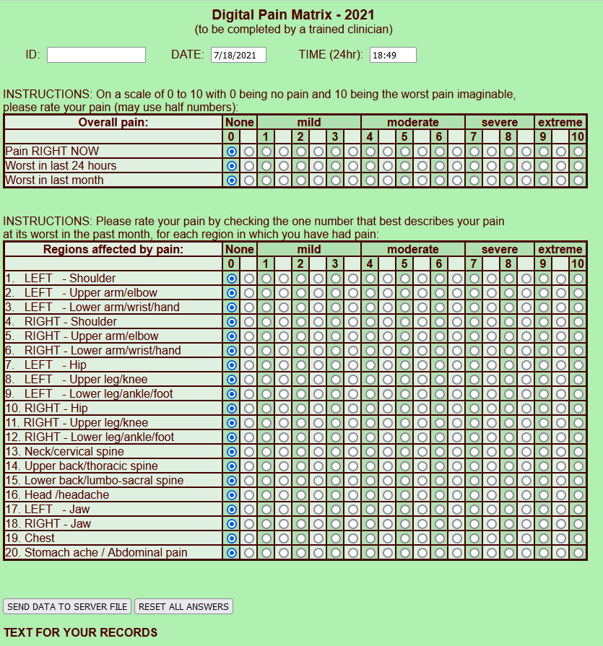
Measurement of Pain
http://www.medafile.com/PainMatrix-2021.htm

Slide 60
WRIISC Research Addresses Veteran Top Symptoms
Top WRIISC Veteran Complaints | WRIISC Research | Sample of WRIISC Protocol
1. Pain |  | A Multimodal Evaluation of the Comparative Efficacy of Yoga versus a Patient-Centered Support Group for Treating Chronic Pain in Gulf War Illness
2. Fatigue |  | Post-Exertion Malaise in Gulf War Illness: Brain, Autonomic and Behavioral Interactions
3. Cognition |  | Cognitive Rehabilitation for Gulf War Veterans
4. GI |  | Development of Dietary Polyphenol Preparations for Treating Veterans with GWI
7. Neurological |  | Diagnosis of Late-stage, Early-onset, Small-fiber Polyneuropathy
8. Sleep |  | CAM for Sleep, Health Functioning and Quality of Life in Veterans with GWVI
10. PTSD |  | Breathing Meditation Intervention for PTSD

Slide 61
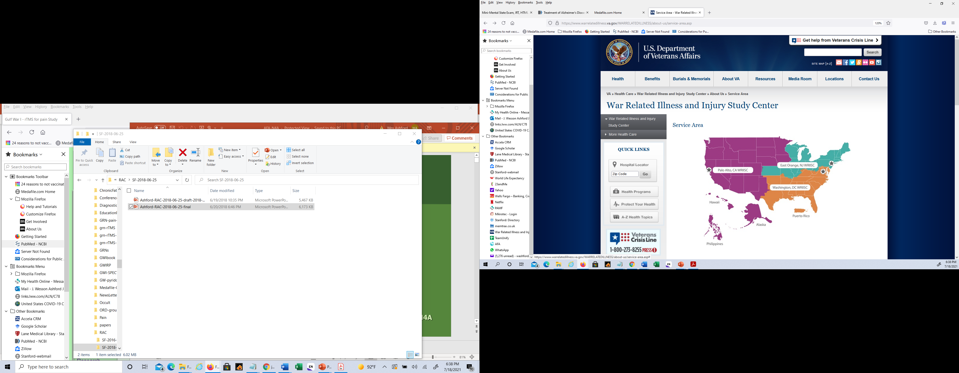
WRIISC Service Area
How to make a referral to the WRIISC program:
For details, refer to:
www.warrelatedillness.va.gov
Primary Care Clinician should make the referral because that clinician will be the one to whom recommendations are directed.
The referring clinician can open the Veteran’s record in CPRS, Consult Tab, then type “WRIISC” and fill out the questionnaire.

