Slide 1
Office of Patient Care Services
Health Outcomes Military Exposures
War Related Illness and Injury Study Center
Gulf War Illness (GWI)
Causation Considerations
Research Advisory Committee on Gulf War
September 21, 2022
J. Wesson Ashford, MD, PhD
Director, WRIISC-CA
VA Palo Alto Health Care System
wes.ashford@va.gov
www.warrelatedillness.va.gov
Sides at:
http://www.medafile.com/GWI/GulfWar-WRIISC-JWA-2022-09-21.pptx

Slide 2
Disclaimer
Dr. Ashford is an employee of the VA
Material presented here does not represent the
official position of the VA
Dr. Ashford has developed a memory test: www.memtrax.com
for assessing memory changes
War Related Illness and Injury Study Center

Slide 3
What is Gulf War Illness (GWI)?
A condition that affects 30-40% of nearly 700,000 Veterans who were deployed to Operations Desert Shield/Storm/Sabre (ODS/S/S)
GWI is considered to exist (Institute of Medicine, 2009)
There have been at least 40 theories that have been considered for GWI, but none has yielded an acceptable pathophysiological explanation
  Is GWI a nervous system disorder?
    Brainstem, autonomic nervous system (ANS)
  Is GWI caused by sarin or related agents?
  Is GWI related to long-COVID (coronavirus, other virus)?

Slide 4
clinical findings of GWI
Results of Iowa Study – 3,695 Veterans:
Symptoms, % Prevalence, Ratio
 | GW Veterans |  | Non-GW Veterans |  | Ratio
Chronic fatigue | 1.5 |  | 0.3 |  | 5.00
Cognitive Dysfunction | 18.7 |  | 7.6 |  | 2.46
PTSD | 1.9 |  | 0.8 |  | 2.38
Fibromyalgia | 19.2 |  | 9.6 |  | 2.00
Asthma | 7.2 |  | 4.1 |  | 1.76
Depression | 17 |  | 10.9 |  | 1.56
Alcohol Abuse | 17.4 |  | 12.6 |  | 1.38
Sexual Discomfort | 1.5 |  | 1.1 |  | 1.36
Iowa Persian Gulf Study Group, 1997

Slide 5
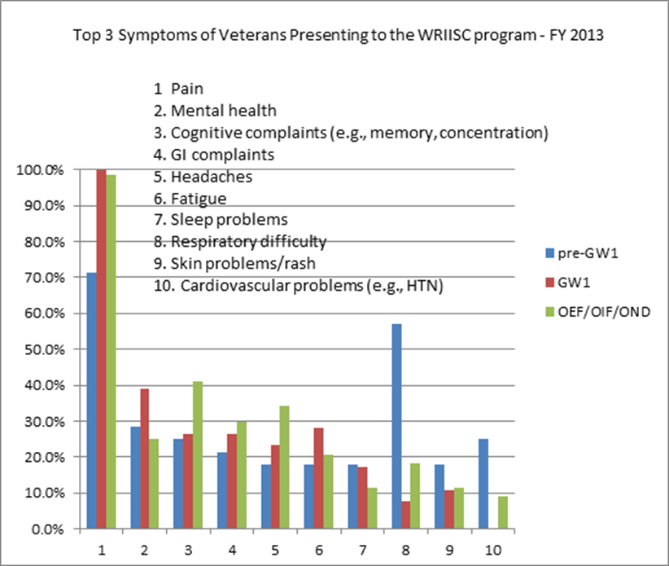
WRIISC EXPERIENCE

Slide 6
Course of GWI
44% still reported symptoms consistent with unexplained multi-symptom illness
Deployed Veterans continue to report:
  Joint stiffness and chronic pain (fibromyalgia?)
  Fatigue (chronic fatigue syndrome?)
  Gastrointestinal (irritable bowel syndrome?)
  Respiratory concerns (shortness of breath, asthma, respiratory concerns)
  Skin rashes
  Sleep issues (insomnia, loss of circadian rhythm, waking during the night)
  Mental Health (depression, anxiety, mood changes)
  Cognitive dysfunction and memory complaints
2012-2013 VA Follow-up Study 30,000 Gulf War/Era Veterans.
Dursa EK, Barth SK, Schneiderman AI, Bossarte RM, 2016. JOEM 58:41-46
There was no increased risk of disease mortality
among Veterans of the 1990-1991 Gulf War.
Cause-specific mortality risks among U.S. Veterans:
25 years after their service in the 1990-1991 gulf war.
Bullman, Schneiderman, Dursa. Ann Epidemiol. 2021 May;57:1-6.

Slide 7
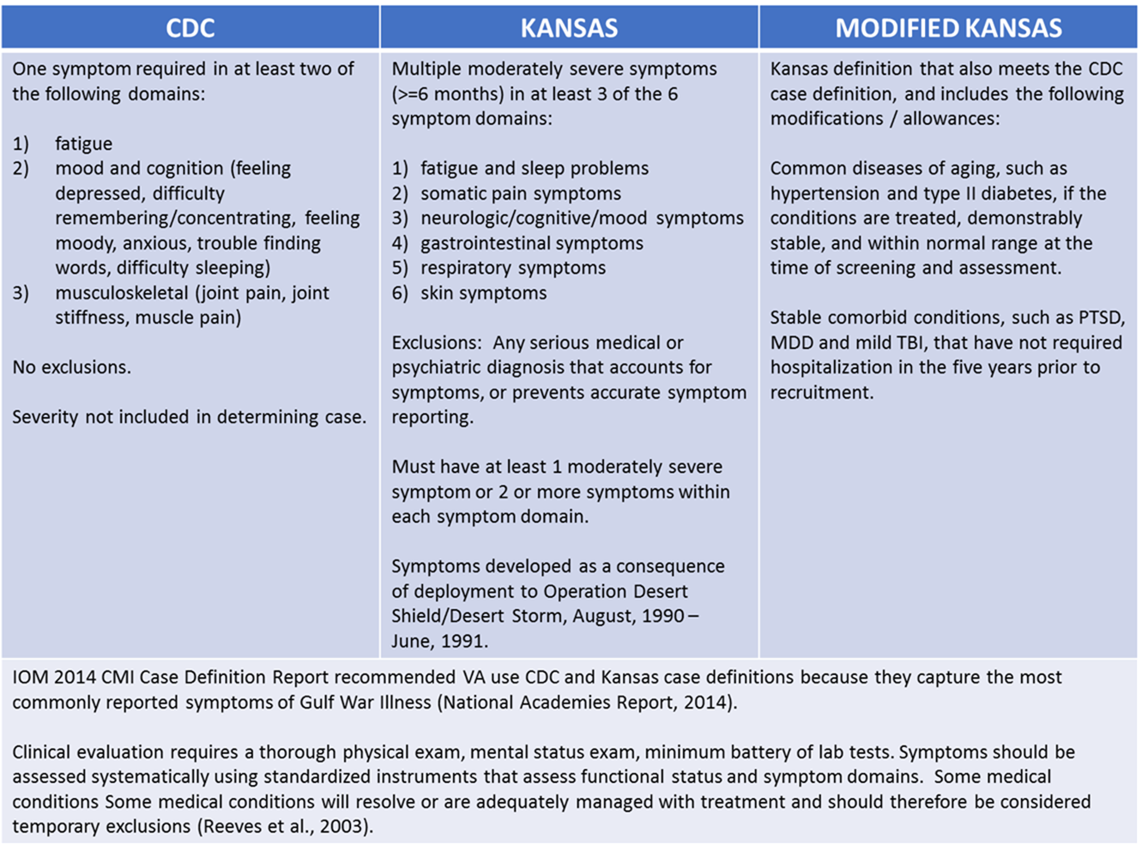
GWI – diagnostic criteria (research)

Slide 8
NERVOUS SYSTEM – Related GWI Disorders
Peripheral nerves – sensory, small fiber neuropathy, chronic pain
Autonomic Nervous System (ANS) - dysautonomia
  Parasympathetic: brainstem (esp: vagus nerve), base of spinal cord (acetylcholine)
  Sympathetic – spinal cord (norepinephrine)
Brainstem - Central control of body energy: behavior, ANS
  Energy feelings/motivation/chronic fatigue/sleep
  Respiration control, respiration during sleep (OSA), lung management
  Cardiac, blood pressure control, blood flow control including brain (SPECT changes)
  Bowel activity (affect by cholinergic, anti-cholinergic drugs) - irritable bowel syndrome
  Temperature control, skin dilation, blood flow to skin, sweating
  Pain management, control (peri-aqueductal gray)
  Management of anxiety (locus coeruleus), mood (raphe, locus coeruleus, depression)
  Vigilance, awareness of the environment, consciousness (dorsal, RAS, PTSD??)
  Management of cerebral cortex: memory (complaints)
Cortex, basal ganglia - Direct injury versus compromise of blood flow

Slide 9
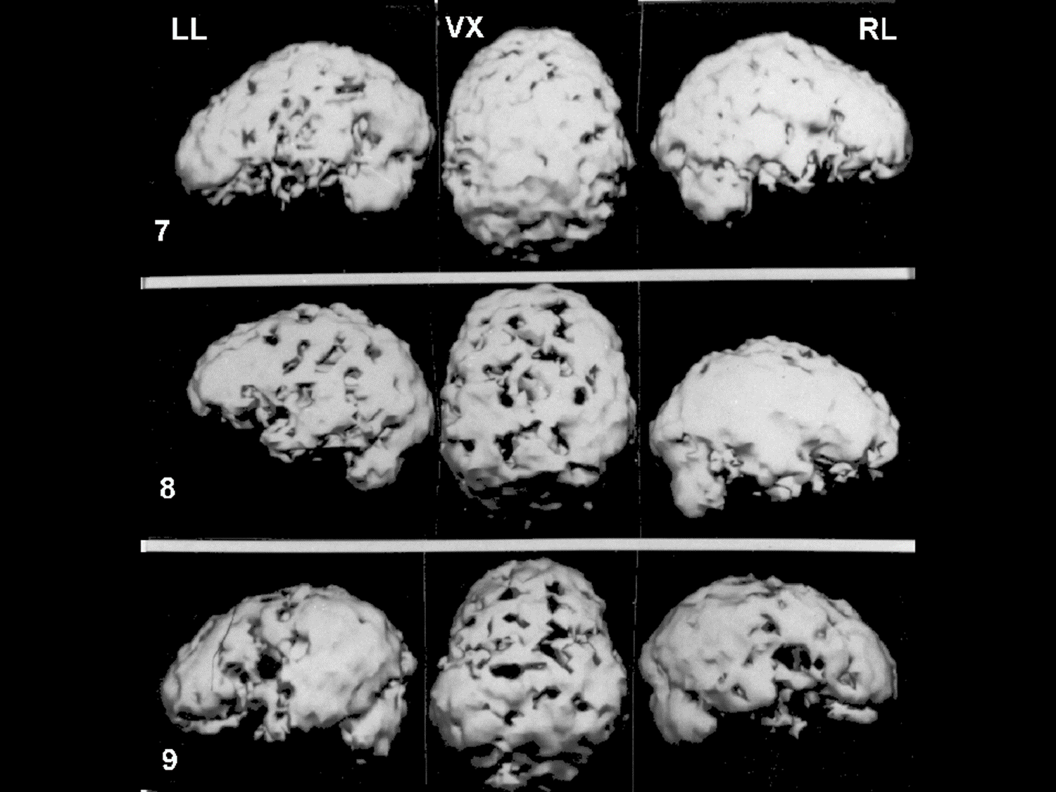
SPECT Brain Changes in GWI
SPECT (single photon emission computed tomography) shows cerebral blood flow, which is controlled by the autonomic nervous system and local neural activity.
(All Veterans had normal MRI brain scans)
Ashford & Shih, VA Lexington, 2002, unpublished

Slide 10
Brain Stem Changes in GWI
Subcortical brain atrophy in Gulf War Illness
  Highest atrophy was observed in the brainstem
  Graded atrophy of regions anatomically connected through the brainstem via the crossed superior cerebellar peduncle (left cerebellum → right thalamus, right cerebellum → left thalamus)
  Distribution of atrophy and systematic reduction in volume of other subcortical areas (basal ganglia, amygdala and diencephalon), resembles the distribution of atrophy seen in toxic encephalopathy
  Peka Christova, Lisa M. James, Brian E. Engdahl, Scott M. Lewis, Adam F. Carpenter & Apostolos P. Georgopoulos. Experimental Brain Research (2017)
Brainstem atrophy in Gulf War Illness
  Significant subcortical atrophy, but no cortical differences, in the GWI group relative to controls
  Largest effect in the brainstem, followed by ventral diencephalon, the thalamus
  Smaller brainstem volumes were significantly correlated with increased severities of fatigue and pain symptoms.
  Yu Zhang, Timothy Avery, Andrei A. Vakhtina, Danielle C. Mathersul, Eric Tranvinh, Max Wintermark, Payam Massaband, J. Wesson. Ashford, Peter J. Bayley, Ansgar J. Furst. NeuroToxicology (2020)

Slide 11
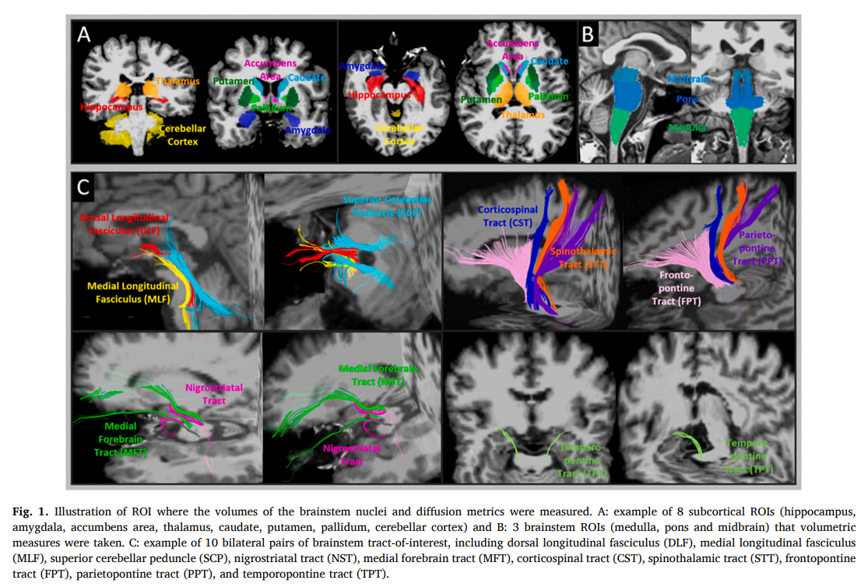
BRAINSTEM DAMAGE IN GWI
Brainstem damage is associated with poorer sleep quality and increased pain in gulf war illness veterans
Yu Zhang a,* , Andrei A. Vakhtin c , Jessica Dietch a,b , Jennifer S. Jennings a , Jerome A. Yesavage a,b , J. David Clark a,b , Peter J. Bayley a,b , J. Wesson Ashford a,b , Ansgar J. Furst a,b a - War Related Illness & Injury Study Center (WRIISC), VA Palo Alto Health Care System, Palo Alto, CA, United States b Stanford University, Stanford, CA, United States c The Mind Research Network, Albuquerque, NM, United States. Life Sciences 280 (2021) 119724.

Slide 12
BRAINSTEM, Autonomic Nervous System

Slide 13
DYSAUTONOMIA AND THE BRAINSTEM
Dysautonomia is common in fibromyalgia, chronic fatigue syndrome, and irritable bowel syndrome, raising the possibility that such dysautonomia could be their common clustering underlying GWI pathogenesis.
BUT, GWI occurs late in Gulf War Veterans, usually after return
  - no evidence of an acute condition (e.g., nerve agent poison)
  - suggests long-term response to unknown factor
  - ? Like long-COVID, related to SARS-CoV-2 infection
  - ? MERS ancestor (from camels, which frequented the theatre)
  - numerous environmental factors/stress – disturb immune system
The Gulf War Veterans have many symptoms
  usually “unexplained”, but most have possible autonomic relationships
The autonomic nervous system is under control of the brain stem, so dysautonomia can be caused by disruption of the brain stem.

Slide 14
Dysautonomia and Related Possible Causes
See: Gean et al., 2021 – Life Sciences
  Title: “Biological measures and diagnostic tools for Gulf War Illness – A systematic review”
  Areas of focus – 56 included studies in field: mostly central nervous system, immune system
  Described 5 studies of the autonomic nervous system
  Immune system can affect brain and could be explanatory
Martinez-Lavin & Tegada-Ruiz, 2020, Autoimmunity Review, 19(9) 102603
  Title: “Gulf war illness, post-HPV vaccination syndrome, and Macrophagic Myofasciitis. Similar disabling conditions possibly linked to vaccine-induced autoimmune dysautonomia”
  This paper states, “Several large independent epidemiological studies suggest that multiple vaccinations at the time of the military operation played a role on the illness development (see their discussion). There are two other vaccine-related chronic syndromes: Macrophagic Myofasciitis originally associated to hepatitis B vaccine, and a syndrome occurring after HPV vaccination.”
Fox et al., 2019 Mar 1, Military Medicine. 184(3-4):e191-e196
  Presence of autonomic symptoms in a sample of Veterans with Gulf War Illness (GWI) using the Composite Autonomic Symptom Scale (COMPASS-31)
Avery...Bayley, 2021 Dec 30 - Military Medicine
  Title: Self-Reported Autonomic Dysregulation in Gulf War Illness
  Autonomic nervous system dysregulation is commonly observed in Gulf War illness
For COMPASS-31 form, see: http://www.medafile.com/COMPASS.htm

Slide 15
sssssssss
POTENTIAL EXPLANATIONS FOR ANS DAMAGE IN GWI
Anti-cholinesterase agents (sarin exposure, combinations, PB predisposal, insecticides, flea collar use, not permethryn).
Immunological response – chronic response to infectious agent
  Autoimmune attack on neurons (like Guillan-Barre syndrome)
  May be similar to longCOVID – related to SARS-CoV-2 infection
  The MERS coronavirus came from camels – many in ODS/S theatre, no support for this specific virus
Spider Bites – biological toxin that could damage small neurons (not infectious agent) (? camel spiders?)
Reaction of body to severe diarrhea or agent that caused severe diarrhea (local fruits, vegetables given to soldiers deployed early, those soldiers deployed later did not seem to get the condition), microbiome?

Slide 16
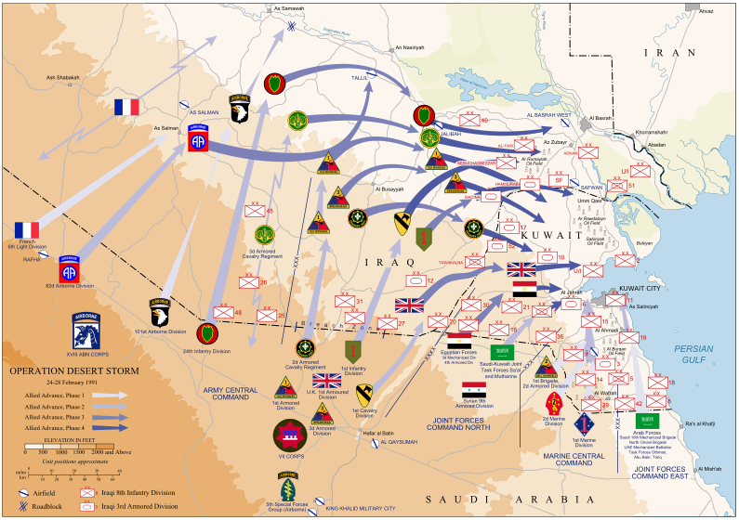
Operation Desert Sabre
Summary of the Offensive Ground Campaign

Slide 17
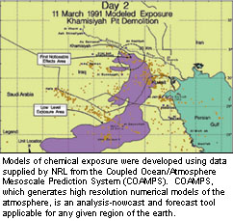
Possible Chemical Weapon Exposures
Many chemical alarms sounded, troops told to put on MOPP suits as protection – feared life-threatening attacks
  Anecdotal reports of isolated chemical weapon exposures to nerve agents, however no cases of acute poisoning were documented
  U. S. destroyed ammunition depot in Khamisiyah containing sarin and cyclosarin nerve agents
    DoD notified 100,000 Veterans that they
    may have been exposed to low levels of
    chemical agents
    There were several detonations
  No specific tests available to detect
  sarin or cyclosarin exposure
Notes:
MOPP (Mission Oriented Protective Posture)

Slide 18
Asymptomatic sequelae to acute sarin poisoning in the central and autonomic nervous system 6 months after the Tokyo subway attack
K Murata, S Araki, K Yokoyama, T Okumura, S Ishimatsu, N Takasu, R F White.
J Neurol. 1997 Oct;244(10):601-6.
LONG-TERM CONSEQUENCES OF SARIN EXPOSURE
Six to eight months after the Tokyo subway attack in March 1995, the neurophysiological effects of acute sarin poisoning were investigated in 18 passengers exposed to sarin (sarin cases) in the subways to ascertain the focal or functional brain deficits induced by sarin.
None of the sarin cases had any obvious clinical abnormalities at testing.
The P300 and VEP (P100) latencies in the sarin cases were significantly prolonged compared with the matched controls.
Electrocardiographic R-R interval variability (CVRR) was related to serum cholinesterase (ChE) levels after exposure.
These findings suggest that asymptomatic sequelae to sarin exposure persist

Slide 19
Survey Report by Dr. Natalie Lambert (U. Indiana) and Survivor Corps, 7/25/2020
COVID-19 “Long Hauler” SYMPTOMS
60 symptoms occurred more than 10% of the time
 | Painful symptoms - 26.5%; Painless symptoms - 73.5%
 | Of 1,567 respondents - Dr. Natalie Lambert - nalamb@iu.edu
 |  | # | prop
1 | Fatigue | 1,567 | 1.00
2 | Muscle or body aches | 1,046 | 0.67
3 | Shortness of breath or difficulty breathing | 1,020 | 0.65
4 | Difficulty concentrating or focusing | 924 | 0.59
5 | Inability to exercise or be active | 916 | 0.58
6 | Headache | 902 | 0.58
7 | Difficulty sleeping | 782 | 0.50
8 | Anxiety | 746 | 0.48
9 | Memory problems | 714 | 0.46
10 | Dizziness | 656 | 0.42
11 | Persistent chest pain or pressure | 609 | 0.39
12 | Cough | 577 | 0.37
13 | Joint pain | 566 | 0.36
14 | Heart palpitations | 509 | 0.32
15 | Diarrhea | 506 | 0.32
16 | Sore throat | 496 | 0.32
17 | Night sweats | 475 | 0.30
18 | Partial or complete loss of sense of smell | 460 | 0.29
19 | Tachycardia | 448 | 0.29
20 | Fever or chills | 441 | 0.28
https://scholarworks.iupui.edu/handle/1805/25685

Slide 20
GWI - Most Frequent Symptoms, Affected Systems
Frequency of Symptoms of 53,835 Participants in Gulf War VA Registry (1992–1997)
Symptoms Percentage
  Fatigue 20.5
  Skin rash 18.4
  Headache 18.0
  Muscle and joint pain 16.8
  Loss of memory 14.0
  Shortness of breath 7.9
  Sleep disturbances 5.9
  Systems
  Musculoskeletal and connective tissue 25.4
  Mental disorders 14.7
  Respiratory system 14.0
  Skin and subcutaneous tissue 13.4
  Digestive system (irritable bowel syndrome) 11.1 SOURCE: Murphy et al., 1999
  Chest pain 3.5
Symptoms of longCOVID

Slide 21
Tardive Dysautonomia in GWI
Late reaction to a MERS coronavirus ancestor - HYPOTHESIS
Dysautonomia or brainstem damage can account for all GWI symptoms
Since the autonomic nervous system is controlled by the brainstem, any condition affecting the brainstem could explain the condition
Tardive means developing later (tardy), and this term describes the late onset of symptoms associated with GWI, i.e., weeks, months, or even years after return
Many of the symptoms of GWI are similar to several of the longCOVID symptoms
Attack could be a late immunological response to a MERs ancestor coronavirus or another virus
Local population affected at young age, minimal manifestation of illness
ODS/S/S soldiers – all over 18 years of age – more susceptible
Variety of stress factors, chemical exposures (pyridostigmine bromide, insecticides, oil-well fire smoke, possible low-doses of sarin (with PON-1 susceptibility) could have predisposed many soldiers (possibly more northern European descent – more in British than French soldiers, higher proportion in women than men)

Slide 22
Current WRIISC Research Projects for GWI
VA-HOME-WRIISC – Clinical Data Collection for Patients Seen in the War Related illness and Injury Study Center
VA-IN-DEPTH – VA-HOME-WRIISC-DC/Miami VA/NIH – phenotyping
  Includes WRIISC CA, WRIISC DC
  Veterans with a history of COVID-19 excluded
GWICTIC – Gulf War Illness Clinical Trial & Intervention Consortium
  Includes WRIISC CA, WRIISC NJ, Miami VA
VA-HOME-WRIISC-CA
  The role of the brain stem in GWVI pathology – Ansgar Furst
  Biopredictors of cognitive and behavioral outcomes
    (sleep in GWI) – Ansgar Furst

Slide 23
Planning WRIISC Research Projects for GWI
Gulf War Illness and long-COVID (Veterans ineligible for VA-IN-DEPTH)
  VA-HOME-WRIISC CA, DC, Miami VA, Boston VA, Charleston VA, NIH
  Registry, clinical evaluation, longitudinal monitoring program
  Developing – registry, questionnaires, on-line assessments (under development)
    General Health Survey (based on Rand SF-36): http://www.medafile.com/longCOVID/GHS38.htm
    Somatic Symptom Scale (PHQ-15): http://medafile.com/PHQ15.htm
    Pain scale: http://www.medafile.com/PainMatrix-2021.htm
    Fatigue scale: http://www.medafile.com/longCOVID/FatigueSeverityScale.htm
    Neuropathy Scale: http://www.medafile.com/DS21sfn.htm
    Autonomic function scale (COMPASS-31): www.medafile.com/COMPASS.htm
    Depression Scale: http://medafile.com/cln/GDS15.htm
    Anxiety Scale: http://medafile.com/longCOVID/BAI.html
    Sleep Scale: Pittsburg Sleep Quality Index Scale: http://www.medafile.com/WRIISC/PSQI.htm
    Memory Impairment – on-line test: www.memtrax.com
Possible NIH/CDC data analyses, collaborations for long-COVID:
  https://recovercovid.org/
  https://www.cdc.gov/coronavirus/2019-ncov/long-term-effects/index.html

Slide 24
ACKNOWLEDGEMENTS
Lexington VA Memory Disorders Clinic (SPECT):
  Cathie Cool
  Linda Godfrey
  Joel Stephens
  Jonathan Sickman
  Wei-Jen Shih
  Vickie Stipp
The WRIISC-CA program (VA PaloAlto -HCS)
  Sandy Bell - Jennifer Jennings
  Maheen Adamson - Ronit Katz
  Louise Mahoney - Leah Eizadi
  Stacy Moeder - Angela Malenfant
  Ansgar Furst - Jauhtai Joseph Cheng
  Valerie Darcy - Yu Zhang
  Janet Baldwin - Vince Torres
  Jennifer Kong - Tamera Guess
  Mohsen Jahani - Rachel Cooper
  Allyson Rosen - Marina Vetlkamp
  Peter Bayley - Lindsey Proctor
  Ahmad Salehi - Miguel Robinson
  Jerome Yesavage - Andre Vahktin
Appreciate discussion regarding MERS with
Stanley Perlman,
University of Iowa

Slide 25
THANK YOU
Slides at:
www.medafile.com/GWI/GulfWar-WRIISC-JWA-2022-09-21.pptx
or
www.medafile.com/GWI (this slide deck link at lower left)
For WRIISC referral, see: www.warrelatedillness.va.gov
More of Dr. Ashford’s developments at:
www.medafile.com
www.medafile.com/COVIDstudy
  www.memtrax.com (memory test)
NIH long-COVID research: https://recovercovid.org/
WHO-MERS https://www.who.int/news-room/fact-sheets/detail/middle-east-respiratory-syndrome-coronavirus-(mers-cov)

