Slide 1
The Issues of Genetic Testing and Alzheimer’s Risk
J. Wesson Ashford, M.D., Ph.D.
Clinical Professor (affiliated), Department of Psychiatry and Behavioral Sciences
Stanford University
Director, War Related Illness & Injury Study Center (WRIISC)
VA Palo Alto Health Care System
Wes.Ashford@va.gov wes.ashford@gmail.com ashford@Stanford.edu
Saturday, March 16, 2024
www.warrelatedillness.va.gov www.medafile.com www.memtrax.com
Slides at: www.medafile.com/LEC/APOE-2024-03-16.pptx

Slide 2
Relative Risk Factors for Alzheimer’s Disease (after age of early onset genotypes)
APOE-e4 genotype vs e3/3 1 allele x 3.5; 2 alleles x 13.13
Family history of dementia 3.5 (2.6 - 4.6)
Family history - Downs 2.7 (1.2 - 5.7) (rare)
Family history - Parkinson’s 2.4 (1.0 - 5.8)
Obese, large abdomen 3.6
Maternal age > 40 years 1.7 (1.0 - 2.9)
Head trauma (with LOC) 1.8 (1.3 - 2.7)
History of depression 1.8 (1.3 - 2.7)
History of hypothyroidism 2.3 (1.0 - 5.4)
History of severe headache 0.7 (0.5 - 1.0)
History of “statin” use 0.3 (and hypercholesterolemia)
NSAID use 0.2 (0.05 – 0.83) (and arthritis)
Use of NSAIDs, ASA, H2-blockers 0.09
Exercise 0.1
Roca, 1994; ‘t Veld et al., 2001, Breitner et al., 1998, Wolozin et al., 2000; Horder et al., 2918

Slide 3
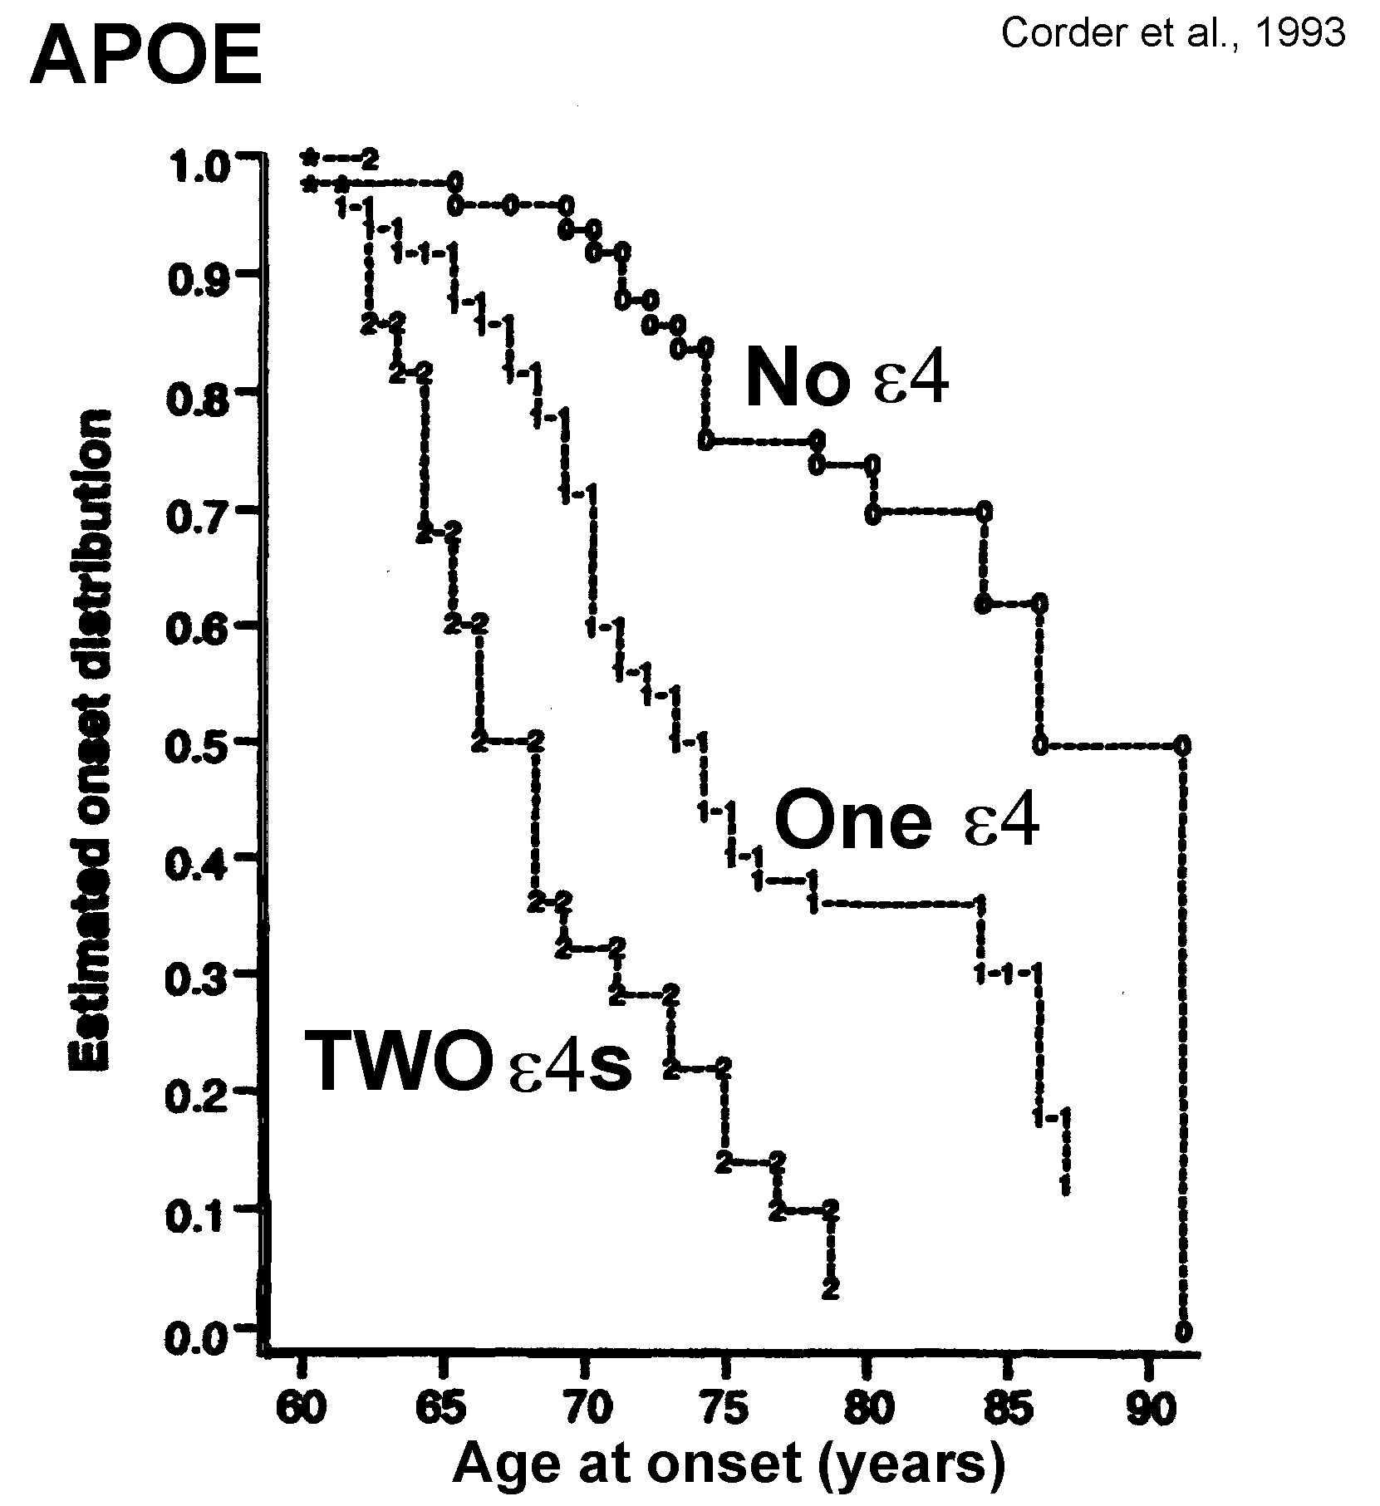

Slide 4
APOE Distribution
By Age Group
Males only
Females only
National Institute on Aging - Late Onset Alzheimer's Disease Family Study: Genome-Wide Association Study for Susceptibility Loci
  dbGaP Study Accession: phs000168.v2.p2

Slide 5
Alzheimer Genetic Risk Factors
  GENE Location SNP OR (Frequency)
    Major risk factor
  APOE 19q13.32 rs429358 3 - 5 per e4 allele (frequency ~ 14%)
  Population attributable fraction (%) = 30.8
  APOE 19q13.32 rs7412 .5 to 0 for 1, 2 e2 alleles
  APOE-3 TOMM40 – repeat (not a SNP) risk may related to number of repeats
    Early onset - autosomal dominant ~200 (less than 1%, onset < 60 years of age)
  APP 21q21.3 rs63750847
  PSEN1 14q24.3
  PSEN2 1q31-q42
    Minor risk factor
  TREM2 6p21.1 rs75932628 4.5 (frequency = .001)
    20 SNPs associated with AD – total less than half of the variance of APOE genotype

Slide 6
20 SNPs associated with AD
- all can be related to synaptic plasticity/memory
GENE LOCATION SNP Com/Path Min/Path OddsRatio Frequency Pop-attrib-frac %
ABCA7 19p13.3 rs3764650 T/G 1.23 0.09 2.8
CR1 1q32.2 rs6656401 G/A 1.21 0.19 3.5
BIN1 2q14.3 rs744373 A/G 1.15 0.30 8.2
FERMT2 14q22.1 rs17125944 T/C 1.14 0.09 1.2
CD2AP 6p12.3 rs9349407 G/C 1.12 0.28 2.6
HLA-DRB5/1 6p21.32 rs9271192 A/C 1.11 0.26 3.0
PTK2B 8p21.2 rs28834970 T/C 1.10 0.36 3.6
CELF1 11p11.2 rs10838725 T/C 1.08 0.32 2.5
INPP5D 2q37.1 rs35349669 C/T 1.08 0.47 3.8
MEF2C 5q14.3 rs190982 A/G 0.93 0.59 2.8
NME8 locus 7p14.1 rs2718058 A/G 0.93 0.62 2.5
CD33 19q13.41 rs3865444 C/A 0.91 0.69 1.8
EPHA1 7q35 rs11771145 G/A 0.91 0.81 3.3
MS4A6A locus 11q12.2 rs983392 A/G 0.91 0.58 3.8
SLC24A4/RIN3 loc 14q32.12 rs10498633 G/T 0.91 0.80 1.9
ZCWPW1 7q22.1 rs1476679 T/C 0.91 0.66 2.5
CASS4 20q13.31 rs7274581 T/C 0.88 0.91 1.0
PICALM 11q14.2 rs3851179 C/T 0.86 0.65 4.5
CLU 8p21.1 rs11136000 C/T 0.85 0.60 5.1
SORL1 11q24.1 rs11218343 T/C 0.77 0.95 0.91
Flanders-Belgian population: Sleegers et al., 2015; Cauwenberghe et al., 2016; Carmona et al., 2018

Slide 7
APOE - rs429358 - snpedia.com
This SNP, located in the fourth exon of the ApoE gene, affects the amino acid at position 130 of the resulting protein. The more common rs429358 allele is (T). If the allele is (C) and the same chromosome also harbors the rs7412(C) allele, the combination is known as an APOE-ε4 allele. The APOE-ε4 allele has a strong influence on the risk of Alzheimer's disease. Both deCODEme and 23andMe test for this SNP.
Many studies have estimated the level of risk, and it varies depending on age, sex, ethnicity, and other factors. One meta-analysis estimated the odds ratios for homozygous rs429358(C;C) individuals compared to the more common ApoE3/ApoE3 homozygotes to be 12x for late-onset Alzheimer's and 61x for early-onset disease.
Meta-analyses have also supported the association between the APOE-ε4 allele and somewhat increased risk for heart disease, with an odds ratio of 1.42 (CI: 1.26 - 1.61).
Note: Although ApoE status is technically defined by these two SNPs, rs429358 and rs7412, a SNP in the adjacent ApoC1 gene, rs4420638, is co-inherited with ApoE and thus often - though not completely - predictive of it.
Associated Conditions:
ALZHEIMER DISEASE
HYPERLIPOPROTEINEMIA, TYPE III, ASSOCIATED WITH APOE4
Apolipoprotein E genotype is associated with serum C-reactive protein
Apolipoprotein E Gene Polymorphisms Are Strong Predictors of Inflammation and Dyslipidemia in Rheumatoid Arthritis

Slide 8
Based on 2020 US Census and suggestions that 8 million individuals have Alzheimer’s disease
APOE | % pop | %AD | #pop>=60 | of 8mil AD | Percent chance
e2/2 | 1 | 0.1 | 792,482 | 8,000 | 1.01%
e2/3 | 13 | 4 | 10,302,262 | 320,000 | 3.11%
e2/4 | 2 | 2.9 | 1,584,963 | 232,000 | 14.64%
e3/3 | 60 | 35 | 47,548,903 | 2,800,000 | 5.89%
e3/4 | 22 | 42 | 17,434,598 | 3,360,000 | 19.27%
e4/4 | 2 | 16 | 1,584,963 | 1,280,000 | 80.76%
total | 100 | 100 | 79,248,171 | 8,000,000 | 10.09%

Slide 9
Using the Gompertz equation
to model rate of dementia
increase with age:
U(t) = Ro * exp (alpha * t)

Slide 10
Using a Gompertz survival
curve to model probability of
not having dementia with age:
S(t) = exp(Ro/alpha *(1- exp (alpha * t)))

Slide 11
Using Gompertz equations
to model probability of
dementia with age:
D(t) = U(t) * S(t)

Slide 12
Do women have an age-specific increase in AD risk according to APOE genotype?
No study appears to adequately adjust for age using the exponential increase of AD risk with age – which is critical for this comparison
Most studies use 5-year cohorts, in which longer-living women will automatically have twice the incidence by having more older individuals
One meta-analysis (Neu et al., 2017) suggests:
  Women with e3/e4 have increased AD risk relative to men just 65-75 years of age:
    OR=4.37 vs 3.14 respectively
  Women with e2/e3 have a decreased risk of AD relative to men:
    OR=0.51 vs 0.71 respectively
  No other gender differences were found
Complex interactions of gender differences in health behaviors, fat metabolism, and female changes-of-life make comparisons difficult

Slide 13
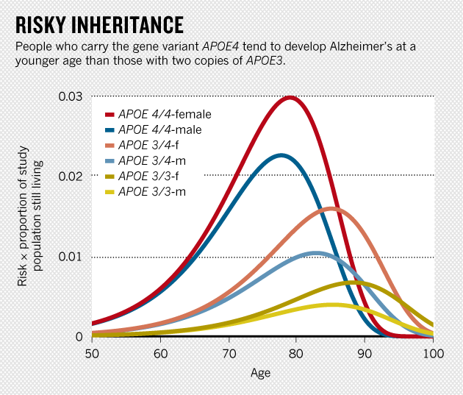
Jun 4, 2014 |By Laura Spinney and Nature magazine; Scientific American, Lancet-Neurology
Credit: Raber, Huang, Ashford. Neurobiol. Aging 25, 641–650 (2004)

Slide 14
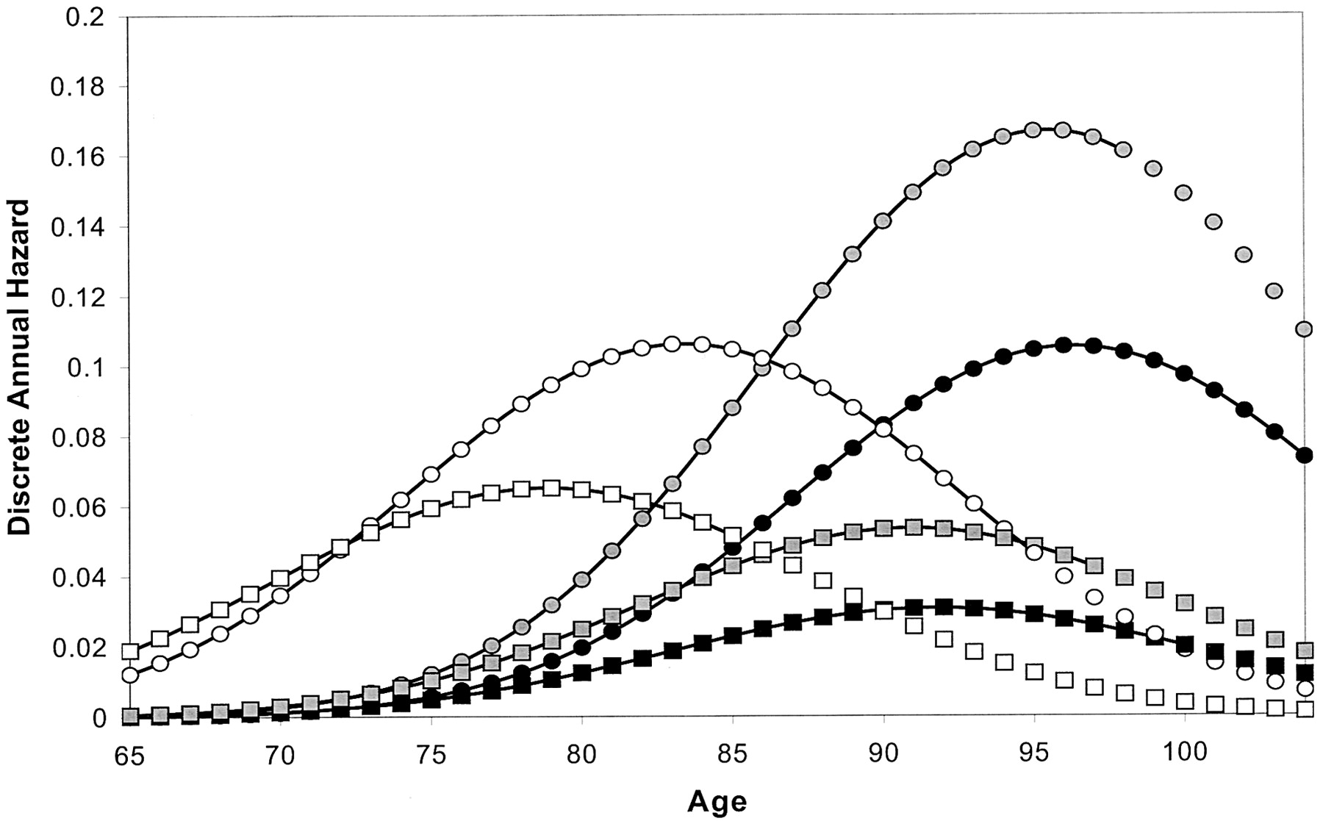
Cache County, probability
of incident dementia
Circles – females
Squares - males
Open – ApoE-e44
Gray – ApoE-e4/x
Black – ApoE-ex/x
Miech et al., 2002

Slide 16
Miech et al., 2002

Slide 17
APOE AND EVOLUTION
(The original allele was APOE-ε4, the ε3 allele appeared about 300,000 years ago, and the ε2 allele appeared about 200,000 years ago)
Does APOE-e2 or e3 do a safer job of supporting the remodeling of dendrites, to minimize the stress on a neuron over time? What is the relationship to neuroplasticity?
Demented elderly cannot foster their young or compete
  APOE-e3/2 AS AN AGENT TO SUPPORT SUCCESSFUL AGING IN GRANDMOTHERS
  APOE-e3/2 AS AN AGENT TO SUPPORT THE DOMINANCE OF ELDERLY MALES OVER YOUNGER MALES – FOR MATING OR SUPPORTING PROGENY
Is APOE protective against enteric diseases in tropical climates?
APOE genotype may be in close linkage-dysequilibrium with a neighboring gene that is specifically responsible for the vulnerability to Alzheimer’s disease
  (possibly TOMM-40 – a problem of a repeat, not a SNP)

Slide 18
APOE has been shown to play many roles.
Which one is relevant for Alzheimer Causation??
APOE (apo-lipo-protein E) is a cholesterol chaperone
  Cholesterol transport is critical for synaptic plasticity (Koudinov & Koudinov, 2001)
  APOE may play a critical role in neuroplasticity, moving cholesterol from synapses being removed to new synapses, but if too slow may accumulate Abeta
Younger APOE-e4 carriers may have better memory, but burn out the neurons most involved in neuroplasticity, leading to Alzheimer pathology
APOE may affect APP transcription (in relation to AD risk (Huang et al., 2017)
APOE may play a role in Abeta clearance (with cholesterol)
APOE affects as many as 1700 different genetic factors (Rao et al., 2017)
CAVEAT – the role of APOE protein variations (e2, e3, e4) in the causation of Alzheimer pathology has not been clarified
  FDA approval of 23&me for providing results may be a tremendous benefit for scientists seeking to understand the role of APOE in AD

Slide 19
APOE has been shown to play many roles.
Which one is relevant for Alzheimer Causation??
APOE (apo-lipo-protein E) is a cholesterol chaperone
  Cholesterol metabolsim is a central part of synaptic plasticity (Koudinov & Koudinov, 2001)
  APOE may play a critical role in neuroplasticity, moving cholesterol from synapses being removed to new synapses
Younger APOE-e4 carriers may have better memory, but burn out the neurons most involved in neuroplasticity, leading to Alzheimer pathology
APOE may affect APP transcription
APOE may play a role in Abeta clearance
APOE affects as many as 1700 different genetic factors (Rao, 2017)
CAVEAT – the role of APOE protein variations (e2, e3, e4) in the causation of Alzheimer pathology has not been clarified
  FDA approval of 23&me for providing results may be a tremendous benefit for scientists seeking to understand the role of APOE in AD

Slide 20
Theendakara et al., Mol Neurobiol, 2017

Slide 21
Shi et al., Nature, 2017

Slide 22
Huang, Zhou, Wernig, Sudhof, Cell, 2017

Slide 23
Huang,Zhou,
Wernig,Sudhof,
Cell, 2017

Slide 24

Forming a polygenic risk score – www.axgen.us

Slide 25
Are we ready to do genetic testing to predict AD?
How much danger is involved, is genetic counselling needed?
  Does genotype knowledge have adverse effects – anxiety, depression, suicide?
Are recommendations against genetic testing “paternalistic”?
  Like not telling someone they have cancer or another untreatable disease
The family members may want to know (but may not have a choice)
Informed individuals can make more powerful financial decisions based on this knowledge
  Should insurance companies implement changes in actuarial calculations
Those at risk can seek more frequent testing
  This is the best opportunity for early recognition
  Those at decreased risk can focus on other issues
Those at risk will be better advocates for research (like HIV)
Specific preventive treatments can be developed by genetic factor

Slide 26
Future directions for Alzheimer genetics: prevention and early treatment
Understanding the Genes is the key to treating and preventing AD
Genotyping – GWAS will soon be done on all newborns
Large population studies will redefine risk-factors by genotype
Preventive measures based on genetics – life-time intervention
Modify APOE protein to mimic e2
  Transfection, decrease APP transcription, or block APOE action
Treatments based on genetics – could be dietary modification
Specific treatments for APOE modulation
  May be related to statin effects, diet, DHA (omega-3-FA for brain)
  Leptin may modulate APOE formation, lipid raft thickness

Slide 27
The Issues of Genetic Testing and Alzheimer’s Risk
J. Wesson Ashford, M.D., Ph.D.
Clinical Professor (affiliated), Department of Psychiatry and Behavioral Sciences
Stanford University
Director, War Related Illness & Injury Study Center (WRIISC)
VA Palo Alto Health Care System
Wes.Ashford@va.gov wes.ashford@gmail.com ashford@Stanford.edu
Saturday, March 16, 2024
www.warrelatedillness.va.gov www.medafile.com www.memtrax.com
Slides at: www.medafile.com/LEC/APOE-2024-03-16.pptx

