Slide 1
MemTrax Screening for Cognitive Impairment, Memory Problems, Dementia, Alzheimer’s Disease
J. Wesson Ashford, M.D., Ph.D.
Clinical Professor (affiliated), Department of Psychiatry and Behavioral Sciences
Stanford University
Director, War Related Illness & Injury Study Center (WRIISC)
VA Palo Alto Health Care System
ashford@stanford.edu Wes.Ashford@gmail.com
March 14, 2024
www.memtrax.org www.medafile.com/CMS www.afamemorytest.com
www.memtrax.org/n.html www.brainhealthregistry.org
Slides can be viewed at:
www.medafile.com/LEC/MemTrax-2024-03-14.pptx

Slide 2
Disclosures
Dr. Ashford is an unpaid consultant to MemTrax, LLC, which provides an on-line screening test for memory function.
Dr. Ashford applied for patent protection for a continuous performance memory test which he developed.
Dr. Ashford is the Chair of the Medical, Scientific, and Memory Screening Advisory Board of the Alzheimer’s Foundation of America, which provides the MemTrax memory test: www.afamemorytest.com
Dr. Ashford is a full-time employee of the VA.
The views expressed by Dr. Ashford do not represent the official views of the VA.

Slide 3
Need for Mass Screening, Early AD Detection
AD, dementia, and memory problems are difficult to detect when they are mild
especially Alzheimer’s disease (AD)
the problem is subtle –
MCI – mild cognitive impairment,
minor neurocognitive disorder
family members avoid the problem and compensate for the patient
physicians tend to miss the initial signs and symptoms
about 90% missed early, especially early AD
about 25% - 50% are still missed late, at moderate and severe levels
There is no efficient laboratory test – brain scan, CSF, blood – to accurately and efficiently diagnosis dementia or AD
There are important accommodations and interventions that should be made when there are cognitive impairments
(like needing glasses or having driving restrictions if you have vision problems)

Slide 4
Why Screening is Important to Consider
Cognitive impairment is disruptive to human well-being and psychosocial function
Cognitive Impairment is potentially a prodromal condition to dementia and Alzheimer’s disease
Dementia is a tremendously costly condition
With the aging of the population (even beyond the baby-boom) there will be a progressive increase in the proportion of elderly individuals in the world
Screening will lead to more diagnoses which will advance the understanding of Alzheimer’s disease and foster the development of better treatments

Slide 5
Benefits of Early AD Diagnosis Social
Undiagnosed AD patients face avoidable problems
social, financial
Early education of caregivers
how to handle patient (choices, getting started)
Advance planning while patient is competent
will, proxy, power of attorney, advance directives
Reduce family stress and misunderstanding
caregiver burden, blame, denial
Promote safety
driving, compliance, cooking, etc.
Patient’s and Family’s right to know
especially about genetic risks
Promote advocacy
for research and treatment development

Slide 6
Benefits of Early AD Medical
Early diagnosis and treatment and appropriate intervention may:
improve overall course substantially
lessen disease burden on caregivers / society
Specific treatments now available
(anti-cholinesterases, memantine) (aducanumbab of questionable benefit)
Improve cognition
Improve function (ADLs)
Delay conversion from Mild Cognitive Impairment to AD
Slow underlying disease process, the sooner the better
Decreased development of behavior problems
Delay nursing home placement, possibly over 20 months
Delay nursing home placement longer if started earlier

Slide 7
Issues for Memory Screening
Current testing for memory problems is based on having a tester sit in front of a subject for a prolonged period of time and administer unpleasant tests, mostly unavailable in the US.
Testing must be
Inexpensive (minimal need for administrator)
Fun (so people will return for frequent testing, repeatability)
More precise, reliable, and valid
To improve sensitivity
To improve specificity

Slide 8
Time-Index model
of the course of Alzheimer’s disease
(calculated from the CERAD data set)
The best model to fit the progression,
both mathematically and biologically,
is the Gompertz survival curve
(99.7% fit to mean changes over time):
S(t) = exp(Ro/alpha *(1- exp (alpha * t)))
- Time-Index Scale -
Ashford et al., 1995
Ashford & Schmitt, 2001
AAMI / MCI/ early AD -- DEMENTIA

Slide 9
AD COGNITIVE PATHOLOGY REFLECTS FAILURES OF MEMORY STORAGE
Shown on the next slide is an “Item Response Theory” analysis of the items of the Mini-Mental State Exam (MMSE). The results show that items which are more involved in memory processing are affected earlier in AD (Ashford et al., 1989, 1995).

Slide 10
Mini-Mental State Exam items
Shows that AD is primarily a condition of episodic memory (retention of information)
Using the Gavrilov & Gavrilova explanation of the Gompertz curve, AD is a progressive failure of the massively redundant memory storage mechanism of the brain
Ashford et al., 1989
Ashford et al., 1995
Ashford, 2008

Slide 11
To Screen and Quantitate Dementia, and Test Therapeutic Modalities, Need Rapid Assessment of Episodic Memory Function
Importance of episodic memory assessment
Disruption in many conditions – Alzheimer’s disease, cerebral hypoxia, etc.
Major concerns for driving, TBI, anesthesia, chemobrain, ICU psychosis
Challenges
The precise measurement of memory
Lack of short assessment tools
Cognitive assessment tools that can be used in a variety of settings (on-line)
Test stability across administrations
Test-retest learning
Tiredness, confusion with repeated testing
Engagement

Slide 12
Issues for Memory Testing
Current testing for memory problems is based on having a tester sit in front of a subject for a prolonged period of time and administer unpleasant tests
Testing must be
Extensively and frequently administered
Inexpensive (minimal need for administrator)
Fun (so people will return for frequent testing)
More precise, reliable, repeatable, and valid
To improve sensitivity
To improve specificity

Slide 13
Issues for Alzheimer Measurement
The problem in Alzheimer’s disease is dementia
The build up of plaques and tangles and the loss of blood flow is a sign of an underlying process, not the cause of the dementia
Dementia is most related to loss of synapses, but the loss selectively affects the most neuroplastic synapses
Accurate, relevant assessment of dementia must directly measure episodic memory

Slide 14
Current Memory Assessments are Inadequate
Problems
Large practice effects over time
Lack precision of analysis and huge data
Require trained experts to administer
Require special equipment/environment
Time intensive (for rater and subject)
High cost
Not tech or mobile friendly
Limited, or no ability to customize
Limited ability for individuals, healthcare providers, and researchers to precisely measure & monitor memory
Tsoy, Zygouris, Possin. 2021
Current State of Self-Administered Brief Computerized Cognitive Assessment for Detection of Cognitive Disorders in Older Adults: A Systematic Review.
J Prev Alz Dis. 3(8): 267-276

Slide 15
“What you can’t measure you can’t treat”
Need better measurement systems for screening, longitudinal assessment, outcome evaluation
Major push by NIA to develop better systems for cognitive and memory measurement
www.detectcid.org
www.afamemorytest.com
www.memtrax.org
www.memtrax.com/cn (and on WeChat)
Development of on-line registry programs to assemble populations at risk for dementia and Alzheimer’s disease
Monitor change over time

Slide 16
Ideal Dementia Screening Test
Need test to screen patients for Alzheimer’s disease
Test needs to be on multiple platforms:
Doctor’s offices (6th VITAL SIGN)
Best if computerized for rapid, objective assessment
World-Wide Web – based testing,
Smart-phone, tablets (HTML-5, WordPress)
KIOSK administration – drug stores, shopping malls
Test needs to be very brief (less than 2-minutes)
Multiple test forms needed so it can be repeated often (quarterly)
Screening should be done yearly after age 50, and repeated every 3 months for individuals over 65 years of age or with concerns – variety of versions allow daily as an excercise
Any change over time needs to be detected (monthly if concern)
The test should be free initially, nominal cost available universally
Serve as a indicator of cognitive impairment during the Medicare Annual Wellness Visit: www.cms.gov/cognitive

Slide 17
MemTrax A Memory Assessment System based on a continuous performance task (CPT) which is widely used in episodic memory research
Shows 50 pictures – of a set of 3,000 pictures, 60 pictures in each of 50 categories, verbally foiled, colorful, interesting
25 pictures are unique, 20 are repeated once, 5 are repeated twice
The instruction is when a picture is seen for the first time, for the subject to look at it carefully and try to remember it (3 seconds).
The subject is instructed to respond (space-bar press, screen-touch) as quickly as possible when a repeated picture is seen.
The test takes 90 seconds for a fast and perfect performance and 150 seconds (2.5 minutes) if no responses are made.

Slide 18
MemTrax - Memory Test (on-line version)
Test to screen for memory function and change
Available on any platform
Determines percent correct and recognition time
Measures episodic memory, inhibition, reaction time
Test takes 1.5 to 2.5 minutes
Test can be repeated often (even multiple times daily, minimal learning over repeated tests)
High test-retest consistency
Change over time sensitively detected
Captures 64% of the variance of the MoCA, at least as good ROC
www.memtrax.org
www.memtrax.com/cn
www.afamemorytest.com
Ashford et al., 2019; Hoek et al., 2019; Bergeron et al., 2019

Slide 19
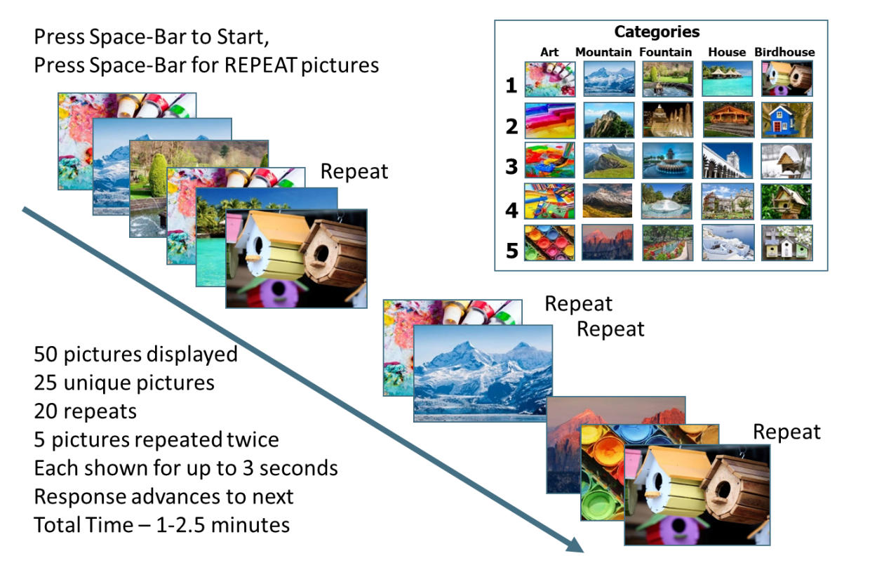
To test neuroplasticity:
Highly precise measures of memory performance required
www.memtrax.com A 2-minute Continuous Recognition Task

Slide 21
MemTrax Metrics, HAPPYneuron dataset:
Population (French and English, online)
Over twice as many females took the test, mostly age 45 to 65, in the age when women go through menopause and complain of “brain fog”

Slide 22
Initial MemTrax Metrics
The number of Responses decreases with age in both Males and Females

Slide 23
MemTrax Metrics, HAPPYneuron dataset:
Correct: HITs, Correct Rejections (1-false alarms), versus age
HITs and Correct Rejections both decline with age

Slide 24
MemTrax Metrics, HAPPYneuron dataset:
Correct: % Correct, HITs, Correct Rejections (1-false alarms),

Slide 25
MemTrax Metrics, HAPPYneuron dataset:
Response Time, HITs, false alarms
Cannot compare because half of subject made no FAs

Slide 26
MemTrax Metrics, HAPPYneuron dataset:
Response Times to HITs vs #HITs, # Correct Rejections
HITs are related to the Response Times to HITs, and speed and accuracy are correlated.
Correct Rejections are not related to Response Times to HITs.

Slide 27
MemTrax Metrics, HAPPYneuron dataset:
Response Times to HITs and False Alarms
Response Times to both HITs and False Alarms show a skewed distribution.
This skewing has been studied extensively for years without a clear explanation.
Note there are fewer false alarms, about half faster than HITs, half slower.

Slide 28
MemTrax Metrics, HAPPYneuron dataset:
Response Times to HITs vs #HITs, # Correct Rejections
A cumulative distribution of both plots shows that there are inverse survival curve dynamics, which is based on an exponential growth curve.
A negative lognormal regression explains over 98% of the variance (RevEx model). Though there is some discontinuity at the extremes.

Slide 29
MemTrax Metrics, HAPPYneuron dataset:
Response Times to HITs vs #HITs, <50y/o, >50y/o
The age-effect on Response Time is clearly demonstrated with the survival curve.
The RevEx model shows the increased difference with age as slowing increases.

Slide 30
MemTrax - Memory Test (conclusions)
HITs are likely related to successful recognition, resulting from adequate encoding into episodic memory with strongly sustained consolidation.
HITs are partially related to the Response Time, and both likely reflect functions of temporal lobe (medial and lateral)
False Alarms (1-Correct Rejections) likely represent an intrusion and may reflect frontal lobe inhibition failure.
Response Times to HITS likely represent the integrity of the whole visual perception system, including the functioning of the brain stem.
The RevEx model suggests that each 100 msec faster represents doubling the recruitment of neural resources for recognition, while each 100 msec slower reflects loss of 50% of the resources.
Accordingly, MemTrax can provide several layers of information about brain function.

Slide 31
MemTrax - Memory Test (need further analyses and clinical reports)
Further study is needed to determine test-retest stability.
Analyses can be made of the number of distracting items between the first and second appearance of an image, and then the third appearance.
The average and standard deviations of Response Times for HITs for each individual can determine the stability of visual perception and reaction. The RevEx model can be applied more meaningfully to understand the dynamics of neural processing.
Relationships to brain measurements and Alzheimer biomarkers need to be established.
The MemTrax metrics can be obtained daily to determine the benefit of experimental or clinically available medications.

Slide 32
Others (of many)
MemTrax Advantage
Computerized cognitive tests
Easy, quick, and longitudinal
CANS-MCI
CAMCOG / CANTAB
CAMCI
CogState MCI/AD
CST (Computerized Self Test)
IN/WN (IntegNeuro/WebNeuro)
Mindstreams (NeuroTrax)
MC-CARE
Staying Sharp (AARP)
Easier to administer––established model of self-administration
Works across platforms
Faster to administer
More precise in measurement of episodic memory
Better ability to track memory performance over time
Manage huge data sets, low cost

Slide 33
Publications and Research Directions
Published Works: see PubMed, search: Ashford JW or MemTrax
Ongoing Studies
Ashford J. W., Gere E., & Bayley P. J. Measuring Memory in Group Settings Using a Continuous Recognition Test. Journals of Alzheimer's Disease. 2011;27(4): 885-895.
van der Hoek MD, Nieuwenhuizen A, Keijer J, Ashford JW. The MemTrax Test Compared to the Montreal Cognitive Assessment Estimation of Mild Cognitive Impairment. J Alzheimers Dis. 2019;67(3):1045-1054. doi: 10.3233/JAD-181003.
Ashford JW, Tarpin-Bernard F, Ashford CB, Ashford MT. A Computerized Continuous-Recognition Task for Measurement of Episodic Memory. J Alzheimers Dis. 2019;69(2):385-399. doi: 10.3233/JAD-190167.
Cholerton B, Weiner MW, Nosheny RL, Poston KL, Mackin RS, Tian L, Ashford JW, Montine TJ. Cognitive Performance in Parkinson's Disease in the Brain Health Registry. J Alzheimers Dis. 2019;68(3):1029-1038. doi: 10.3233/JAD-181009.
Ashford JW. The Dichotomy of Alzheimer's Disease Pathology: Amyloid-β and Tau. J Alzheimers Dis. 2019;68(1):77-83. doi: 10.3233/JAD-181198.
Smith CJ, Ashford JW, Perfetti TA. Putative Survival Advantages in Young Apolipoprotein ɛ4 Carriers are Associated with Increased Neural Stress. J Alzheimers Dis. 2019;68(3):885-923. doi: 10.3233/JAD-181089.
Ashford JW. Treatment of Alzheimer's Disease: Trazodone, Sleep, Serotonin, Norepinephrine, and Future Directions. J Alzheimers Dis. 2019;67(3):923-930. doi: 10.3233/JAD-181106.
Bergeron MF, Landset S, Zhou X, Ding T, Khoshgoftaar TM, Zhao F, Du B, Chen X, Wang X, Zhong L, Liu X, Ashford JW. Utility of MemTrax and Machine Learning Modeling in Classification of Mild Cognitive Impairment. J Alzheimers Dis. 2020;77(4):1545-1558.
Liu X, Chen X, Zhou X, Shang Y, Xu F, Zhang J, He J, Zhao F, Du B, Wang X, Zhang Q, Zhang W, Bergeron MF, Ding T, Ashford JW, Zhong L. Validity of the MemTrax Memory Test Compared to the Montreal Cognitive Assessment in the Detection of Mild Cognitive Impairment and Dementia due to Alzheimer's Disease in a Chinese Cohort. J Alzheimers Dis. 2021;80(3):1257-1267.
MemTrax, LLC is owned and managed by Curtis Ashford
www.memtrax.com - > one million tests taken
UCSF Brain Health Registry includes MemTrax in cognitive testing battery along with self-report data (>30K participants) and ADNI-4: www.brainhealthregistry.org
China, 30,000 subjects, with MoCA (Liu et al.)
Alzheimer’s Foundation of America, memory screening: www.afamemorytest.com
Analyzing MemTrax data from over 20,000 individuals to norm across age bands, gender and education levels
Notes:
Listed as a cognitive test as part of the Medicare Annual Wellness, visit: https://www.nia.nih.gov/research/cognitive-instrument/search?title=Continuous+Recognition+Test+&field_ct_abbreviation_value

Slide 34
MemTrax is available: www.memtrax.com www.memtrax.org www.afamemorytest.com www.cognifit.com
J. Wesson Ashford, M.D., Ph.D.
Clinical Professor (affiliated), Department of Psychiatry and Behavioral Sciences
Stanford University
Director, War Related Illness & Injury Study Center (WRIISC)
VA Palo Alto Health Care System
Wes.Ashford@gmail.com ashford@stanford.edu
March 2, 2024
Slides at: http://www.medafile.com/LEC/MemTrax-2024-03-14.pptx
Search PubMed: “memtrax” for over 16 publications

