Slide 1
Top Ten Recommendations for Preventing Alzheimer’s Disease
J. Wesson Ashford, M.D., Ph.D.
Clinical Professor (affiliated), Department of Psychiatry and Behavioral Sciences
Stanford University
Director, War Related Illness & Injury Study Center (WRIISC)
VA Palo Alto Health Care System
washford@medafile.com ashford@Stanford.edu Wes.Ashford@gmail.com
Sunday, March 17, 2024
Slides at: www.medafile.com/LEC/Top10-2024.pptx
https://www.j-alz.com/editors-blog/posts/development-prevention-and-intervention-recommendations-alzheimers-disease

Slide 2
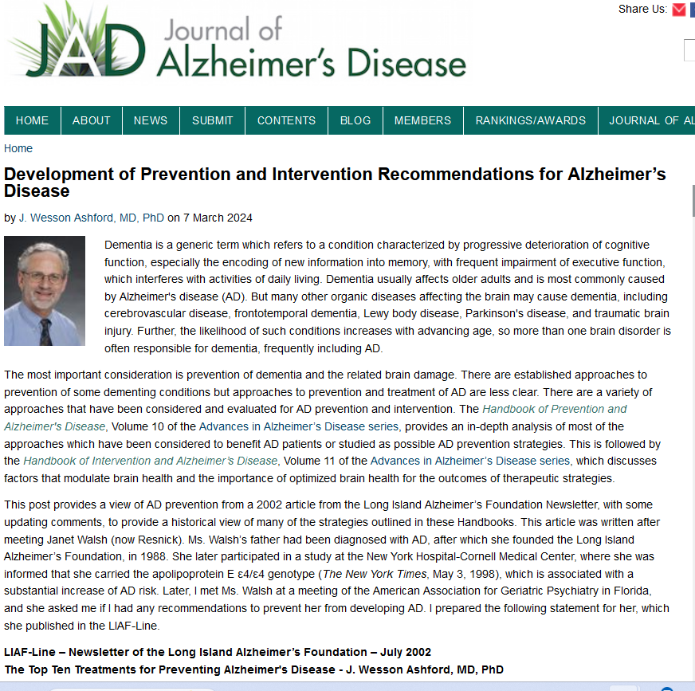

Slide 3
Disclosures
Dr. Ashford is an unpaid consultant to MemTrax, LLC, which provides an on-line screening test for memory function.
Dr. Ashford has applied for patent protection for a continuous performance memory test which he developed.
Dr. Ashford is the Chair of the Medical, Scientific, and Memory Screening Advisory Board of the Alzheimer’s Foundation of America, which provides the MemTrax memory test: www.afamemorytest.com
Dr. Ashford is a full-time employee of the VA.
The views expressed by Dr. Ashford do not represent the official views of the VA.

Slide 4
Dementia Definition
Multiple Cognitive Deficits:
  Memory dysfunction
    especially new learning, a prominent early symptom
  At least one additional cognitive deficit
    aphasia, apraxia, agnosia, or executive dysfunction
Cognitive Disturbances:
  Sufficiently severe to cause impairment of occupational or social functioning and
  Must represent a decline from a previous level of functioning

Slide 5
Need for Mass Screening, Early AD Detection
AD, dementia, and memory problems are difficult to detect when they are mild
  especially Alzheimer’s disease (AD)
  the problem is subtle –
    MCI – mild cognitive impairment,
    minor neurocognitive disorder
  family members avoid the problem and compensate for the patient
  physicians tend to miss the initial signs and symptoms
  about 90% missed early, especially early AD
  about 25% - 50% are still missed late, at moderate and severe levels
There is no efficient laboratory test – brain scan, CSF, blood – to accurately and efficiently diagnosis dementia or AD
There are important accommodations and interventions that should be made when there are cognitive impairments
  (like needing glasses or having driving restrictions if you have vision problems)

Slide 6
Why Screening is Important to Consider
Cognitive impairment is disruptive to human well-being and psychosocial function
Cognitive Impairment is potentially a prodromal condition to dementia and Alzheimer’s disease
Dementia is a tremendously costly condition
With the aging of the population (even beyond the baby-boom) there will be a progressive increase in the proportion of elderly individuals in the world
Screening will lead to more diagnoses which will advance the understanding of Alzheimer’s disease and foster the development of better treatments

Slide 7
Benefits of Early AD Diagnosis
Social
Undiagnosed AD patients face avoidable problems
    social, financial
Early education of caregivers
    how to handle patient (choices, getting started)
Advance planning while patient is competent
    will, proxy, power of attorney, advance directives
Reduce family stress and misunderstanding
    caregiver burden, blame, denial
Promote safety
    driving, compliance, cooking, etc.
Patient’s and Family’s right to know
    especially about genetic risks
Promote advocacy
    for research and treatment development

Slide 8
Benefits of Early AD
Medical
Early diagnosis and treatment and appropriate intervention may:
  improve overall course substantially
  lessen disease burden on caregivers / society
Specific treatments now available
  (anti-cholinesterases, memantine) (aducanumbab of questionable benefit)
  Improve cognition
  Improve function (ADLs)
  Delay conversion from Mild Cognitive Impairment to AD
  Slow underlying disease process, the sooner the better
  Decreased development of behavior problems
  Delay nursing home placement, possibly over 20 months
  Delay nursing home placement longer if started earlier

Slide 9
DSM-5 (APA Diagnostic and Statistical Manual)
Inventory for Neurocognitive Impairment and Global Assessment of Severity
I) Learning and memory
A) Recent memory
B) Remote memory
C) Orientation
II) Complex Attention
III) Executive Function, planning, decision-making, inhibition,
judgement, problem solving, abstract thinking
IV) Language function, aphasia (dominant hemisphere)
V) Perceptual-motor function
A) Visuospatial organization, agnosia (non-dominant hemisphere)
B) Home activities, motor coordination, praxis
VI) Social Cognition
A) Community affairs, social function, and interactions with others
B) Personal care, habits, hygiene, fully incontinent.
http://www.medafile.com/AFA/DSM5-NCI.htm

Slide 10
Differential Diagnosis
(mnemonic device: AVDEMENTIA)
Alzheimer Disease (pure ~40%, + mixed~70%)
Vascular Disease, MID (5-20%)
Drugs, Depression, Delirium
Ethanol (5-15%)
Medical / Metabolic Systems
Endocrine (thyroid, diabetes), Ears, Eyes, Environment
Neurologic (other primary degenerations, etc.)
Tumor, Toxin, Trauma
Infection, Idiopathic, Immunologic
Amnesia, Autoimmune, Apnea, AAMI
Adapted from Yesavage, 1979

Slide 11
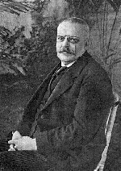
Alzheimer’s Disease
First described by Alois Alzheimer, a German neuropathologist, in 1907
Observed in a 51-year-old female
patient with paranoia, memory loss, disorientation, and hallucinations
Postmortem studies characterized senile plaques and neurofibrillary tangles (NFTs) in the cerebral cortex
  Senile plaques: Extracellular accumulation of insoluble
  fragments of beta-amyloid (Aβ₁₋₄₂)
  NFTs: Intracellular accumulation
  of hyperphosphorylated
  tau strands
Notes:
Purpose:
To introduce Alzheimer’s disease and the discovery of senile plaques and neurofibrillary
tangles
Key Points:
Frau Auguste D. was brought by her husband to Alois Alzheimer at a German mental asylum. The husband complained that she had changed drastically over the last few years, that she had become insanely jealous, had severe memory loss, fits of screaming, and hallucinations. He no longer recognized the woman he was married to.
Upon her death, Alois Alzheimer examined her brain and observed abundant senile plaques and strange neurofibrillary formations in the cerebral cortex, which he determined were responsible for her dementia.
As we now know, senile plaques, made up of insoluble amyloid beta fragments, and neurofibrillary tangles of hyperphosphorylated tau are the hallmarks of Alzheimer’s disease.

Slide 12
Cholinergic Changes in AD – 1976
(Davies & Maloney, 1976; Bowen et al., 1976; Perry et al., 1977;
The most prominent neurotransmitter abnormalities in AD are cholinergic
  Reduced activity of choline acetyltransferase (synthesis of acetylcholine)¹
Reduced number of cholinergic neurons in late AD (particularly in basal forebrain)²
Selective loss of nicotinic receptor subtypes in hippocampus and cortex^{1,3}
1. Bartus RT et al. Science. 1982;217:408-414.
2. Whitehouse PJ et al. Science. 1982;215:1237-1239.
3. Guan ZZ et al. J Neurochem. 2000;74:237-243.
Notes:
The associated decline of cognitive function in AD with decreased cholinergic neurotransmission
in the cortex, hippocampus, and amygdala is the basis for what is known as the cholinergic
hypothesis of AD

Slide 13
Problems with the Cholinergic Hypothesis
Many cholinergic neurons throughout brain, spinal cord, but only discrete groups of ACh neurons in the nucleus basalis of Meynert are affected in AD
Numerous other neurotransmitter systems are affected in AD, the earliest are norepinephrine neurons of the LOCUS COERULEUS
Cholinergic agents are only modestly effective in treating AD, slowing progression
No clear relationship between acetylcholine and microscopic neuropathological features

Slide 14
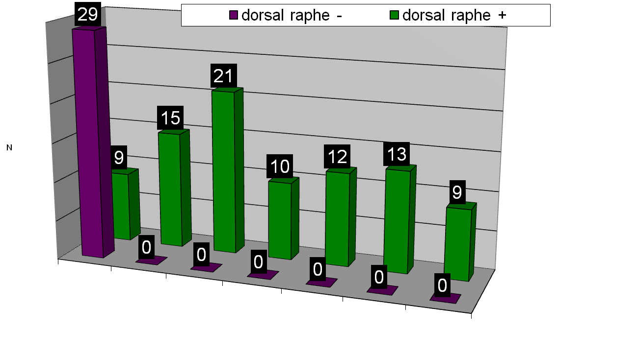
Norepinephrine changes occur first in AD.
Bondareff, Mountjoy, Roth, 1981
Braak & Tredici, 2011
Trillo et al., 2013
Theofilas et al., 2018
(see Ashford, 2019, JAD for review)
Serotonin neuron loss in AD
ALL BB≥0 – dorsal raphe + 22.5% BB 0 – dorsal raphe +
Dorsal raphe – BB 0.5???
Grinberg et al., 2009
Notes:
14

Slide 15
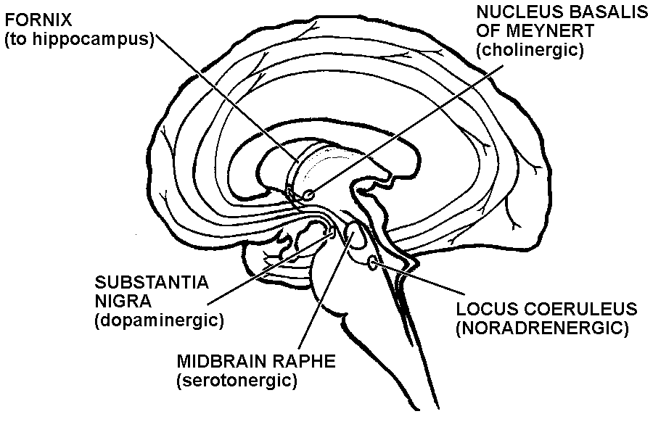
Specific groups of cholinergic, serotonergic, and noradrenergic that project to the cortex, and glutamatergic and somatostatinergic GABA neurons of discrete cortical regions are selectively affected in Alzheimer’s disease – these neurotransmitters stimulate APP-alpha-secretase!!!
Cortex
- Glutamate neurons
- highly affected by AD
- detail memory
- Rx: memantine
GABA neurons
- Somatostatinergic
neurons affected by AD
– memory modulation
Affected by AD
-memory-write signal
Rx:
cholinesterase inhibitors
(not affected by AD - movement)
(Affected by AD
- Operant conditioning)
(Affected by AD early
- Classical conditioning)

Slide 16
Neurotransmitter therapies
Cholinergic system –
  Modest clinical benefit of cholinesterase inhibitors, improvement, slowing of progression
  Marked, rapid decline frequent on discontinuation
  No benefit from any other treatments
  No evidence of benefit in early AD or mild cognitive impairment
Serotonergic system – none shown effective
Noradrenergic system – none shown effective
Dopaminergic system – none shown effective
Glutamate system
  NMDA modulator memantine
    Slight improvement in moderate to severe AD
    May improve behavior or make it worse
    May increase life-expectancy to near normal
GABA system – none effective (e.g., benzodiazepines – exacerbate)

Slide 17
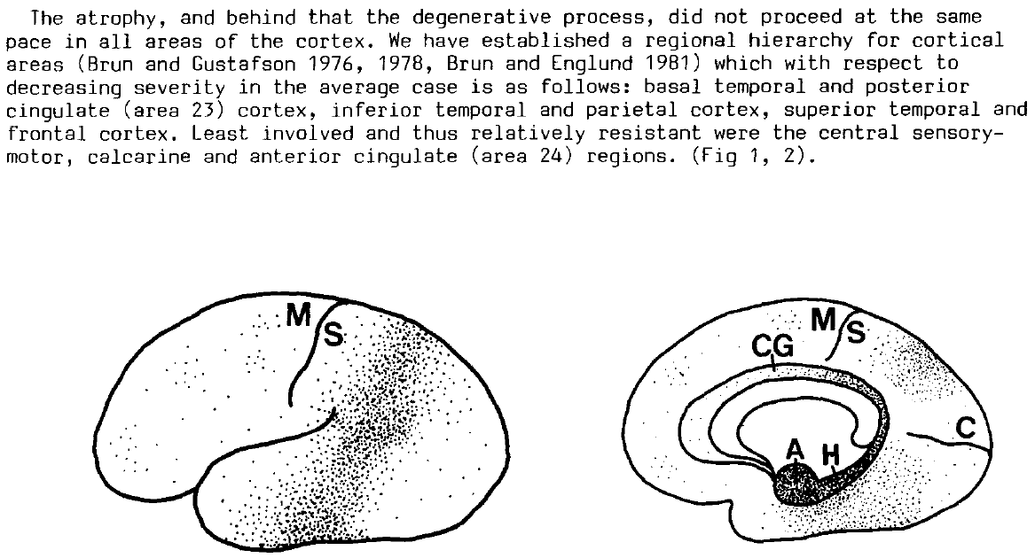
Discrete regions of the cerebral cortex are selectively affected by Alzheimer pathology
Brun & Englund, 1981, 1986

Slide 18

Braak & Braak, 1985; 1991; Braak et al., 2006

Slide 19
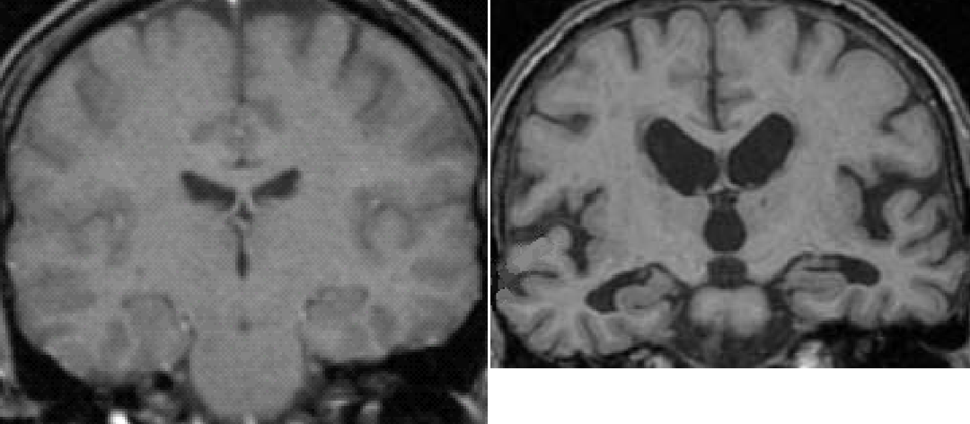
MRI scans of brain, coronal sections
Normal Alzheimer
Ashford, 1988

Slide 20
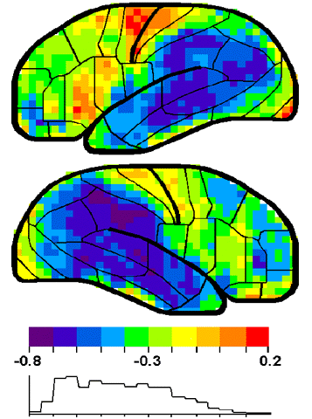
a
Correlation of SPECT scan measures of cerebral blood flow across cerebral cortical regions with Time-Index estimation of severity, calculated from MMSE scores
The areas of highest correlation are those with the highest demands from neuroplasticity
Ashford et al,
2000

Slide 21
AD COGNITIVE PATHOLOGY
REFLECTS FAILURES OF
MEMORY STORAGE

Slide 22
ALZHEIMER PATHOLOGY AND NEUROPLASTICITY
AD ATTACKS NEUROPLASTIC MECHANISMS
NEUROPLASTICITY AS THE FOCUS OF THE ALZHEMER ATTACK
FOCUS ON NEUROPLASTIC MECHANISMS TO TREAT ALZHEIMER’S DISEASE
Scheibel, 1982
Ashford & Jarvik, 1985
Geddes et al., 1985
Geddes & Cotman, 1986
Crutcher, 1986
Flood & Coleman, 1986
Mattson, 1988
Ashford et al., 1989
Teter & Ashford, 2002
Ashford & Bayley, 2013
Ashford, 2015, 2019
2021 – PubMed: 3,618 results

Slide 23
Neuroplasticity Hypothesis of Alzheimer’s Disease
At all Bio-Psycho-Social System Levels, the Alzheimer Process Attacks Mechanisms Associated with Memory
SOCIAL SYSTEMS REQUIRING MEMORY
    INSTRUMENTAL ADLs - EARLY
    BASIC ADLs - LATE
PSYCHOLOGICAL MEMORY SYSTEMS
    PRIMARY LOSS OF SHORT-TERM MEMORY
      LEARNING PROCESSES – CLASSICAL, OPERANT
    LATER LOSS OF LEARNED SKILLS
NEURONAL MEMORY SYSTEMS
    CORTICAL
      GLUTAMATERGIC LARGE NEURONS
      SOMATOSTATINERGIC GABA NEURONS
    SUBCORTICAL
      acetylcholine, norepinephrine, serotonin neurons – stimulate APP alpha secretase
    CELLULAR-LEVEL PLASTIC PROCESSES
      Alpha-secretase cleavage of APP leads to nexin formation and new synapses
      Default beta-secretase cleavage leads to Abeta and pTAU and destruction of old synapses
      APOE chaperones cholesterol from destroyed synapses to new synapses
Ashford & Jarvik., 1985; Ashford et al., 1989; 1992; 1995; 1998, 2023; Teter & Ashford, 2002

Slide 24
NEUROPLASTICITY HYPOTHESIS
OF ALZHEIMER PATHOLOGY
AD ATTACKS NEUROPLASTIC MECHANISMS OF THE BRAIN
SENILE PLAQUES AND NEUROFIBRILLARY TANGLES ARE THE VISIBLE SCARS OF THE ATTACK, NOT THE PATHOGENIC AGENTS
THERE IS NO EVIDENCE THAT THE BETA-AMYLOID PROTEIN IS HARMFUL TO THE BRAIN, AND AMYLOID DEPOSITS ARE POORLY CORRELATED WITH THE DEMENTIA, NOT LIKELY IN A CAUSATIVE CHAIN
NEUROFIBRILLARY TANGLES ARE CORRELATED WITH THE DEMENTIA, BUT NOT CAUSAL OF DEMENTIA
EARLY CAUSAL GENETIC FACTORS CAN ALL BE RELATED TO THE AMYLOID PRE-PROTEIN AND EITHER ITS OVER-PRODUCTION, OR MODULATION OF BETA- OR GAMMA-SECRETASE CLEAVAGE
LATE CAUSAL GENETIC FACTORS, MOSTLY APOE (>50%), ARE RELATED TO CHOLESTEROL MANAGEMENT AND NUMEROUS OTHER BRAIN NEUROPLASTICITY, METABOLIC, AND PROTECTIVE FACTORS
THE HARMFUL EVENT IS THE HYPER-PHOSPHORYLATION OF THE MICROTUBULE-ASSOCIATED PROTEIN TAU, LEADING TO PAIRED HELICAL FILAMENTS, NEUROPIL THREATS, AND LOSS OF SYNAPSES, WITH PROLONGED DEGENERATION OF NEURONS WITH HIGH NEUROPLASTICY
Ashford JW. Neuroplasticity: The Critical Issue for Alzheimer's Disease and Links to Obesity and Depression. Am J Geriatr Psychiatry. 2023 Jul 15:S1064-7481

Slide 25
Alzheimer Neuroplasticity Cascade Hypothesis
Genetic Factors – some related to APP
  SNPs - related to APP/beta (strongest factors, but rare), APP 50% excess – Down Syndrome
  APOE genotype – related to management of cholesterol in neuronal membranes (most common)
High energy, membrane processing demand of neuroplasticity stresses vulnerable neuroplastic neurons
APP cleavage control (neuroplasticity – APP switch)
  Alpha stimulation failure (inadequate stimulation by norepinephrine, serotonin, acetylcholine)
  Resulting Beta degradation over-activity (caused by stress, excess new information)
Excess Beta-cleavage then Gamma-cleavage of APP increases AICD - APP-intracellular domain
  Gamma secretase modulation prevents AD (NSAIDs, statins), decreases Abeta 42/40 ratio
  AICD-42 stimulates tau-hyperphosphorylation causing synapse retraction
Excess AICD-42 causes Tau hyperphosphorylation – pTau
  Hyperphosporylated pTau causes Paired helical filament (PHF) formation
  PHF aggregation leads to Neuropil Thread formation, which cause dendritic amputation, breakage
  Dendritic amputation causes massive synapse loss and dementia
Synapse formation disruption leads to episodic memory failure, then rote memory failure
Neuropil threads migrate back to cell body to cause tangles (leads to neuron death, not memory loss)
For treatment assessment, need to measure episodic memory more precisely

Slide 26
The Energy Demands of Neuroplasticity
Brainstem energy management – serotonin, norepinephrine, acetylcholine
  Sleep issues – lower beta-amyloid levels while sleeping
  Exercise – muscle/BDNF; bone/osteocalcin
  Lipid management – Leptin, insulin
Synapse creation, destruction decision pathway – APP
  Large energy requirements, requires huge movement of membrane components, cholesterol
  Management from brainstem by serotonin, norepinephrine, acetylcholine •
Cholesterol / membrane management proteins
  omega-3-FAs, DHA – APOE
Energy generation systems – mitochondria, TOMM-40
Endosomal trafficking proteins – SORL1
Inflammatory mechanism – for glia to manage synaptic debris – TREM2
TAU phosphorylating, dephosphorylating proteins (GSK-3beta, phosphatases)

Slide 27
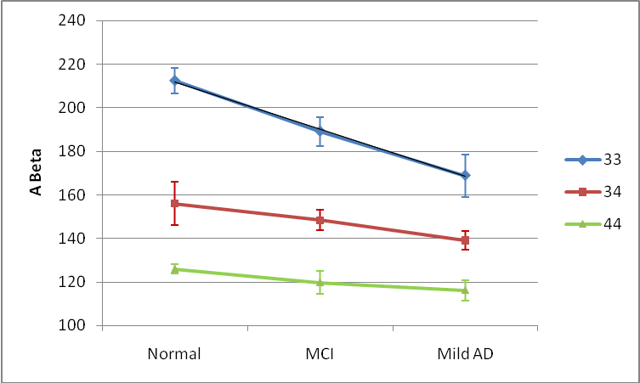
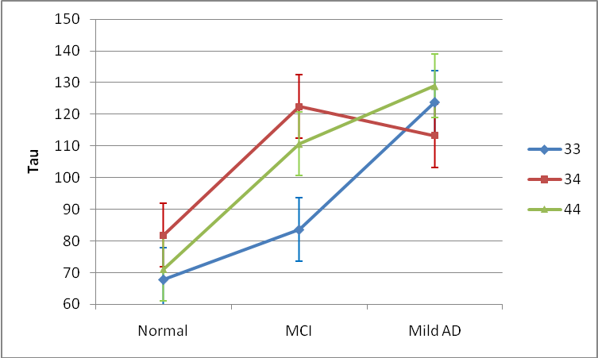
ADNI Data – CSF ABeta, total tau
CSF beta-amyloid
Comparison | p-value
33 vs 34 | <.0001
33 vs 44 | <.0001
34 vs 44 | 0.08
Normal vs MCI | 0.57
Normal vs Mild AD | 0.15
MCI vs Mild AD | 0.20
CSF TAU
Ashford et al., 2011, JAD, Handbook of Imaging the Alzheimer Brain
Comparison | p-value
33 vs 34 | 0.07
33 vs 44 | 0.67
34 vs 44 | 0.99
Normal vs MCI | 0.05
Normal vs Mild AD | <.01
MCI vs Mild AD | 0.06
Notes:
27

Slide 28
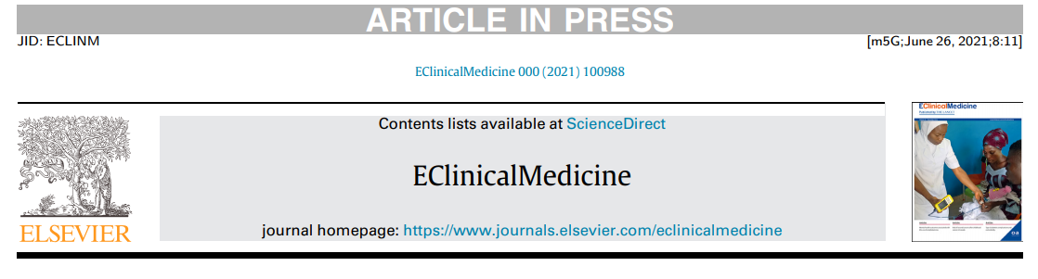
High cerebrospinal amyloid-b 42 is associated with normal cognition in individuals with brain amyloidosis
Andrea Sturchioa,b , Alok K. Dwivedic , Christina B. Youngd , Tarja Malme , Luca Marsilia , Jennifer S. Sharmaa , Abhimanyu Mahajana , Emily J. Hilla , Samir EL Andaloussif , Kathleen L. Postond , Fredric P. Manfredssong , Lon S. Schneiderh , Kariem Ezzatf,1 , Alberto J. Espaya, * ,1
a James J. and Joan A. Gardner Family Center for Parkinson’s disease and Movement Disorders, Department of Neurology, University of Cincinnati, Cincinnati, OH, USA b Department of Clinical Neuroscience, Neuro Svenningsson, Karolinska Institute, 171 76 Stockholm, Sweden c Division of Biostatistics & Epidemiology, Department of Molecular and Translational Medicine, Texas Tech University Health Sciences Center, El Paso, TX, USA d Department of Neurology and Neurological Sciences, Stanford University School of Medicine, Stanford, CA, USA e A.I. Virtanen Institute for Molecular Sciences, University of Eastern Finland, Kuopio, Finland f Department of Laboratory Medicine, Clinical Research Center, Karolinska Institutet, Stockholm, Sweden g Department of Neurobiology, Barrow Neurological Institute, Phoenix, AZ, USA h University of Southern California Keck School of Medicine, Los Angeles, CA, USA
:Normal cognition and hippocampal volume are associated with preservation of high soluble Ab42 levels despite increasing brain amyloidosis.

Slide 29
Role of Amyloid Protein Precursor (APP) in Alzheimer’s disease
APP is located on chromosome 21
Trisomy 21 (Down Syndrome) is associated with high levels of brain amyloid and Alzheimer pathology in nearly all cases by age 40 (50% excess APP)
All of the early onset AD genetic factors affect APP, near the beta-secretase cleavage site, or the gamma-secretase (presenilins) which can cleave APP
APP cleavage by beta- then gamma-secretase forms beta-amyloid and AICD (APP intra-cellular domain)
Beta-amyloid is toxic to synapses
AICD causes tau hyperphosphorylation (? critical issue in AD)
APP may be a critical mechanism in neuroplasticity
Management of this protein may be central for AD prevention

Slide 30
β-Amyloid Cascade Hypothesis a total failure
This hypothesis has dominated the field and led to tens of billions$ in research that has provided no benefit to patients (now adacanumab)
The problem is the focus on β-Amyloid:
It does not explain the lack of a clear relationship between Aβ measures and
AD dementia or other AD-related pathology
Aβ has been shown to be a highly turned-over normal protein
Aβ is increased during neuronal repair and decreased in AD
Since Aβ decreases in the CSF with AD risk, it is unlikely to cause AD
Aβ deposits are predominantly in the frontal lobes, not the tempero-parietal lobes
Anti-bodies against Aβ remove the protein but do not slow the course of AD
This hypothesis does not explain how Aβ selectively affects neuroplasticity, memory
APP (the amyloid protein precursor) likely has a central role in neuroplasticity and the formation of memories and should be the target of explanatory and therapeutic investigations.
Notes:
30

Slide 31
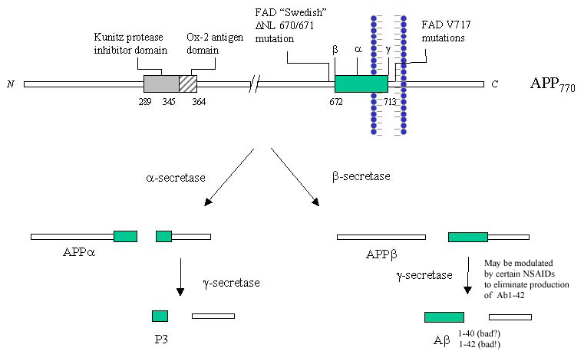
extra cellular or in endosome
intracellular
APP – formed
during learning
- ? XS in APOE-e4
Iceland mutation
APP-673 – no AD
Lipid raft
Formed by cholesterol
-Transported by APOE
(from macroglia)
ADAM-10 - Stimulated by acetylcholine
through muscarinic receptor, norephinephrine, and serotonin
APP
switch
Involvement of cholesterol suggests
possible benefit of statins
Pathway to build new synapses
Pathway to remove old synapses
NEXIN to stimulates new synapse growth
with ADAM-10 activating neurexin
NO
Amyloid –beta:
? Free-radical generator
? To destroy old synapses
Turn-over – 8 hours
Clearance – IDE, APOE
NSAIDS reduce
AD risk
?
AICD
JW Ashford, MD PhD, 2002 - 2018
Favored when
lipid raft too thick

Slide 32
Evidence that the Amyloid-beta Protein Precursor Intracellular Domain (AICD)
Derives From beta-Secretase-Generated C-Terminal Fragment
Brice Flammang, Raphaelle Pardossi-Piquard, Jean Sevalle, Delphine Debayle, Anne-Sophie ¨ Dabert-Gay, Aurelie Thevenet, Inger Lauritzen and Frederic Checler ´ ∗
Journal of Alzheimer’s Disease 30 (2012) 145–153 DOI 10.3233/JAD-2012-112186 IOS Press 145
Universit´e de Nice-Sophia-Antipolis, Institut de Pharmacologie Mol´eculaire et Cellulaire, UMR6097CNRS, team labeled “Fondation pour la Recherche M´edicale” and “Excellence Laboratory Distalz”, Sophia-Antipolis, Valbonne, France
The gamma-secretase complex exhibits a better efficiency toward C99 yielded after beta-cleavage in the amyloidogenic pathway, compared to C83 that is produced following alpha-cleavage of APP in the non-amyloidogenic pathway. This result is consistent with recent data from Goodger et al. 2009 showing that AICD production mostly occurs through the endosome-mediated –secretase-linked pathway and was reinforced by Belyaev et al., 2010, who confirmed that beta- and gamma- but not alpha-secretase inhibitors abolished AICD mediated up-regulation of neprilysin, one of the AICD target genes.

Slide 33
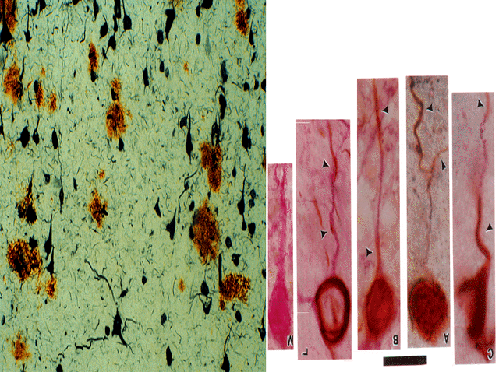
Ashford et al., 1998
J Neuropathol Exp Neurol.57:972

Slide 34
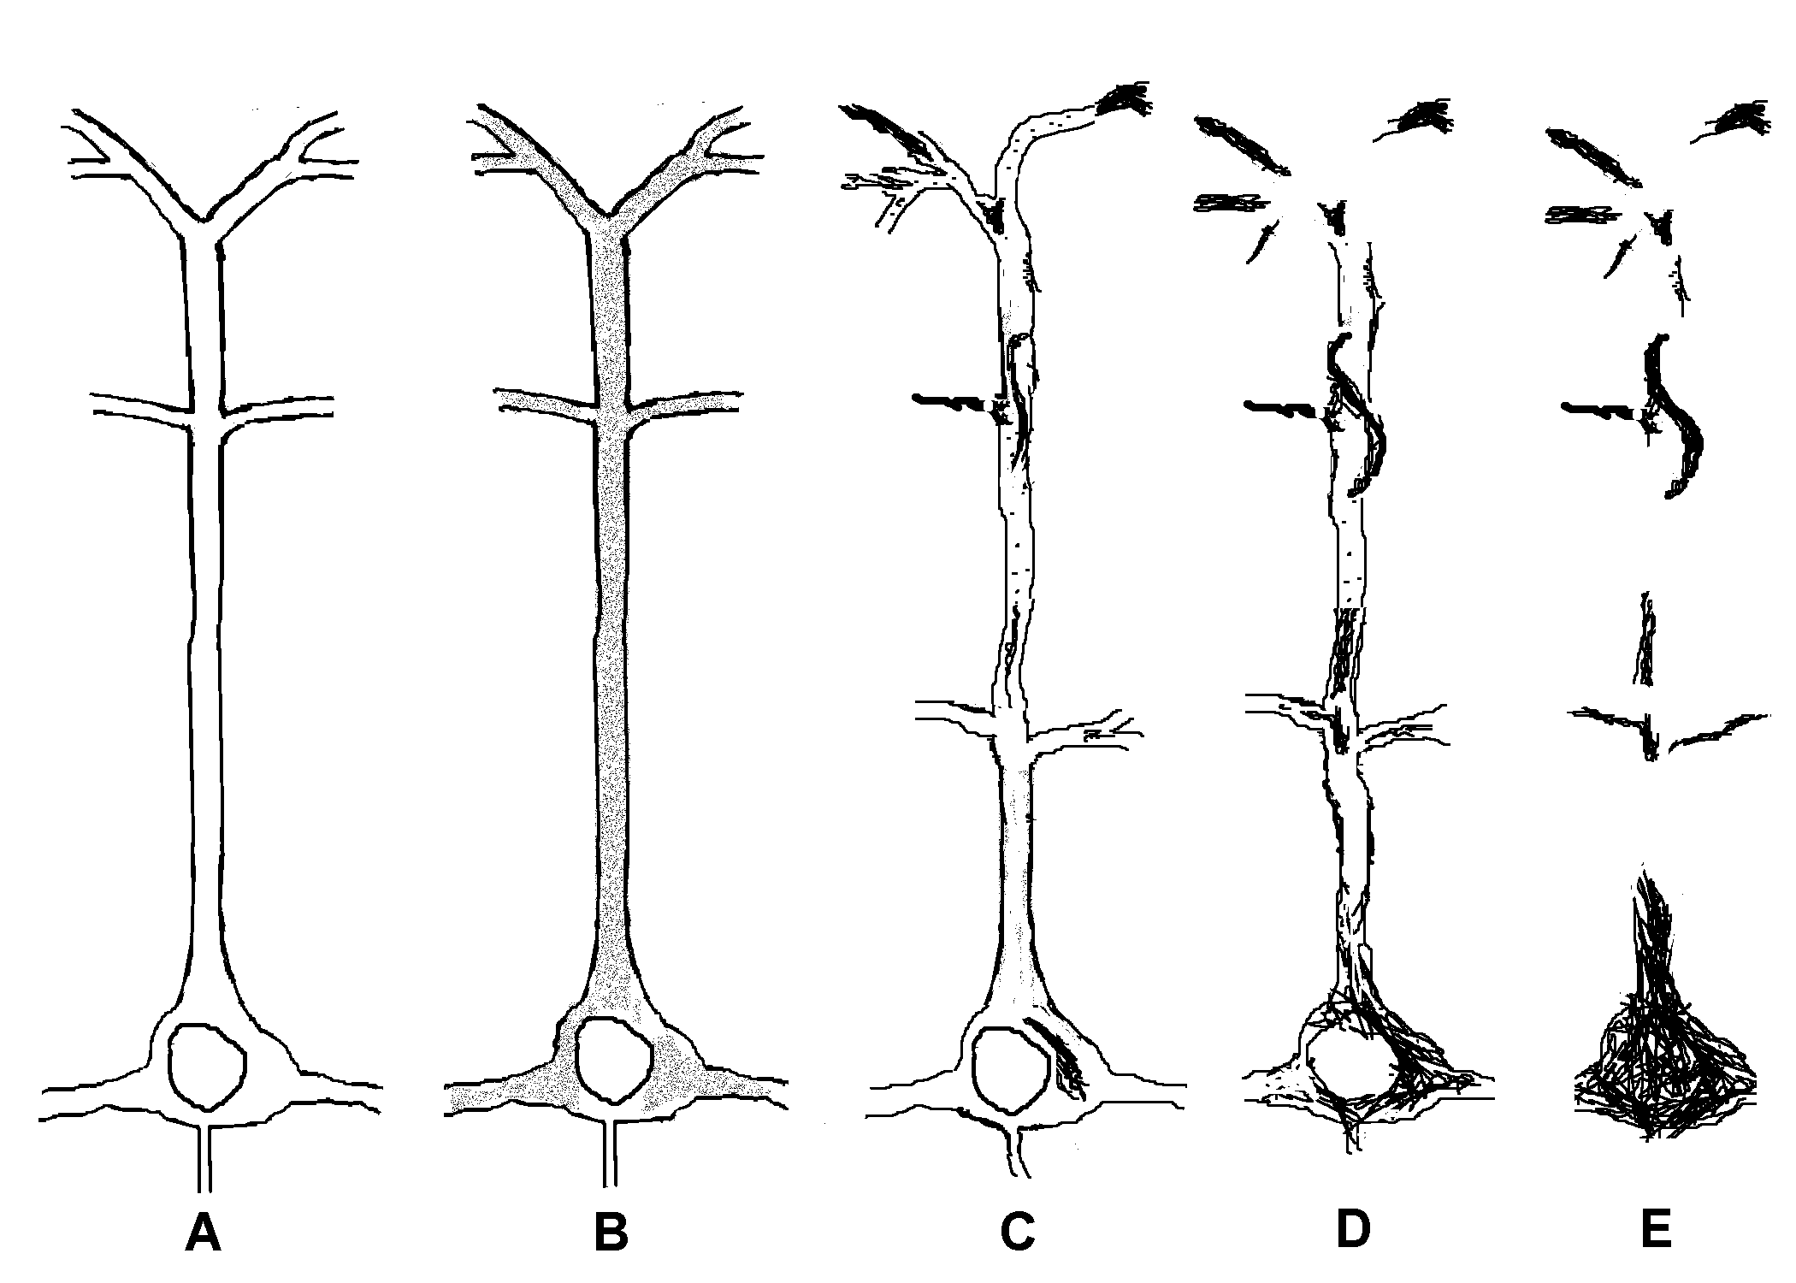
Progression of tau hyperphosphorylation to neuropil threads and neurofibrillary tangles
Ashford et al., 1998, J Neuropathol Exp Neurol.57:972

Slide 35
To Screen and Quantitate Dementia, and Test Therapeutic Modalities, Need Rapid Assessment of Episodic Memory Function
Importance of episodic memory assessment
  Disruption in many conditions – Alzheimer’s disease, cerebral hypoxia, etc.
  Major concerns for driving, TBI, anesthesia, chemobrain, ICU psychosis
Challenges
  The precise measurement of memory
  Lack of short assessment tools
  Cognitive assessment tools that can be used in a variety of settings (on-line)
  Test stability across administrations
  Test-retest learning
  Tiredness, confusion with repeated testing
  Engagement

Slide 36
“What you can’t measure you can’t treat”
Need better measurement systems for screening, longitudinal assessment, outcome evaluation
Major push by NIA to develop better systems for cognitive and memory measurement
  www.detectcid.org
  www.memtrax.com
Development of on-line registry programs to assemble populations at risk for dementia and Alzheimer’s disease
Monitor change over time

Slide 37
Comprehensive Screening Plan
At age 50 – initial screen, review risks
  Consider dementia family history
  Review of Systems, Vital Signs
  Brief Cognitive Evaluation
  CBC, B12, cholesterol
  Begin yearly assessments if high risk
At ages 55, 60 - Follow-up assessments
  Review of Systems, Vital Signs
  Brief Cognitive Evaluation
  CBC, B12, cholesterol
At age 65 - Beginning annual assessments
  Review of Systems, Vital Signs
  Brief Cognitive Evaluation
  CBC, B12, cholesterol

Slide 38
TOP 10 HEALTHY BEHAVIORS to Prevent AD
Exercise – walking, running, swimming, bicycling, yoga, Pilates
  Increase osteocalcin
  Increase BDNF
Diet (continually monitor and improve your diet)
  Mediterranean
  Omega-3-fatty acids (may be critical for APOE-e4 -Yassine)
Maintain a healthy Body Mass Index (BMI)
Maximize mental stimulation - Education – early and continued
Socialization – attend to your social network
Sunlight (keep your vitamin D in upper mid-range normal)
Avoidance of toxic and intoxicating substances
Safety – avoid traumatic brain injuries (for contact sports – use helmet)
Sleep – (6-8 hours per night, consider use of melatonin, trazodone)
Monitor your physical health (BP, cholesterol, glucose, B12) and your mental, cognitive, and memory health
  (monitor on-line: www.memtrax.com )
(Ashford, since 2000)

Slide 39
None of the prevention suggestions have strong evidence supporting their use
- Annals of Internal Medicine, 2018: 4 articles
Evidence for a benefit of physical activity interventions is largely insufficient, multi-domain intervention had low-strength evidence
  Brasure et al. (but the FINGER study has some very encouraging evidence)
There is no support for studied pharmacologic interventions for cognitive protection in persons with normal cognition or MCI
  Estrogen, raloxifene, anti-hypertensives, NSAIDs, statins, AChEIs
  Fink et al.
There is insufficient evidence to support any over-the-counter supplement for cognitive protection
  Omega-3-FA, soy, ginko biloba, B vitamins, vitamin D, C or beta-carotene
  Butler et al. (but a 2021 report – CITAD – claims 60% protection with multivitamins)
Cognitive training improves performance only in the domain trained
  Butler et al. (recent judgment against Lumosity for such claims)
The real problem may be studies with inadequate outcome measures
There is evidence that controlling Blood Pressure is beneficial (? vascular dementia)

Slide 40
Alzheimer prevention and early treatment focus: APP
Decrease APP transcription
Stabilize the APP Switch
  Can the APP Switch be controlled by mental, physical exercise, better sleep, more education (probably minor effects)? (? BDNF), bryostatin (PKC, negative trial reported in 2019)
  Augment alpha-secretase (ADAM-10) activity (neurotransmitter agents, leptin)
  Modulation of beta-secretase effect at APP673 (Icelandic mutation)
  BACE inhibitors – important idea, no evidence of benefit
Modify the gamma-secretase cleavage
  Gamma-secretase inhibitors – important idea, no evidence of benefit
  Can affects of certain NSAIDs (flurbiprofen, ibuprofen) have an early effect on gamma-secretase to prevent Abeta42 from forming and prevent AD, at least in APOE-e4 carriers?
  Other gamma-secretase modulators under development
  Use statins / Omega-3 fatty acids , DHA to decrease membrane thickness (over many years)
Stimulate Neuroplasticity, support synapses
  Exercise to increase BDNF, osteocalcin (possibly repetitive Transcranial Magnetic Stimulation)
  LEPTIN to modify central neuroplastic mechanisms, lipid configurations
Abeta deposit removal, anti-bodies, oligomer blockage – no evidence of benefit

Slide 41
Current Possibilities to Prevent AD
Anti-cholinesterase treatments to prevent AD
  May need to be started early at very low doses, build up progressively
  Has not had any clear benefits
Immunologic therapy to eliminate beta-amyloid
  Preliminary trials appear to remove deposits – lower insulin levels
  Aducanumab (Aduhelm) approved by FDA – 6/2021 - controversial
  Removing brain amyloid deposits does not seem to stop cognitive decline
Specific treatments for APOE modulation
  APOE may be related to statin effects, diet, DHA (omega-3-FA for brain)
  Diet, exercise may help APOE-e4 carriers (FINGER study)
  Leptin may modulate APOE formation, lipid raft thickness
  APOE-e4 modulation – bumetanide (Taubes…Huang, 2021)
Medication to prevent tau hyperphosphorylation
  Lithium and valproic acid, which inhibit GSK-3beta may be helpful
  Available and beneficial in open studies, no clinical trials to support

Slide 42
Pathways to Prevent / Treat AD (Dementia)
NMDA receptor modulators (memantine, may soon consider ketamine, Epsom Salts – magnesium sulfate)
  Early treatment may prevent excitotoxic neuron damage, with anti-convulsant, extend life
Prevention of beta-amyloid-42 cleavage
  Certain NSAIDs may prevent formation – modulation of gamma-secretase
  Statins may keep lipid-raft membranes thinner
Therapy to change processing of amyloid protein precursor
  Abeta immunologic therapy removes deposits – but no slowing of dementia
  Bryostatin may stimulate alpha-secretase to decrease beta products (trial failed, may need to re-position)
Specific treatments for APOE modulation
  May be related to statin effects, diet (from birth), DHA (omega-3-FA for brain)
  Leptin may modulate APOE formation, lipid raft thickness
Brainstem neurotransmitter augmentation to activate alpha-secretase, decrease beta-cleavage
  Norepinephrine (locus coeruleus) neuron protection – formoterol as beta-agaonist
  Serotonin neuron (mid-line raphe nuclei) - trazodone to stimulate 5HT receptors
  Cholinergic augmentation - Anti-cholinesterase treatments
  May need to be started early at very low doses, build up progressively – short acting galanatamine
Medication to prevent tau hyperphosphorylation
  Lithium and valproic acid, which inhibit GSK-3beta, may be helpful
  Need medications to block AICD induction of tau hyperphosphorylation

Slide 43
Alzheimer prevention and early treatment - Non-APP, Psycho-Social interventions
Develop treatments to control AICD, prevent pTAU excess
  (decrease CSF TAU) Lithium, valproic acid (GSK3-beta inhibitor)
  Methylene blue (TAU binding),
  fluoride (to bind aluminum)
Explore treatments of mitochondria, SIRT1, other proteins (GWAS-SNP):
  Resveratrol (red wine - grape skin, CoQ10, curcumin)
Education - decreases Alzheimer risk, many explanations for why
  (e.g, better diet, fewer traumatic brain injuries, more cognitive reserve, less stress on memory)
Computer tests to monitor memory, cognition, neuropsychiatric conditions
  MemTrax - quick, fun, inexpensive, potentially adaptable to detect very early changes
  (No evidence for computer games as benefit or treatment – recent judgement against Lumosity)
Exercise – walking (or running), swimming, bicycling, yoga, Pilates, dance
  (increase BDNF vs osteocalcin) – exercise may need to be intense to have benefit
Brain Stimulation – repetitive Transcranial Magnetic Stimulation (rTMS)
Sleep – improvement may decrease AD pathology
  Trazodone, melatonin, magnesium

Slide 44
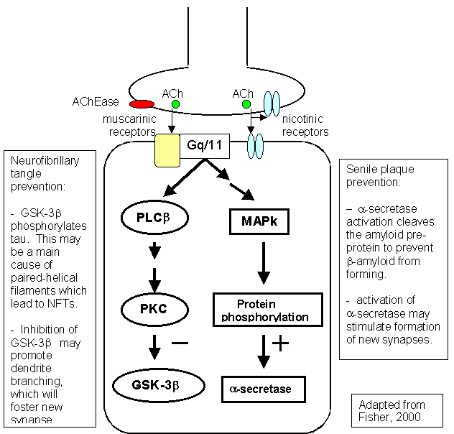
Acetylcholine may prevent Alzheimer pathology
Lithium and valproic acid also inhibit glycogen-synthase-kinase 3-beta (GSK3β)

Slide 45
Future directions for Alzheimer genetics: prevention and early treatment
Understanding the Genes is the key to treating and preventing AD
Genotyping – GWAS will soon be done on all newborns
Large population studies will redefine risk-factors by genotype
Preventive measures based on genetics – life-time intervention
Modify APOE protein to mimic e2, life-time prevention, nutritional therapy? (Yassine)
  Transfection, decrease APP transcription, or block APOE action
Treatments based on genetics – could be dietary modification
Specific treatments for APOE modulation
  May be related to statin effects, diet, DHA (omega-3-FA for brain)
  Leptin may modulate APOE formation, lipid raft thickness
  Did APOE-e3/e2 appear because of the addition of meat to the diet 300,000 years ago

Slide 46
Prevent Alzheimer’s Disease
J. Wesson Ashford, M.D., Ph.D.
Clinical Professor (affiliated), Department of Psychiatry and Behavioral Sciences
Stanford University
Director, War Related Illness & Injury Study Center (WRIISC)
VA Palo Alto Health Care System
Wes.Ashford@gmail.com washford@medafile.com ashford@stanford.edu
Sunday, March 17, 2024
Slides at: http://www.medafile.com/LEC/Top10-2024.pptx
https://www.j-alz.com/editors-blog/posts/development-prevention-and-intervention-recommendations-alzheimers-disease

