Slide 1
The War Related Illness and Injury Study Center
A National VA Post-deployment Resource

Slide 2
Agenda
Mission
History
Clinical Care
Translational Research
Outreach & Professional Education
Inform Policy
The Future

Slide 3
WRIISC Mission
To improve the health, quality of life and function of Veterans with post deployment concerns through:
  Clinical care
  Research
  Education
  Risk communication
Notes:
Success is achieved through the integration of these activities to enhance translation and dissemination of best practices and new knowledge.
Priority is given to highly prevalent or visible conditions attributed to military combat deployment and perceived by Veterans and their healthcare providers to degrade the health and function of Veterans.

Slide 4
History of the WRIISC
Public Law 105-368, Section 103 established a center “for the study of war-related illlnesses and post-deployment health issues.”
On November 5, 1999, the National Academy of Sciences (NAS) recommended similar in structure to VA’s Geriatric Research, Education, and Clinical Centers.
NAS came to the conclusion that applying a proven model of care, research, and education to the issue of deployment health "should contribute greatly to the advancement of knowledge in this area."
In 2001, the first two WRIISC centers were established
  Washington, DC VA Medical Center
  VA-NJ Health Care System in East Orange, NJ
In 2007, an additional WRIISC was authorized and became operational at the VA Palo Alto Health Care System in Palo Alto, CA.
Notes:
PL 105-368 directed VA to contract with the National Academy of Sciences (NAS) to develop a plan for establishing national centers for the study of war-related illnesses and post-deployment issues.

Slide 5
Founding of the WRIISC
Based in VA Office of Public Health
  Epidemiologic research
  Gulf War Registry efforts
  GW referral centers
  Environmental Health Program
“Study Center”
  Research
  Education
  Clinical Care
  Risk Communication
Notes:
We work and collaborate- network- with PDICI, ORD, polytrauma/TBI, OEF/OIF case management, MH, EHP

Slide 6
WRIISC- Translational Research Model
Translate findings in basic research into medical practice and meaningful health outcomes
Research
Research produces
knowledge and evidence-
supported interventions and
tools that can improve patient
care and can be packaged
and disseminated through
education activities.
Education
Education of patients and
providers can improve patient outcomes and identify gaps in knowledge to be addressed
by research.
Clinical Care
Observations from clinical care
lead to research questions and testable hypotheses, highlight
gaps in provider and patient knowledge.

Slide 7
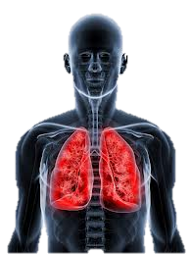
Airborne Hazards
Contributed to VA/DoD
Airborne Hazards symposia
In 2012 & 2013
Received VA ORD
research funding
Lead on CPRS progress note
template for Airborne Hazards
& Open Burn Put registry
Enhanced WRIISC
clinical evaluation
Recognized as concern
among Veterans
Created educational materials
Worked with VSOs
Enhance competency for
clinical evaluation

Slide 8

Integrative Health
WRIISC-DC starts offering integrative clinical and wellness services (2007)
IHW project/program begins.
In FY13, 740 consults are submitted to IHW. 328 Veterans are enrolled, 226 participate in research.
(2012)
OPCC awards $142,000
to expand services.
Online resources launched.
Innitial findings & implications disseminated.
Recommendations for CAM from the field:
IOM Report (2013) identifies CAM services for Gulf War Veterans as area for further study
VA & DoD Research Initiatives (CSRD) for Gulf War includes CAM research initiatives.
-VA/DoD clinical practice guidelines for CMI will include non-pharma section
IHW program becomes hub
of Integrated Health at the DCVAMC.
OPCC awards $692,000
to expand services and research. (2013)
Satisfaction data is collected
(2010)
Acupuncture and Sleep RCT
Pilot funded (HSRD)
Results are published and services expand
The Future of the
IHW Program
will include an increase in services, provider training, and tools for expanding CIM in other VA facilities.
CSR&D Merit Grant 2014 awarded to WRIISC-DC
$2.1 mil, 4 years

Slide 9

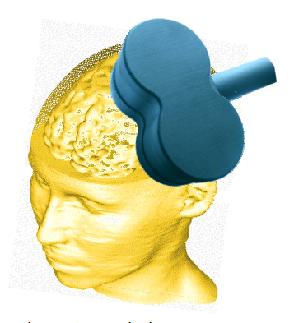
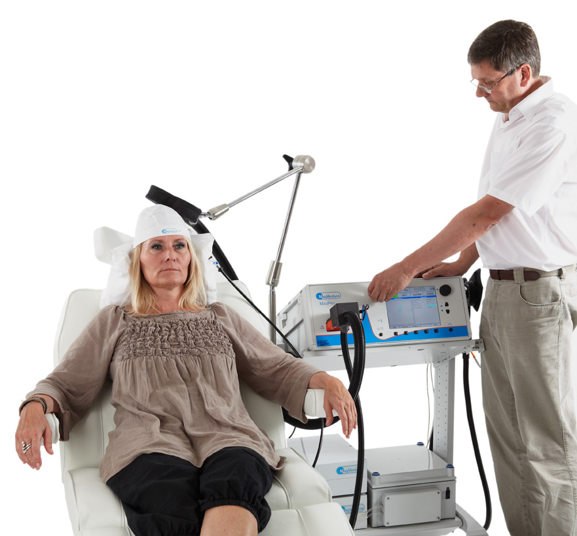
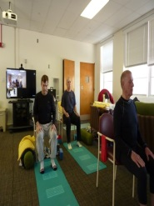
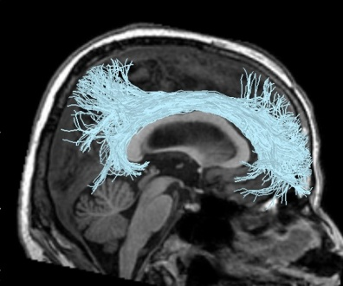
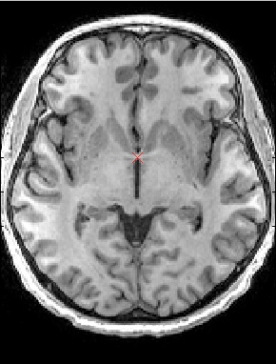
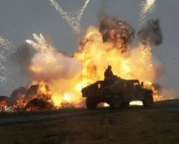
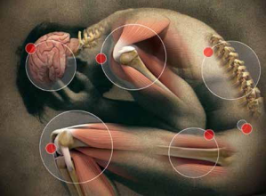
Managing Post-deployment Health
TBI/PTSD
Chronic Pain
Diagnostic evaluation
(Clinical neuroimaging,
Cognitive assessment)
Diagnostic evaluation
(Clinical neuroimaging,
Cognitive assessment)
Funded research
Funded research
Treatment interventions
(rTMS & Cognitive Training)
Treatment interventions
(rTMS & Yoga)
Incorporated in Clinical Radiology, Neurology, Mental Health.
Informs clinical evaluation, treatment recommendations.
Integration of Clinical and Research Neuroimaging to Understand Traumatic Brain Injury in the Veteran Population
Adamson, Main, Soman, Furst, Kinoshita, Yesavage, and Ashford
June, 2014
Veteran & provider education
Veteran & provider education
Inform health policy at the VA

Slide 10
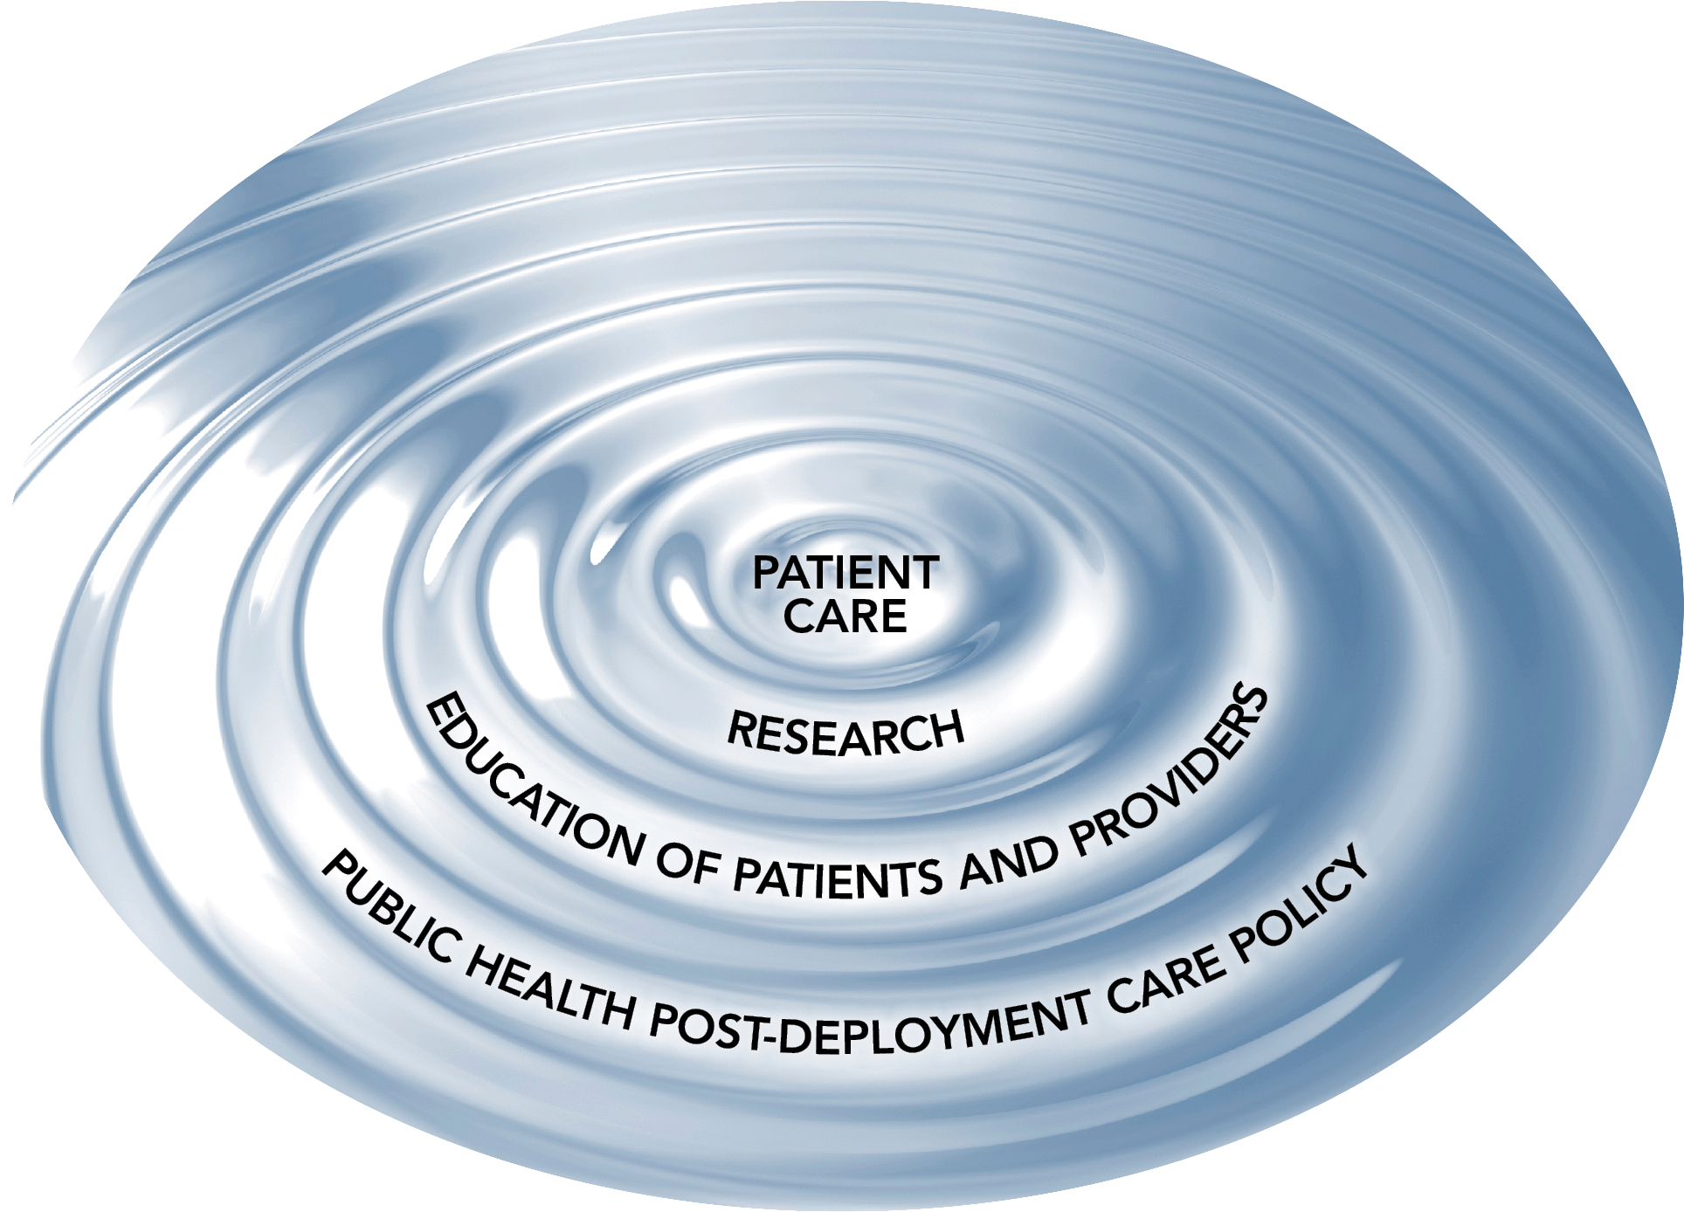
It Starts with the Veteran –
Patient Care

Slide 11
WRIISC Case Example – Airborne Hazards
W. J., former Marine, age 32, gets short of breath playing with his kids at the park and walking up the stairs in his house
His primary care doctor ordered a complete blood count, pulmonary function tests, and EKG- all normal
The pulmonologist attributed his symptoms to deconditioning (despite his daily activity as a mail carrier) and obesity (BMI 31)
His PCP referred W. J. to the WRIISC for his medically unexplained dyspnea that he attributes to his burn pit exposure.

Slide 12
WRIISC Case Example – CMI
S. J., former Army nurse, age 46, has daily fatigue, body aches, and memory problems since her Gulf War service in 1991.
She has seen “a hundred” doctors, and other than diagnoses of fibromyalgia and PTSD, they don’t know what’s wrong with her.
She has been hospitalized for extended PTSD treatment and is on more than 20 medications.
Her PCP referred her to the WRIISC for fibromyalgia and medically unexplained symptoms.

Slide 13
WRIISC Case Example – Agent Orange
M.C., a Vietnam Veteran of the Navy, age 66, has diabetes, ischemic cardiomyopathy, and multiple myeloma.
He is concerned that Agent Orange caused his health problems and asked his PCP.
His PCP noted the service connection Mr. C. already has for his conditions, but referred him to the WRIISC for more information.

Slide 14
Post-Deployment Health Concerns
Environmental Exposures
  Agent Orange
  Chemical weapons
  Qarmat Ali
  Camp Lejeune water contamination
  Dai-ichi reactor melt down
  Burn pits
  Asbestos
Occupational Exposures
  Depleted Uranium
  Chronic lead toxicity
  Project SHAD
  Ionizing radiation
Medical prophylaxis
  Mefloquine
  Anthrax vaccine
Deployment-related conditions
  Gulf War Syndrome
  Blast-related mild traumatic brain injury
  Post-traumatic stress disorder
  Post-deployment motor vehicle accidents
  Suicide
Notes:
Complex & unusual issues often presenting with non-specific symptoms with a paucity of supporting clinical research

Slide 15
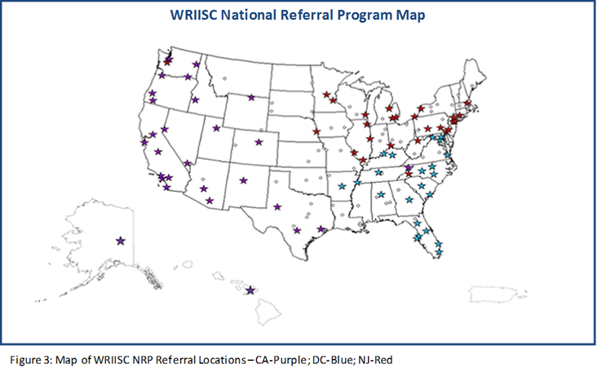
Source of Referrals

Slide 16
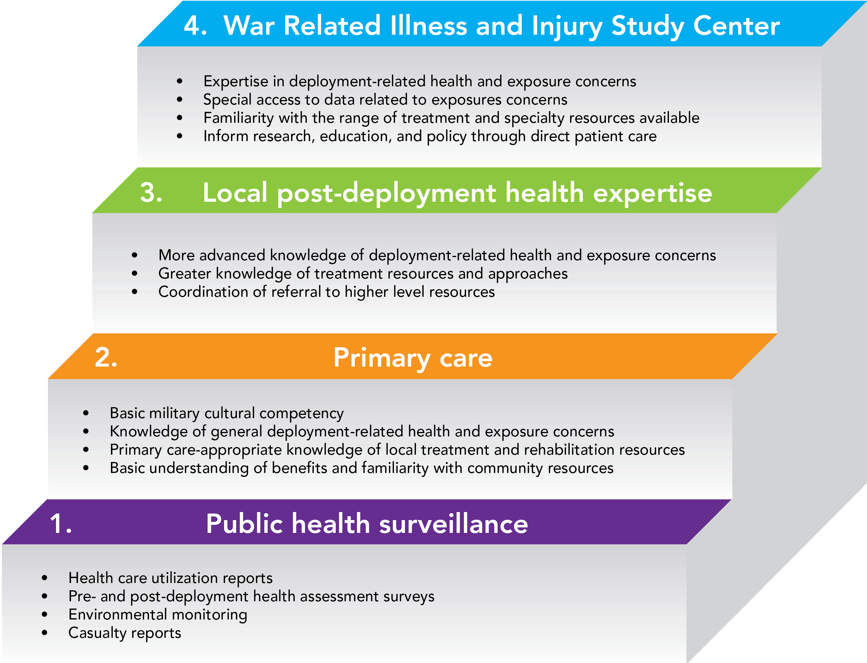
Stepped Care

Slide 17
Clinical Philosophy
Patient-centered
Holistic, wellness-focused
Multidisciplinary Team
Bedside translation of new clinical research
Evidence-based
Integrated with the Patient-aligned Care Teams (PACTs)
Notes:
Necessary for these complex patient with sometimes contentious relationships

Slide 18

Medical Providers
Environmental Exposure Specialists
Psychologists and Neuro-
Psychologists
Social Workers
Education & Risk Communication Specialists
CAM Specialists
WRIISC Multidisciplinary Clinical Team
WRIISC Multidisciplinary Clinical Team
Our Patients
Complex, chronic health problems with unclear cause
Appropriate evaluation and tests completed
Deployment-related exposure concerns
Local expertise exhausted
Appropriate treatments attempted without symptom improvement

Slide 19
Clinical Services
Support and Partner with Primary Care Providers (449 referrals in FY13)
Comprehensive Multidisciplinary Evaluations (163)
Focus is on symptoms and improving function
Multi-day evaluation by WRIISC clinical team
Environmental Exposure
Assessments (163)
As part of comprehensive evaluation
eConsults (85)
Medical record review with individualized recommendations for next steps
As stand-alone service
Phone consults available
38 consults in process at end of FY13 or patient declined
Notes:
Emphasize that types of evaluations have evolved over time to meet needs of PCPs
N=449

Slide 20
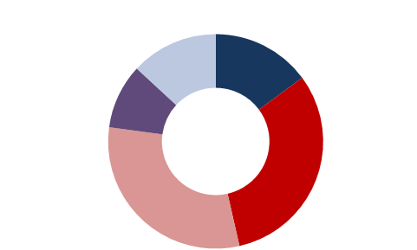
The Veterans we serve
Most recent deployment for inter-facility consults received in FY2013
Other
13%
Vietnam
15%
Gulf War and
OEF/OIF/OND
9%
OEF/OIF/OND
31%
Gulf War
31%

Slide 21
Veterans’ Top Reported Symptoms
Notes:
Denominator: Veterans who received a comprehensive evaluation in FY2013
What is interesting about this slide?
1. Pain marked
2. Other respiratory?
3. Cognitive complaints in “younger” Veterans
These inform our research priorities.
These represent the challenges of management in primary care, as well.

Slide 22
Veterans’ Concerns about
Environmental Exposures
Notes:
Denominator: Veterans who received a comprehensive evaluation in FY2013
These are a concern for all veterans (40% are concerned about occ/env exposures)

Slide 23
Enhanced Care Component | Provider | Face Time | Admin Time | Total Time
Scheduling & Travel | Program Manager | 1 hour | 2 hours | 3 hours
Medical Record Review | NP & Occ Med MD | - | 4 hours | 4 hours
Consultation with referring provider | NP & Occ Med MD | 1 hour | 1 hour | 2 hours
Intake and vitals | NP | 0.75 hour | 0.5 hour | 1.25 hours
History & Physical | NP | 1.75 hours | 1 hour | 2.75 hours
Pulmonary Function Tests | Respiratory Tech/NP | 1 hour | 0.5 hour | 1.5 hours
Laboratory Testing | NP/laboratory | 0.5 hour | 0.5 hour | 1 hour
Balance Assessment (if indicated) | Research team/NP | 1 hour | 0.5 hour | 1.5 hours
Exposure Assessment | Occ Med MD | 1.25 hours | 1 hour | 2.25 hours
Psychological assessment | Psychologist | 1 hour | 0.5 hours | 1.5 hours
Neuropsychological Assessment | Psychologist | 1.25 hour | 0.5 hours | 1.75 hours
Psychosocial Assessment | Social Worker | 1 hour | 0.5 hour | 1.5 hour
Personalized education session | NP | 0.5 hour | 0.5 hour | 1 hour
Sub-specialty evaluations (if indicated) | Specialist/NP | 2 hours | 0.5 hour | 2.5 hours
Interdisciplinary planning meeting | Entire Team | 0.75 hour | 0.5 hour | 1.25 hour
Interdisciplinary meeting with patient | Entire Team | 1 hour | 1 hour | 2 hours
Final report compiled/mailed | NP, program manager | - | 2 hours | 2 hours
Total |  | 15.75hours | 17 hours | 32.75hours

Slide 24
WRIISC Coordination of
Specialty Evaluations
Gastroenterology | Cardiology
Pain Clinic | Rheumatology
Pulmonology | Rehabilitation Medicine
Nutrition | Vascular
Sleep Clinic | Endocrinology
Dermatology | Hematology
Orthopedics | Neurology
Prosthetics | Oncology

Slide 25
Most Frequent Recommendations
For Veterans who had comprehensive evaluations, the top recommendations were:
Subspecialty care:
-Neurology, Gastroenterology, Dermatology, Infectious Disease
Medication adjustments
Physical Medicine and Rehabilitation
Sleep Medicine/Sleep Study
Evidence-based psychotherapy
Complementary and Alternative Medicine
Work with Veteran Service Organizations

Slide 26
In Their Own Words
Empathy
"Willingness to consider evidence, Veteran's input, suggestions for improvement; empathy”
"The staff has been the best that I have experienced in the VA health care system. Very smart and thorough.”
They cared
“The staff and doctors listened. They cared.”
Smart and thorough

Slide 27
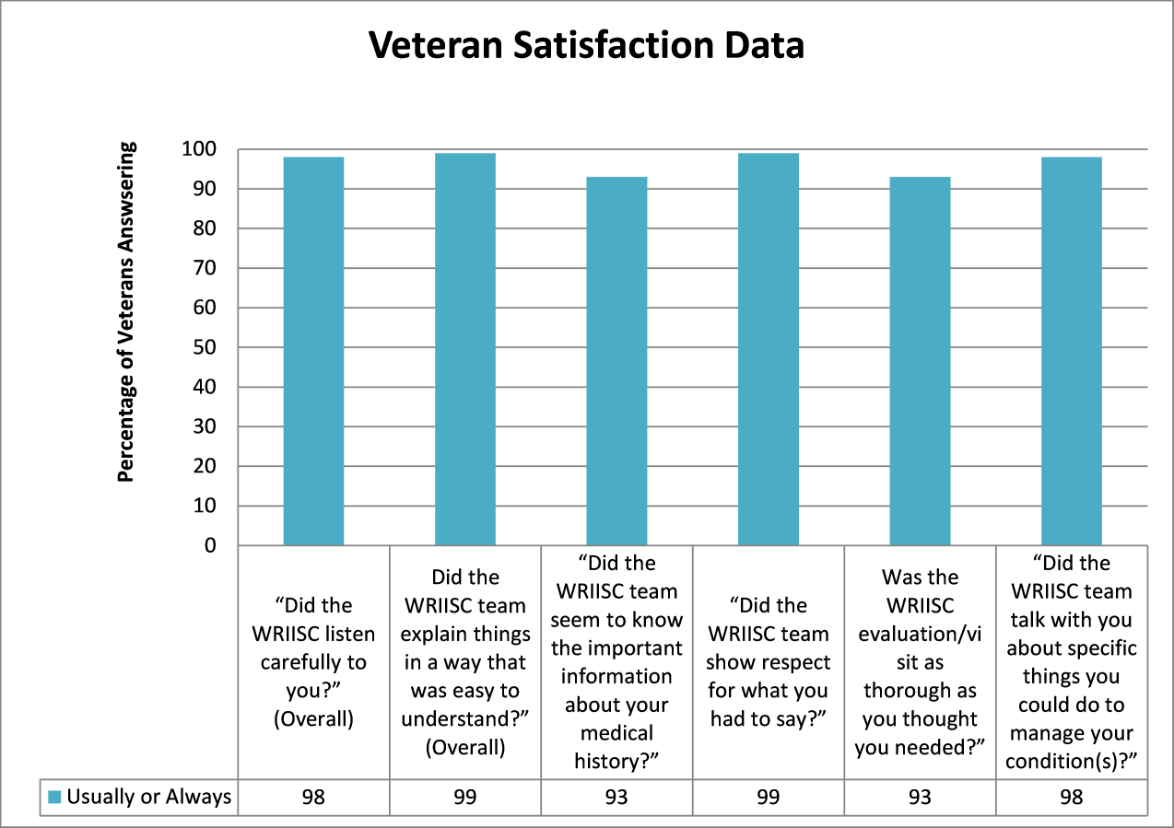
Notes:
Compare to typical primary care ratings- in the 80’s. our group is typically more challenging.
Positive experiences are communicated via patient networks to national VSO leaders and advocates.

Slide 28
It Starts with the Veteran –
Translational Research

Slide 29
WRIISC- Translational Research Model
Research
Research produces
knowledge and evidence-
supported interventions and
tools that can improve patient
care and can be packaged
and disseminated through
education activities.
Education
Education of patients and
providers can improve patient outcomes and identify gaps in knowledge to be addressed
by research.
Clinical Care
Observations from clinical care
lead to research questions and testable hypotheses, highlight
gaps in provider and patient knowledge.

Slide 30
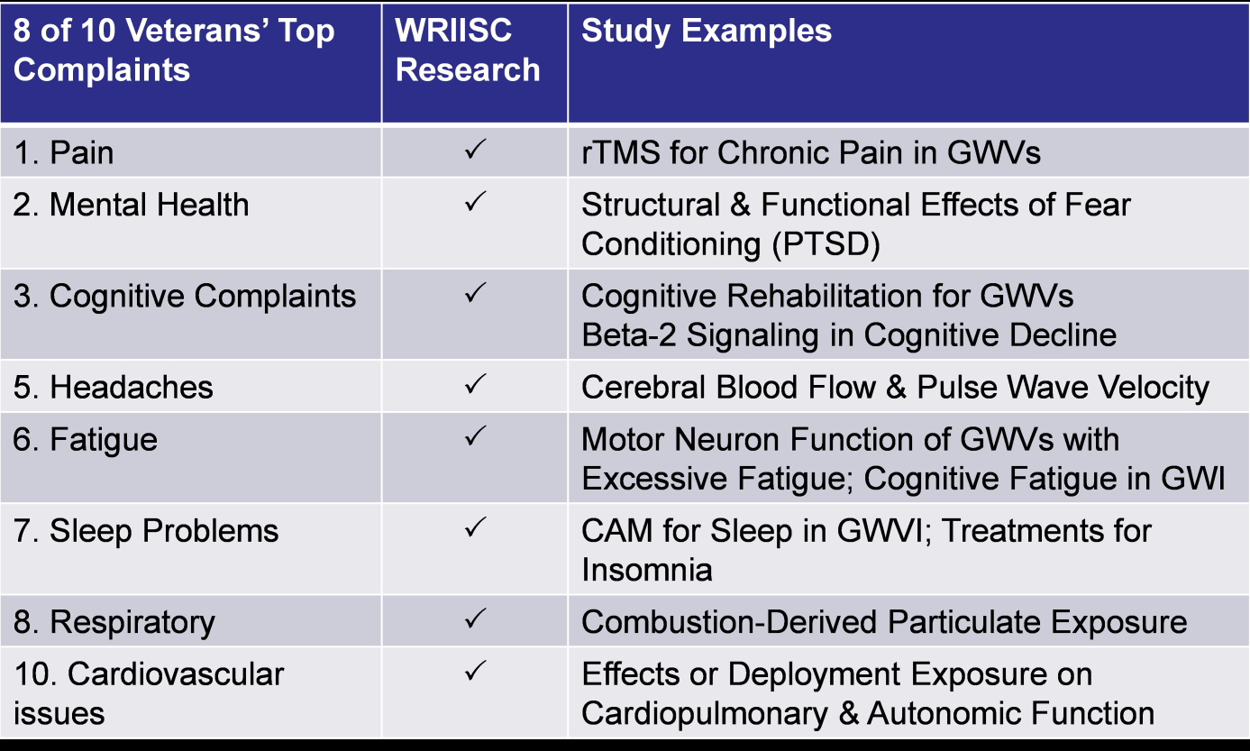

Slide 31
WRIISC Research Continuum
*Integrative Physiology
*Survey/Qualitative
Research
*Cellular/Molecular
*Behavioral Treatments
*Novel Medical Devices
*Exercise
*Integrative medicine
*Telemedicine
*Implementation of new services
*Risk Communication
*Doctor Patient
Communication
Health Services Research
Treatment Studies
Basic Research

Slide 32
FY13 Research Funding
Notes:
Leverage research $ more than 3:1 (HSRD standard for COE’s)

Slide 33
FY13 WRIISC Research
54 Active Protocols
1050+ Veterans enrolled
14 New Grants
89% PIs Grant-Funded
40 Conference Presentations
48 Peer-Reviewed Articles
Notes:
Follow the figure clockwise. The WRIISC had a very successful research year. We had 54 active protocols with over 1050 Veterans enrolled in those projects. This has yield 40 presentations at (mostly) National conferences and 36 peer reviewed publications, many in high-impact and top specialty journals. We are additionally proud to report that even in the intensely competitive grant funding climate, WRIISC researchers secured 14 new grants in FY13 and now almost 90% of our principal investigators have external funding as PI.

Slide 34
It Starts with the Veteran -
Education
Notes:
2100 provider attendees at WRIISC education activities (e.g., webinars, train the trainer, fact sheets, website)
Outreach presentations reached another 700
National VSO leadership research update

Slide 35
WRIISC Synergies
Research
Research produces
knowledge and evidence-
supported interventions and
tools that can improve patient
care and can be packaged
and disseminated through
education activities.
Education
Education of patients and
providers can improve patient outcomes and identify gaps in knowledge to be addressed
by research.
Clinical Care
Observations from clinical care
lead to research questions and testable hypotheses, highlight
gaps in provider and patient knowledge.

Slide 36
Community Engagement
Education & Outreach
Referrals
Clinical Care
Knowledge that Benefits Veterans
Research

Slide 37
FY13 Veteran Education Activities
>30,000 Contacts with Veterans
3
Issues of the WRIISC Advantage Newsletter
63
Integrative Health & Wellness Classes
>63
Individual Patient Education Sessions
4
Agent Orange Classes
>16,000
Unique WRIISC web site visitors
3
My Best Self Classes
27
Other Patient Classes
Notes:
Reuse, recycle, reformat
Exploring new ways to educate Veterans and family members.
Need to finely calibrate public education- we’re a referral center requiring an inter-facility consult from a VA provider.
Research updates to national VSO leadership.

Slide 38
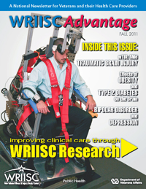

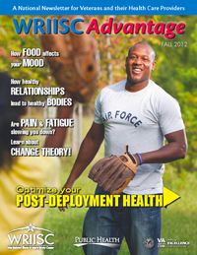
FY13 WRIISC Newsletters
>4,500
Newsletters distributed to Veterans, providers, and community partners 3 times per year

Slide 39
FY13 Provider Education
Education Mode | Number of VA Providers
Webinars and COP Calls | >700
My VeHU broadcast | >75 + post-delivery viewers
Post-deployment champ Train-the-trainer | 14 + second stage dissemination in the field
Environmental Health Program train-the-trainer | 63 + second stage dissemination in the field
TOTAL | ~1000 providers
Notes:
VA Providers includes: physicians, OEF/OIF program coord; SW, Psych, nurses and NPs, and others.

Slide 40
2014 WRIISC Webinar Series
Date | Title | Presenters | Online Logins | Pre-Registrations
January 14 | Latest Research on Advanced Diagnosis of Vestibular Damage in mTBI and Novel Treatment Paradigms Being Explored | Jorge Serrador | 238 | 278
February 11 | The Role of Social Work in Reintegration | Rita Torres & Kathleen Ray | 310 | 400 +75 waitlist
March 11 | Exercise as Medicine | Michael Falvo, Jacqueline Klein, Megan Skidmore | 334 | 400 + wait list
April 8 | Non-Pharmacologic Treatment for Chronic Pain: rTMS and Yoga | Peter Bayley & Allyson Rosen | 390 | 400 + 200 wait list
May 13 | Risky Driving in Veterans Returning from Combat | Maheen Adamson & Eric Kuhn | 291 | 375
June 10 | Communicating with the Veteran about Deployment Exposures | Louise Mahoney & Susan Santos | 324 | 281 Pre-registered on 6/3/2014
July 8 | Neuropsychological Impact of Common Post-deployment Health Concerns | Stephanie Holliday, Chris Hansen
August 12 | Nutritional Psychology: the Interplay between Nutrition, Mood, Diet, and Functional States | Amanda Hull
September 9 | Camp Lejeune | Michelle Prisco, Jen Lipkowitz-Eaton
 |  | TOTAL | 1563

Slide 41
Feedback from Providers
Overwhelmingly positive- train-the-trainer
  “I was inspired all over again to be a part of the reinvention of primary care in the PD/Transition Clinic model!!”
  “Great presentation of a national resource.”
Webinar attendance
Requests for additional presentations

Slide 42
A Learning Organization
35 Trainees in FY13
  Special Office Academic Affiliations Fellowships
  Graduate students/trainees
  Undergraduate students
>100 trainee didactic sessions
>125 learning/training activities within WRIISC
Notes:
Fellows become WRIISC faculty, other med school faculty, clinicians.

Slide 43
It Starts with the Veteran

Slide 44
Surveillance
High-Profile Veteran Concerns Detected through WRIISC Clinical Care
Mefloquine
Lead from shoot houses
Asbestos exposure
Ionizing radiation- Chernobyl
Ft. McClellan water contamination
Notes:
Emphasize that there is nowhere else for these Veterans to get help

Slide 45
Support VA/DoD Policy
Airborne Hazards Registry
Occupational & Environmental Medicine
Camp Lejeune water contamination
Revision to VA/DoD Clinical Practice Guideline on chronic multisymptom illness
VA Response teams for IOM reports
VA and DoD research review panels
Notes:
Tapped as subject matter experts, asked about clinical experience with certain topics of concern, partner to find solutions. Tangible extension of VACO.

Slide 46
WRIISC Momentum
Increasing number of inter-facility consults
Increasing research funding
Increasing reach of education
Growing role in policy
Strengthening collaborations across VA

Slide 47
Growth in Referrals
(NJ to August 11, 2014)

Slide 48
New Research Funding FY14
rTMS for Improvement of cognitive function in TBI
A Multimodal Evaluation of the Comparative Efficacy of Yoga versus a Patient-Centered Support Group for Treating Chronic Pain in Gulf War Illness
Use of a Portable Vestibular Stimulator to Treat Vestibular Dysfunction in Gulf War Illness
Development of Dietary Polyphenol Preparation for Treating Veterans with Gulf War Illness
Diverting the pathway to substance misuse by improving sleep
Total Funding- $1.9 million

Slide 49
2014 WRIISC Webinar Series
Date | Title | Presenters | Online Logins | Pre-Registrations
January 14 | Latest Research on Advanced Diagnosis of Vestibular Damage in mTBI and Novel Treatment Paradigms Being Explored | Jorge Serrador | 238 | 278
February 11 | The Role of Social Work in Reintegration | Rita Torres & Kathleen Ray | 310 | 400 +75 waitlist
March 11 | Exercise as Medicine | Michael Falvo, Jacqueline Klein, Megan Skidmore | 334 | 400 + wait list
April 8 | Non-Pharmacologic Treatment for Chronic Pain: rTMS and Yoga | Peter Bayley & Allyson Rosen | 390 | 400 + 200 wait list
May 13 | Risky Driving in Veterans Returning from Combat | Maheen Adamson & Eric Kuhn | 291 | 375
June 10 | Communicating with the Veteran about Deployment Exposures | Louise Mahoney & Susan Santos | 324 | 281 Pre-registered on 6/3/2014
July 8 | Neuropsychological Impact of Common Post-deployment Health Concerns | Stephanie Holliday, Chris Hansen
August 12 | Nutritional Psychology: the Interplay between Nutrition, Mood, Diet, and Functional States | Amanda Hull
September 9 | Camp Lejeune | Michelle Prisco, Jen Lipkowitz-Eaton
 |  | TOTAL | 1563

Slide 50
Vision of the WRIISC
Optimize the health and well-being of deployed Veterans through clinical study, research, and education.
  Serve as a hub for the study of deployment health & health care.
  Continue to model and innovate the care of post-deployment health issues
  Disseminate lessons learned from clinical care to Veterans with complex post-deployment concerns
  Uncover pathophysiology of deployment health effects and study promising interventions
  Work closely with Veterans to improve their experience
  Inform policy and management decisions related to deployment health
Notes:
Better coordination of WRIISC sites- standardize core services/activities/processes/metrics. Complementary strengths.
Education- SCAN-ECHO, eConsults, integrate into PACT, mini-residencies
Identify better solutions to assess and address post-deployment health concerns (intake packet, burn pit registry self-assessment).
Data collection, management, analysis, interpretation and dissemination.
Build on existing relationships with PDICI, PACT/primary care, EHP, pulmonary

